Slide 1
EMERGENCY COMMUNICATIONS AUXILIARY COMMUNICATIONS / AUXC FORUM
HAM RADIO UNIVERSITY 2024

Slide 2
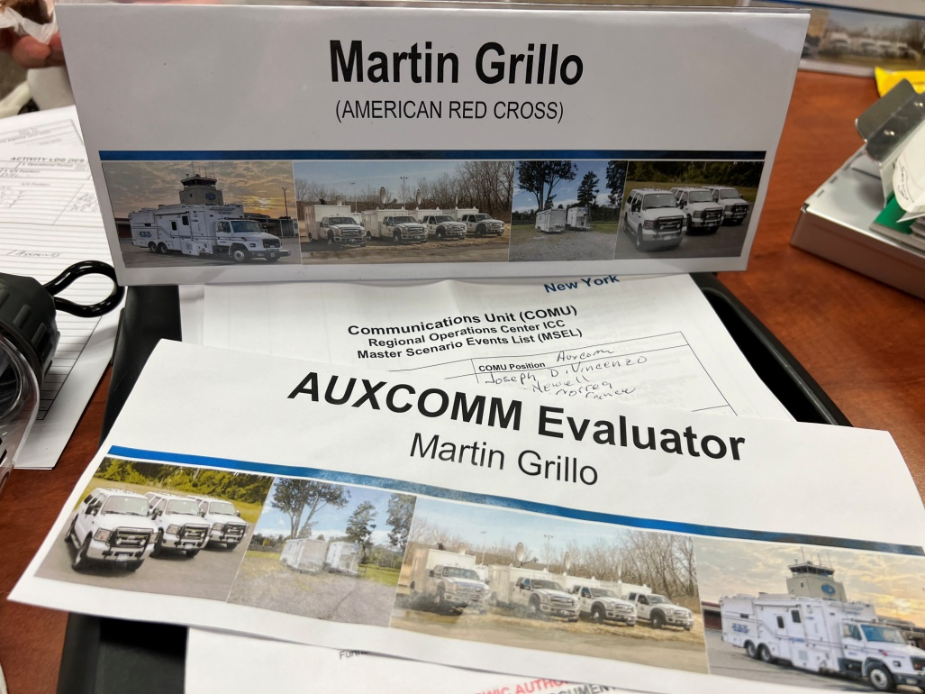
Forum Lead
Martin Grillo EMT-P, CIC, EMC
COM L Inst. / ITSL(t) / COM T/ INCM/ INTD / RADO /
AUX C Inst.
W1EMR / Amateur Extra
PGGB063396 / GROL/R
NYC DEC / ARRL

Slide 3
Purpose
The purpose of this forum is to provide an overview of the Auxiliary Communicator (AUXC) position and discuss how it is being implemented nationwide and how to request the AUXCOMM course through the Emergency Communications Division of the Cybersecurity and Infrastructure Security Agency (CISA-ECD) and NYS Department of Homeland Security and Office of Interoperable & Emergency Communications
(DHSES-OIEC)

Slide 4
Communications Unit (COMU) Program
There are currently seven (7) ICS positions that fall under the Communications Unit (COMU), as follows:
Communications Unit Leader (COML)
Communications Unit Technician (COMT)
Incident Communications Center Manager (INCM)
Radio Operator (RADO)
Auxiliary Communications (AUXCOMM)
Incident Tactical Dispatcher (INTD)
Information Technology Service Unit Leader (ITSL)

Slide 5
COMU By the Numbers: National
Nationally Trained COMU personnel as of February 15, 2022:
COMLs = 3,970 (+696 for State Sponsored (SS))
COMTs = 2,113 (+1,180 for SS)
AUXCOMM = 2,542 (+920 for SS = Total 3,462)
RADO = 25
INCM = 550
INTD = 883 (+21 for SS)
ITSL = 295

Slide 6
COMU By the Numbers: New York State
NYS Trained COMU personnel as of September 6, 2023:
COMLs = 147
COMTs = 152
AUXCOMM = 65
INCM = 46
INTD = 67
RADO = 40
ITSL = 35
NYS OEIC State Sponsored (SS) Instructors:
COM L 12, COM T 8, AUXCOMM 10

Slide 7
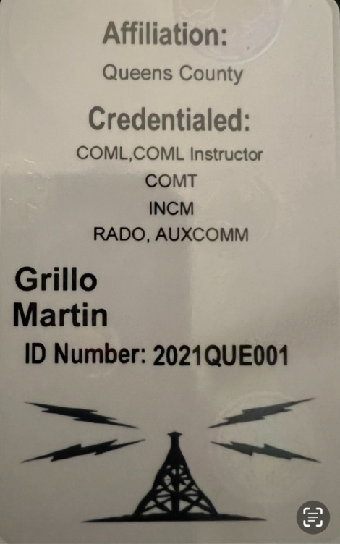
COMU By the Numbers: New York State
NYS Credentialed COMU personnel as of September 6, 2023:
COMLs = 73
COMTs = 47
AUXCOMM = 24
INCM = 10
INTD = 12
RADO = 2
ITSL = 1
NYS OEIC State Sponsored (SS) Instructors:
COM L 12, COM T 8, AUXCOMM 10

Slide 8
COMU in National Incident Management System
NYS Credentialed COMU personnel as of 6 September 2023:
COMLs = 73
COMTs = 47
AUXCOMM = 24
INCM = 10
INTD = 12
ITSL = 1
NYS OEIC State Sponsored (SS) Instructors:
COM L 12, COM T 8, AUXCOMM 10

Slide 9
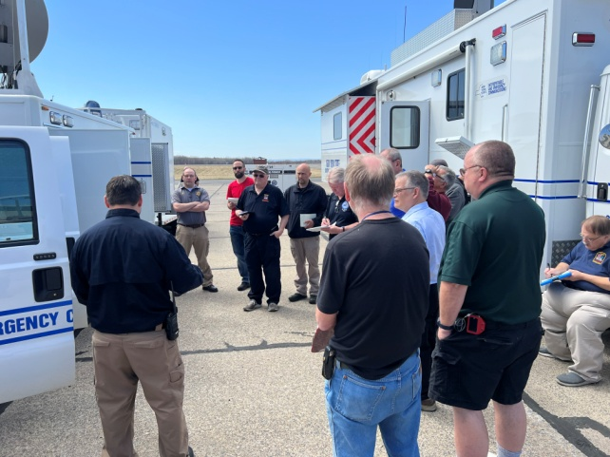
Virtual Training
In-person COMU Training came to a stop in June 2020
In August 2020 we started to convert six COMU courses into virtual classes: (COML, COML TTT, INCM, INTD, AUXCOMM, AUXCOMM TTT)
ITSL, RADO, COMT not converted due to technical requirements of course
55 Classes have been held in FY21/FY22
1 additional virtual class projected

Slide 10
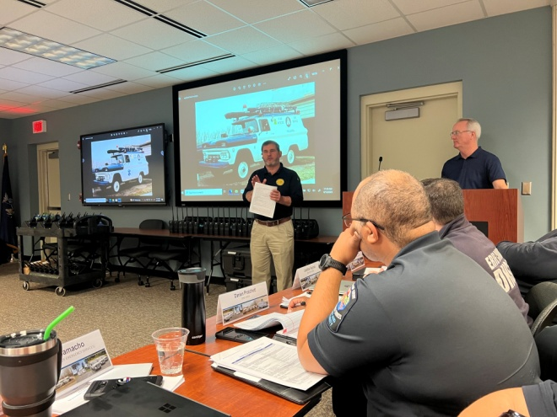
Stakeholder Driven
Curriculum is determined by the needs of the stakeholders
Developed and taught by Subject Matter Experts (SMEs) either via ECD or qualified individual instructors at the state level.
To request a class, it is much more likely to be approved if a large group asks for it versus an individual

Slide 11
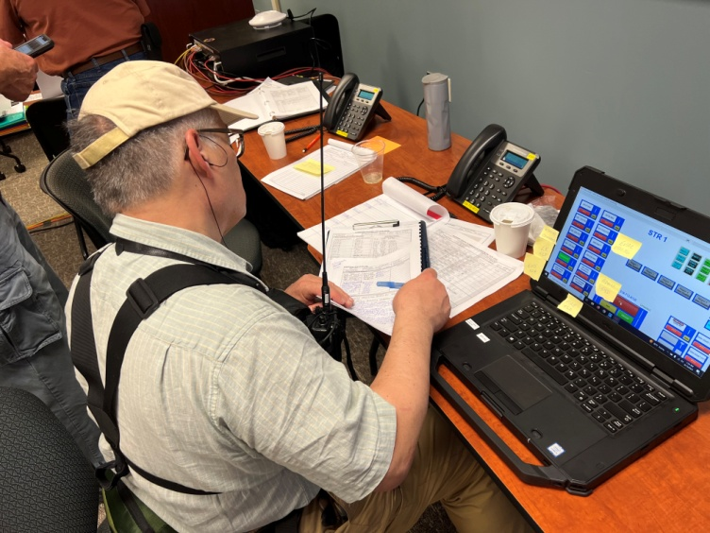
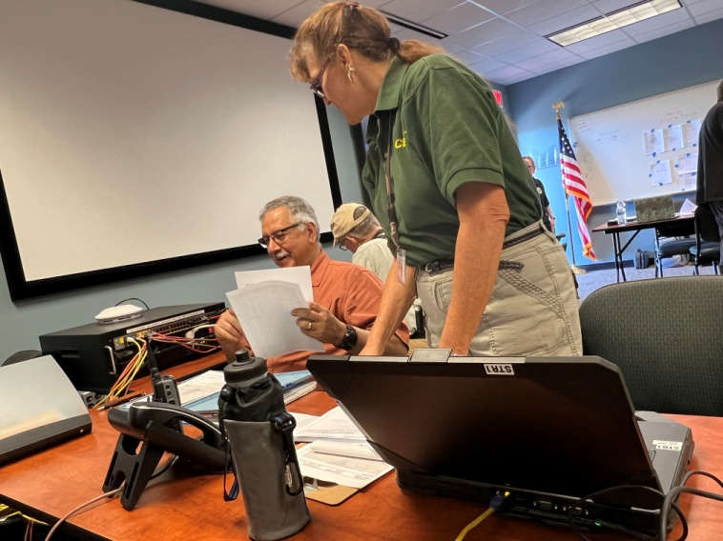
AUXC OVERVIEW

Slide 12
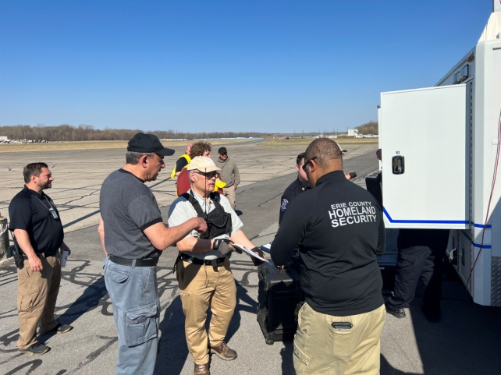
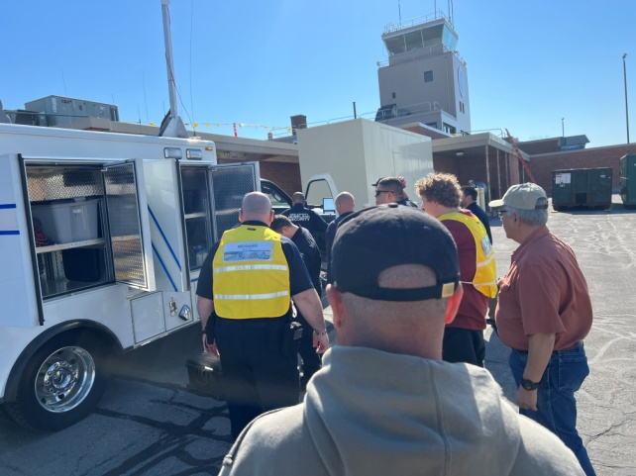
How AUXCOMM/AUXC Started
Then, the conflict between amateur radio-based organizations
Briefed during interview
Discussions with Statewide Interoperability Coordinators regarding course
Curriculum developed utilizing stakeholders and instructors.

Slide 13
Definition
AUXCOMM: Auxiliary Communications (AUXCOMM) is an all-inclusive term used to describe the many organizations (including non-government organizations (NGOs)) that provide various types of communications support to emergency management, public safety, and other government agencies or describes the services themselves. This includes, but is not limited to amateur radio, military radio, citizens band radio (CB), SATCOM, Digital Mobile Radio (DMR), WinLink, EchoLink, etc.

Slide 14
History of AUXCOMM
Developed first course in 2010 and aimed at the volunteer emergency communicators
Based on discussions with states who are the Authority Having Jurisdiction (AHJ)
Intensive two-day (20-hours total) course on how volunteer communicators can play an important role in the NIMS/ICS environment
Emphasis is placed on AUXC’s relationship with the COML under NIMS/ICS
States are encouraged to incorporate AUXCOMM into ICS and strategic planning, ICS-205 and the Statewide Communication Interoperability Plan (SCIP)

Slide 15
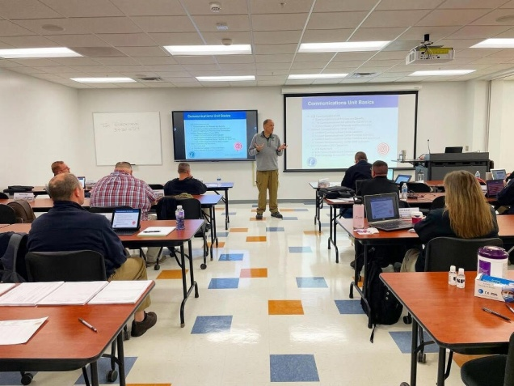
Training Requests
Requests for this Technical Assistance (TA) must come through the OEIC Statewide Interoperability Coordinator (SWIC) Mr. Mark J. Balistreri
Prerequisites include FEMA IS 100, 200, 700, 800, and a current FCC amateur radio license
Maximum of 30 students per class
In most cases, AUXCOMM is very similar to what you are already doing
AUXCOMM is taught by experienced ECD instructors
Decades of amateur radio experience
Have served as COMLs in public safety agencies
Class has been taught 175 times since its inception

Slide 16
Organizations/States Involved with AUXCOMM
In All 50 States
American Red Cross
Salvation Army Team Emergency Radio Network (SATERN)
Radio Emergency Associated Communication Teams (REACT)
Amateur Radio Emergency Service (ARES)
Amateur Radio Operators of Civil Air Patrol (CAP)
Hurricane Watch Net (HWN and VoIP-WX)
SHAred RESources (SHARES)
The Church of Jesus Christ of Latter-Day Saints (LDS)

Slide 17
AUXCOMM Organizations (cont)
Community Emergency Response Team (CERT)
Radio Amateurs of Canada (RAC)

Slide 18
AUXCOMM Instructors
Quality is more important that quantity
Affiliation with a Public Safety agency/organization
Have a valid General Class, or above, license for at least three years
Have taken the CISA AUXCOMM and any ECD Communications Unit (COMU) TTT course
Have taken the latest versions of FEMA 100, 200, 300, 400, 700 and 800 courses
Have taken a formal adult instructors’ course
Signature page from the current version of the AUXCOMM PTB
SWIC and State Training Officer (STO) endorsement for being an AUXCOMM instructor

Slide 19
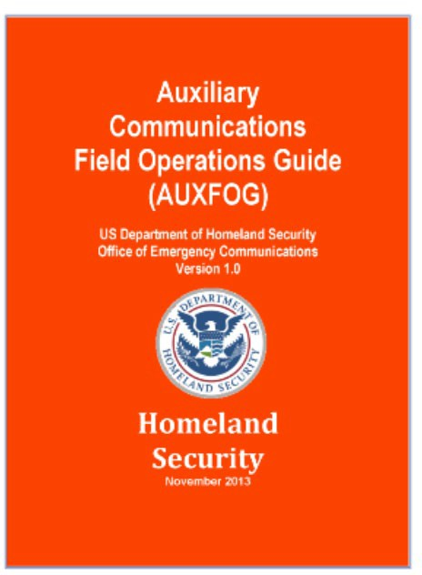
AUXFOG
In 2012, ECD (formerly OEC) initiated a working group to develop a field operations guide (FOG) for volunteer emergency communicators
Representatives from AUXCOMM Working Group
Information on safety, family preparedness, ICS forms, field expedient antennas, guidelines for COML interaction
e-AUXFOG is now available on both the Apple and Google APPs stores
New e-AUXFOG is currently being developed

Slide 20
ECD AUXCOMM Efforts
First course was conducted in Manchester, CT in December 2009
First State Sponsored Course in 2014
AUXFOG originally released in 2016; Updated eAUXFOG in 2020
New AUXFOG release in April 2022
Developed Position Description (509) and original PTB in April 2019
New Projects:
The AUXCOMM Subcommittee of the SAFECOM Communications Section Task Force (CSTF)

Slide 21
AUXCOMM Subcommittee
The AUXCOMM Subcommittee of the Communications Section Task Force (CSTF) was established in April 2019.
Its tasking includes developing national-level goals, standards, and policies related to amateur radio emergency communications in support of public safety interoperable communications needs.
Representatives are authorized decision makers (SWICs) for their respective states regarding interoperable communications. They have the authority to bring in subject matter experts (SMEs) into meetings as consultants. Their ultimate mission is to recommend ideas, develop strategic goals and products for consideration by SAFECOM/NCSWIC.

Slide 22
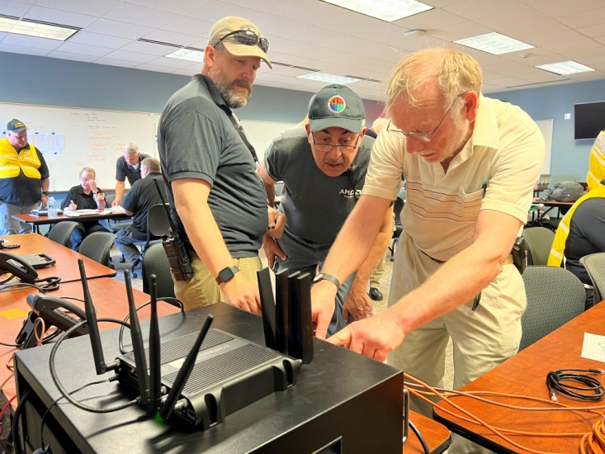
AUXCOMM Subcommittee Cont.
States participating in the AUXCOMM Sub-committee include: Florida, South Carolina, North Carolina, Texas, Colorado, Illinois, Michigan, New Mexico, Georgia
Chaired by Karla Jurrens (Texas) and Co-Chaired by Greg Hauser (North Carolina)
First Meeting took place on January 22, 2020
Initial priorities to include:
The AUXC COMMEX
Update the eAUXFOG
Update the Position Description – 509
Update the AUXCOMM curriculum

Slide 23
Future AUXCOMM Projects Being Worked
Deployment of the AUXCOMM Digital Mobile Radio (DMR) Network
Deployment of the AUXCOMM Response Collaboration Center (ARCC)
AUXC PTB online test

Slide 24
AUXCOMM Myths
AUXCOMM Myths
Taking the AUXCOMM course certifies an individual for their state
An ARES, RACES, MARS, REACT, CERT, CAP, HWN etc. organization cannot also be AUXCOMM
AUXCOMM is trying to take over the world (Public Safety vs Public Service)
AUXCOMM only uses amateur radio
AUXC personnel can only be used to operate radios in an EOC
A state cannot create a AUXCOMM program for themselves
Amateur radio will always be needed in an EOC enviornment

Slide 25
NYS OEIC Communications Unit (COMU) Program
Position Training & Credentialing
There are six (6) steps to attain credentials in New York, as follows:
Step 1: Completion of prerequisites such as NIMS/ICS courses (Most Current Recommended) including a Training Authorization Letter and Student Information Form
Step 2: Completion of COMU position course
Step 3: Completion of COMU position specific Position Task Book (PTB)
Step 4: Completion of NYS COMU Credentialing Paperwork (Appendix A – C)
Step 5: Submission of required paperwork to NYS COMU Program
Step 6: Final approval by New York State COMU Program Manager & SWIC

Slide 26
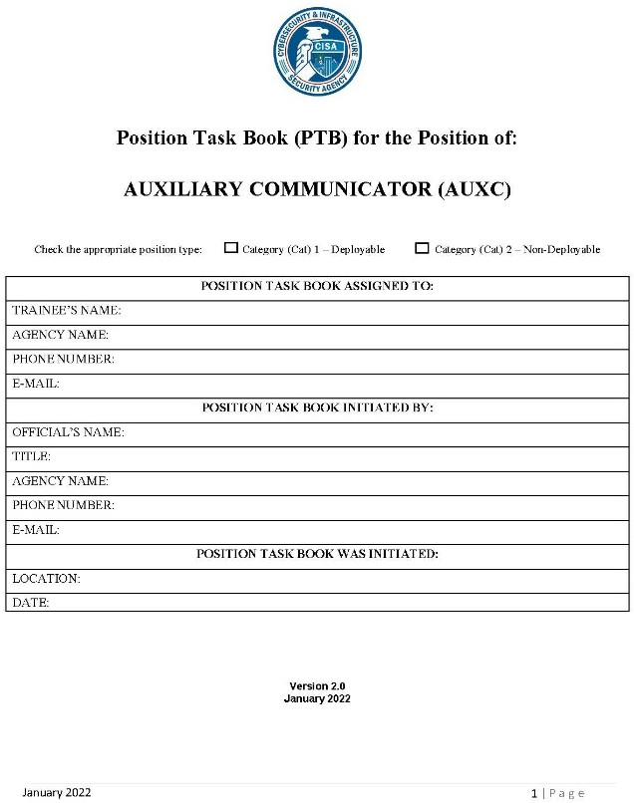
Updated AUXC PTB

Slide 27
Social Media
AUXCOMM: Brotherhood and Sisterhood

Slide 28
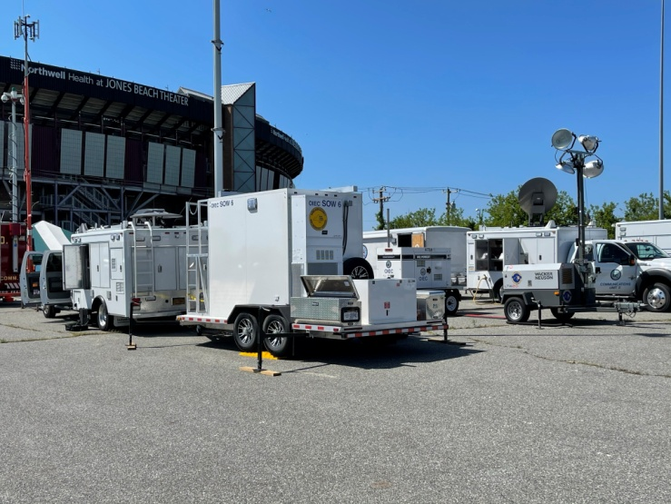
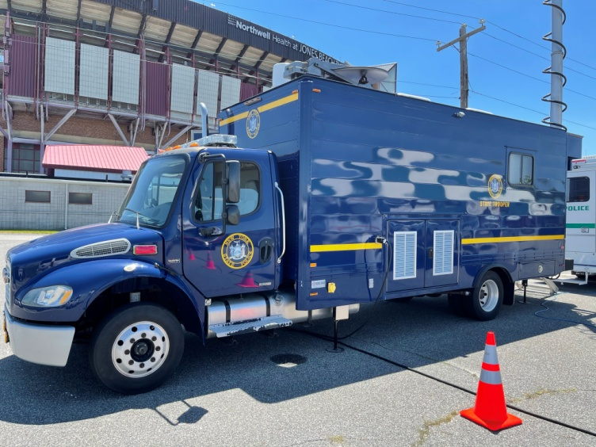
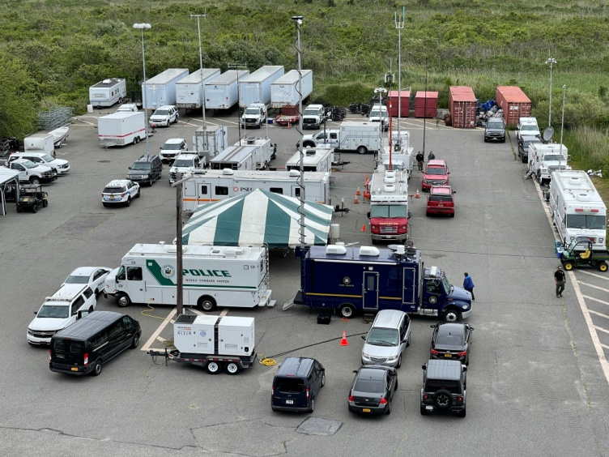
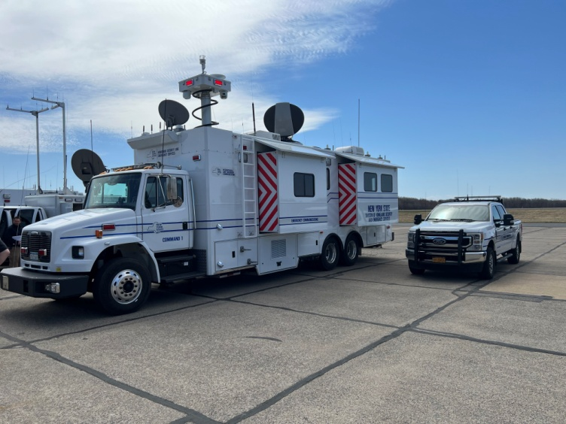

Slide 29
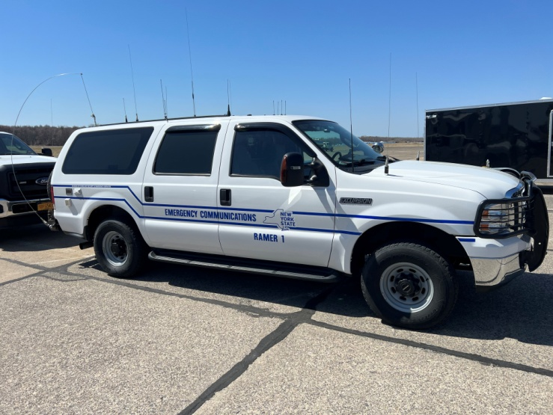
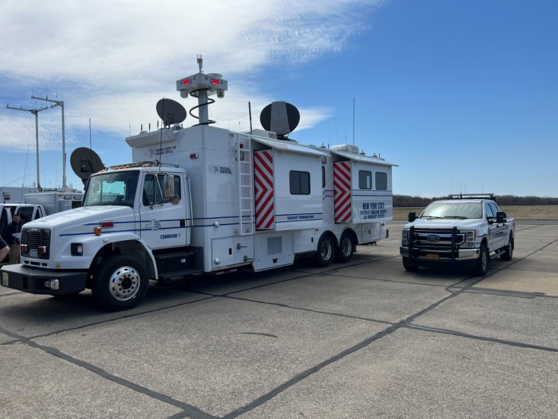
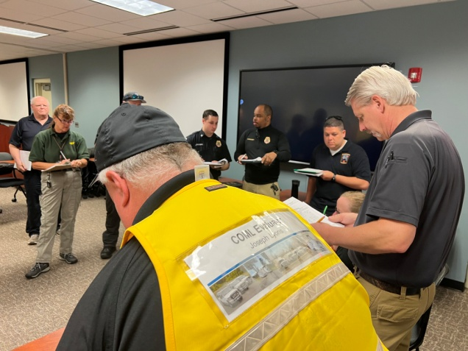
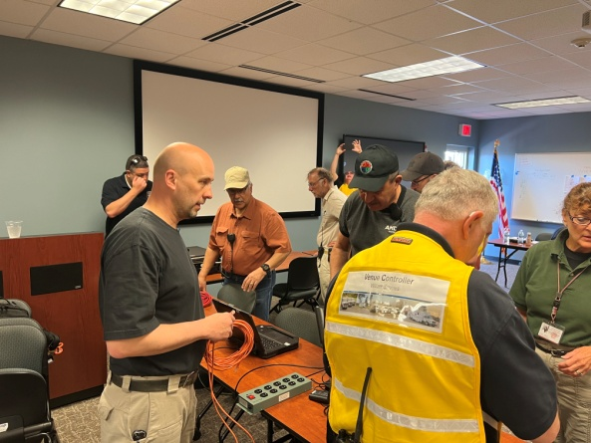
Questions ?

Slide 30
For more information:
Office of Interoperable and Emergency Communications
1220 Washington Avenue
State Campus, Building 7A, Suite 102
Albany, NY 12242
OIEC Main Phone: 518-322-4911
Training Email: OIEC.Training@dhses.ny.gov
Main Mailbox: DHSES.OIEC@dhses.ny.gov

