Slide 1
A NEW WAY TO LEARN MORSE CODE
Howard Bernstein, WB2UZE berny450@aol.com
Mike Padron, N1CC mikepadron@me.com
Notes:
INTRO by Howard

Slide 2
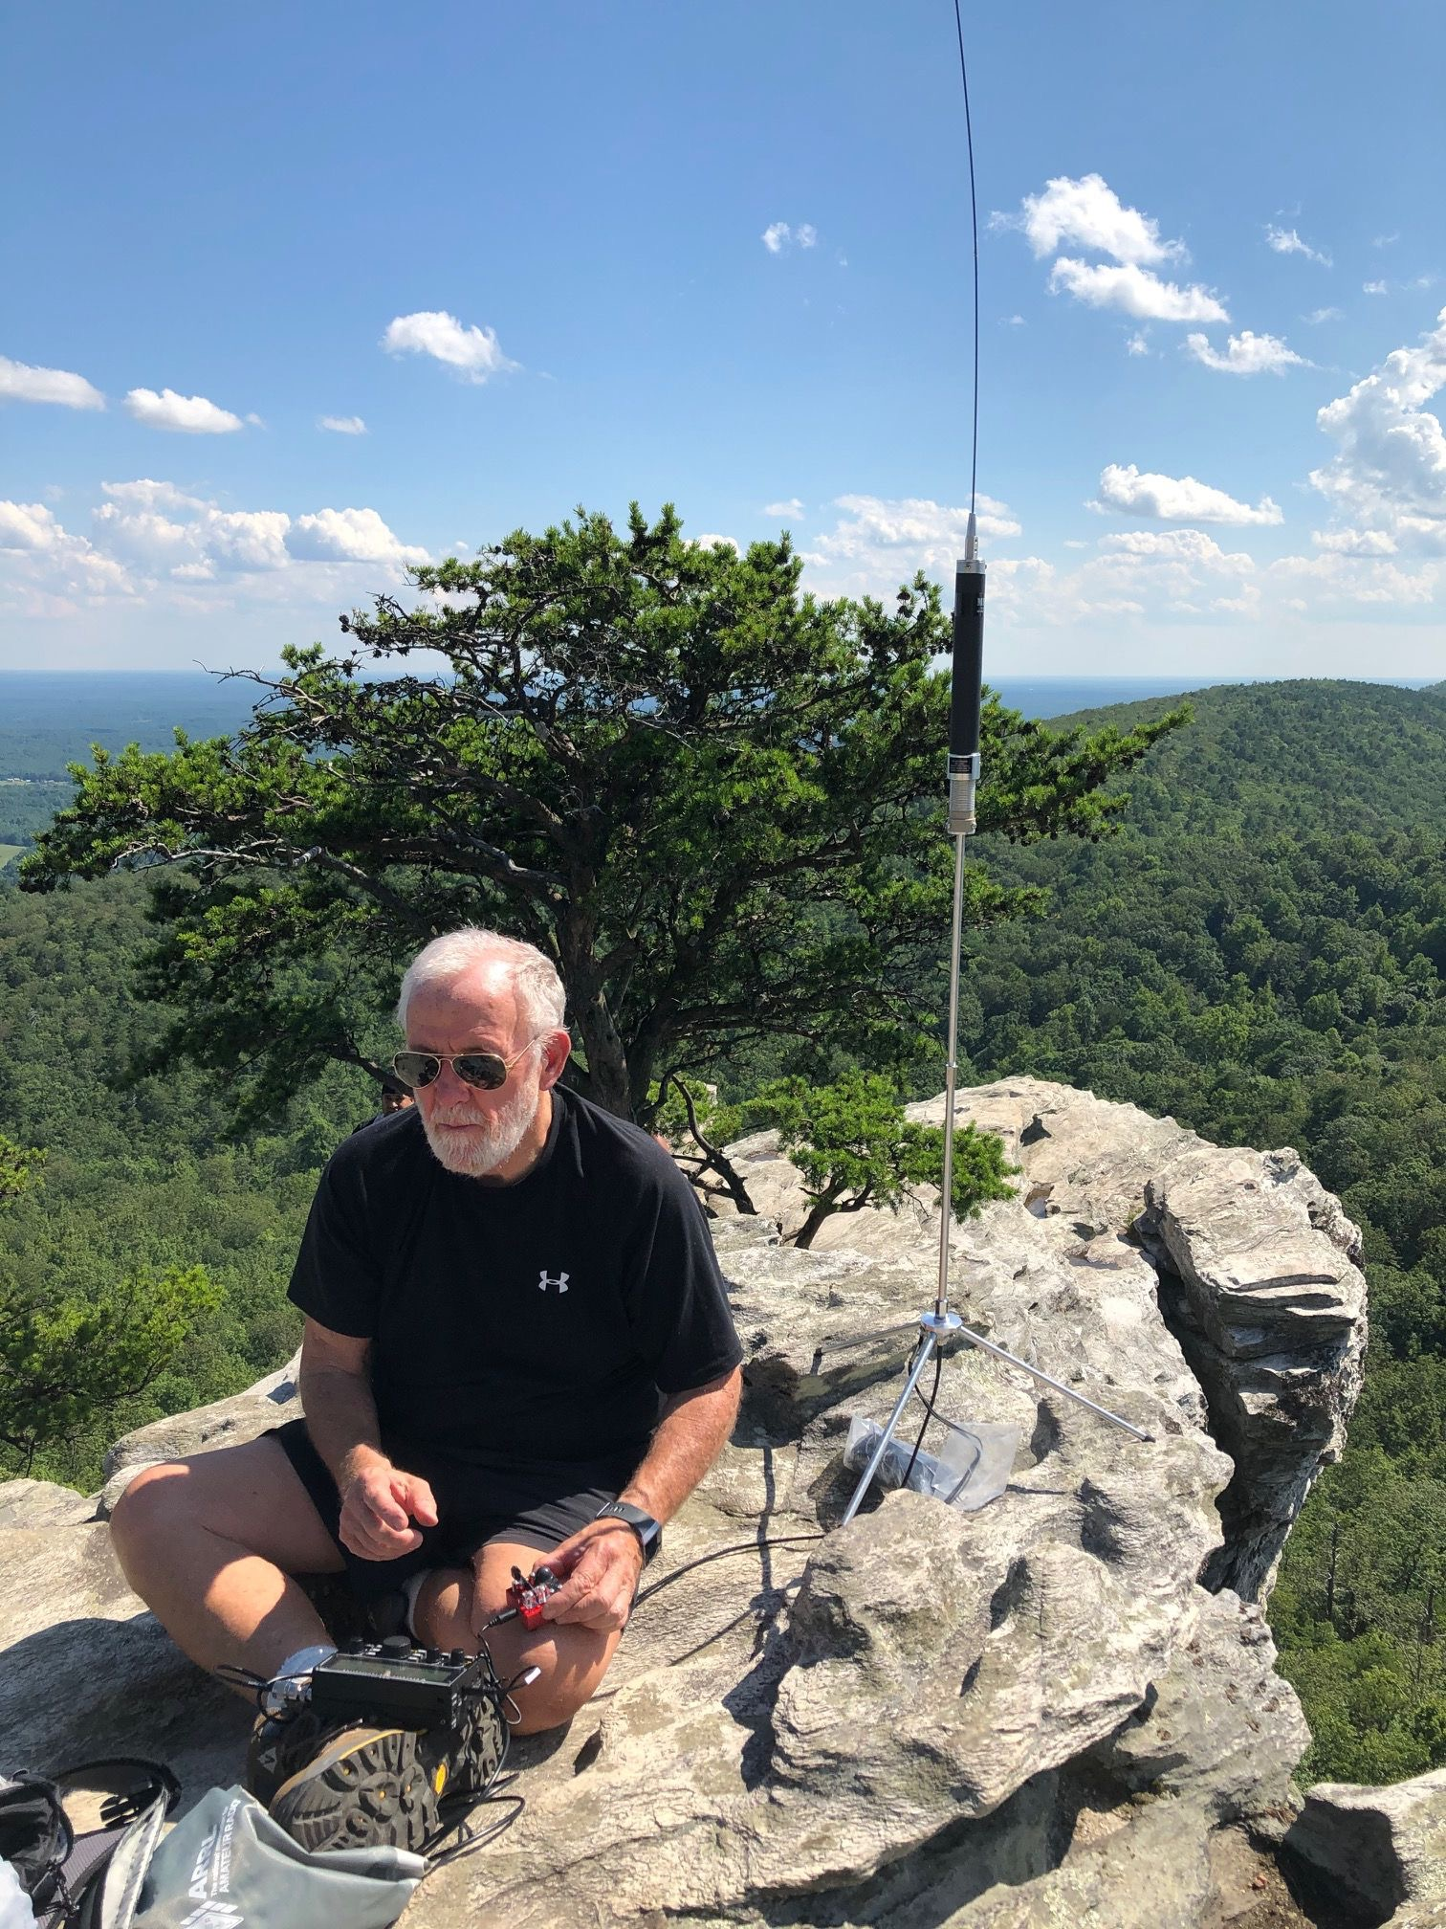
THE ATTRACTION OF CW IN A HI-TECH WORLD
We are witnessing a resurgence in CW
International reach
Reliability
Nostalgia
Portability
SOTA/POTA
Jim N0IPA activating Mt. Sherman 14,000’
Bob K4RLC activating Hanging Rock State Park

Slide 3
WHO WE ARE
Founded in 2018
More CW operators needed following Field Day in 2017
A way to give back to the community
Target of 50 local members from the Long Island area
More successful than we ever dreamed
Over 4200 members
All 50 US States
53 countries around the world
Over 100 Instructors and Moderators
95 Classes and Forums weekly over Zoom video conferencing

Slide 4
A SPECIAL CULTURE
No officers and no board of directors
Bottom-Up organization
Core values of empathy, kindness, and respect
No criticism and no controversial topics allowed
Our mantra: “Prepare Students to Get on The Air”
Our broader goals are having fun, socializing, building friendships and bonds around shared goals and interests
GET
ON THE AIR

Slide 5
THE SECRET SAUCE
Empathy for our students creates a unique bond and imbues our membership with a desire to give back
We strive for academic excellence, but the true measure of our success is how well we help each student achieve their goals to the best of their potential

Slide 6
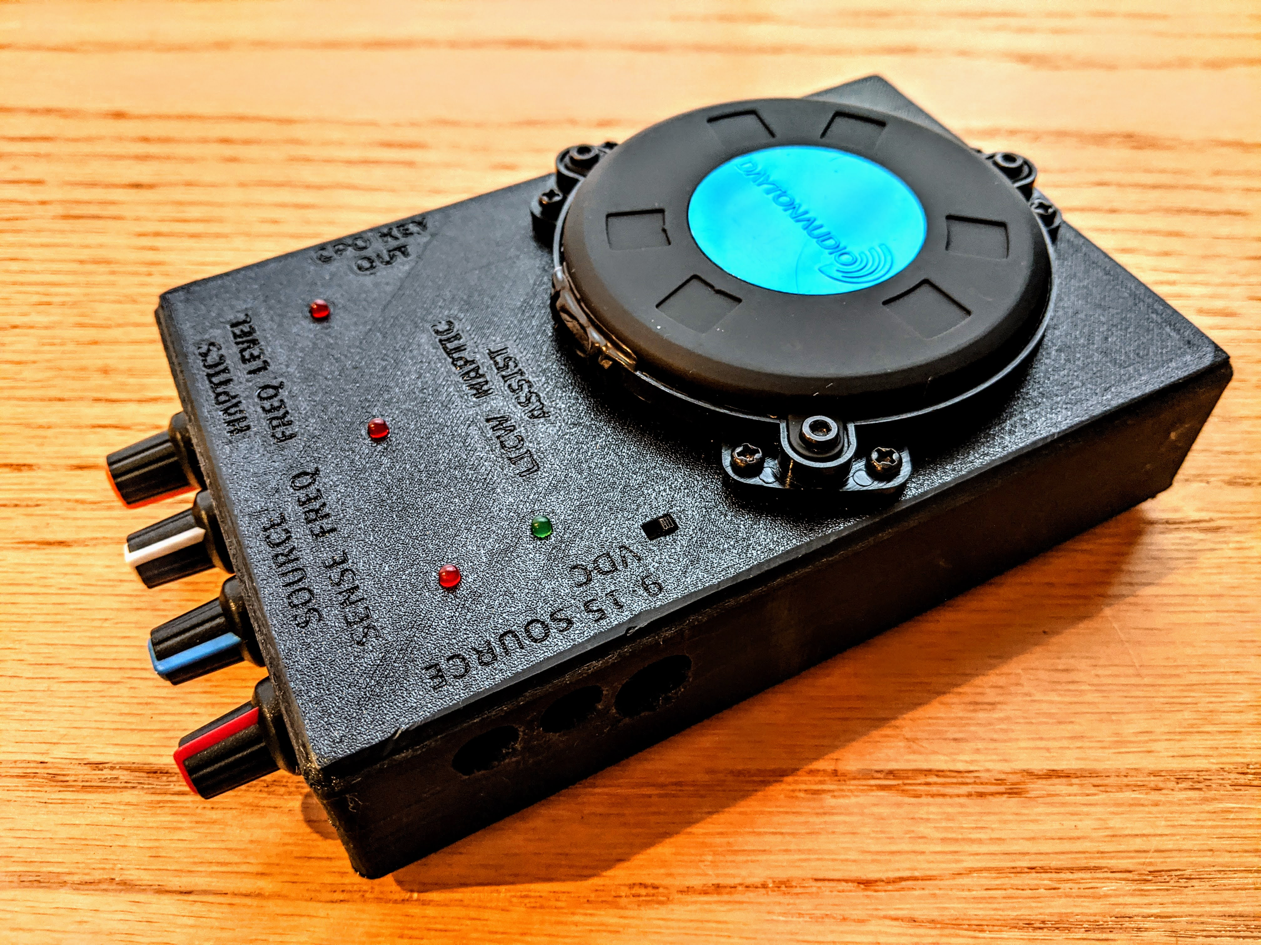
WHAT WE DO
Empathy for those less fortunate
Pilot Program for Autistic Adults
CW for the Hearing Impaired
CW for the Visually Impaired
Commitment to accessibility for people with disabilities
Documents, website, and Morse Practice Page optimized for screen readers used by the visually impaired

Slide 7
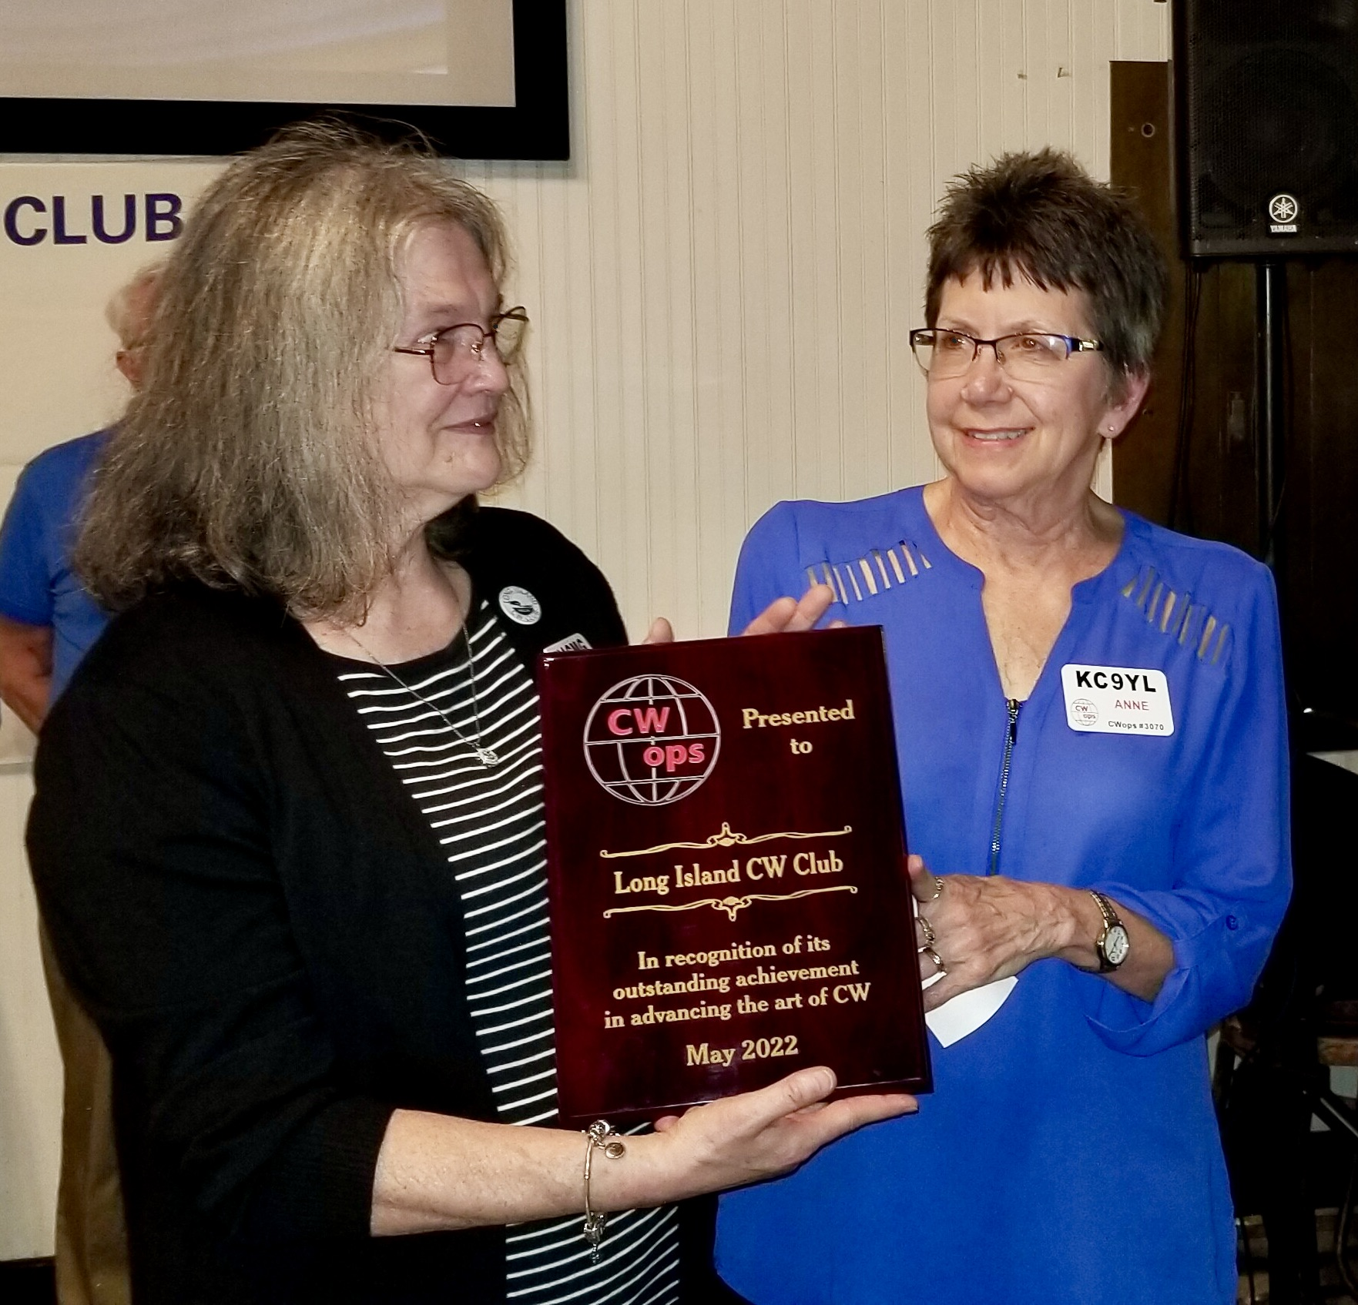
WHAT WE DO
Kids program
Developed during COVID
Over 400 have learned CW
YL’s
Over 200
Instructors, moderators, leaders
Cathy W4CMG and Anne KC9YL accepting a prestigious award on behalf of LICW

Slide 8
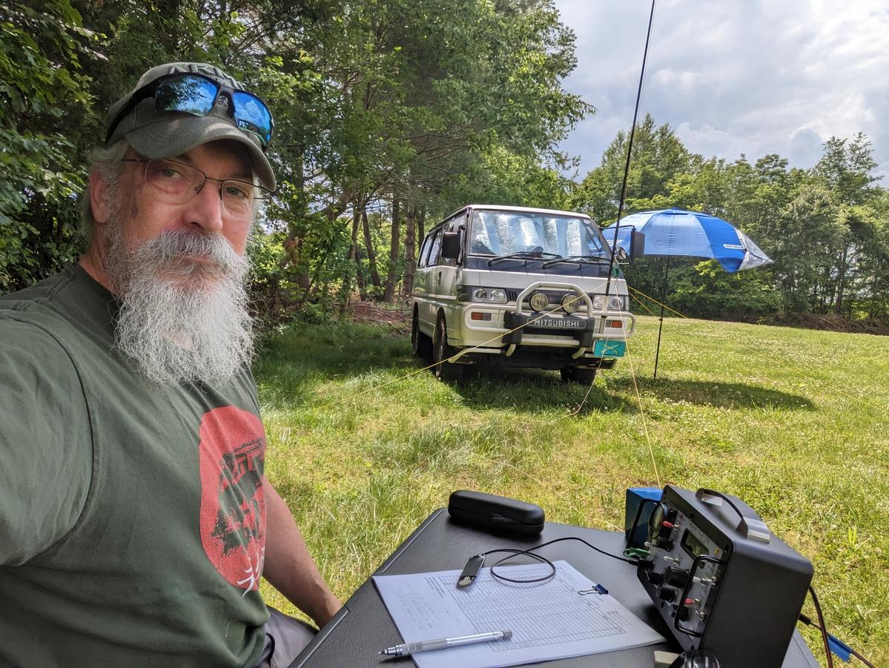
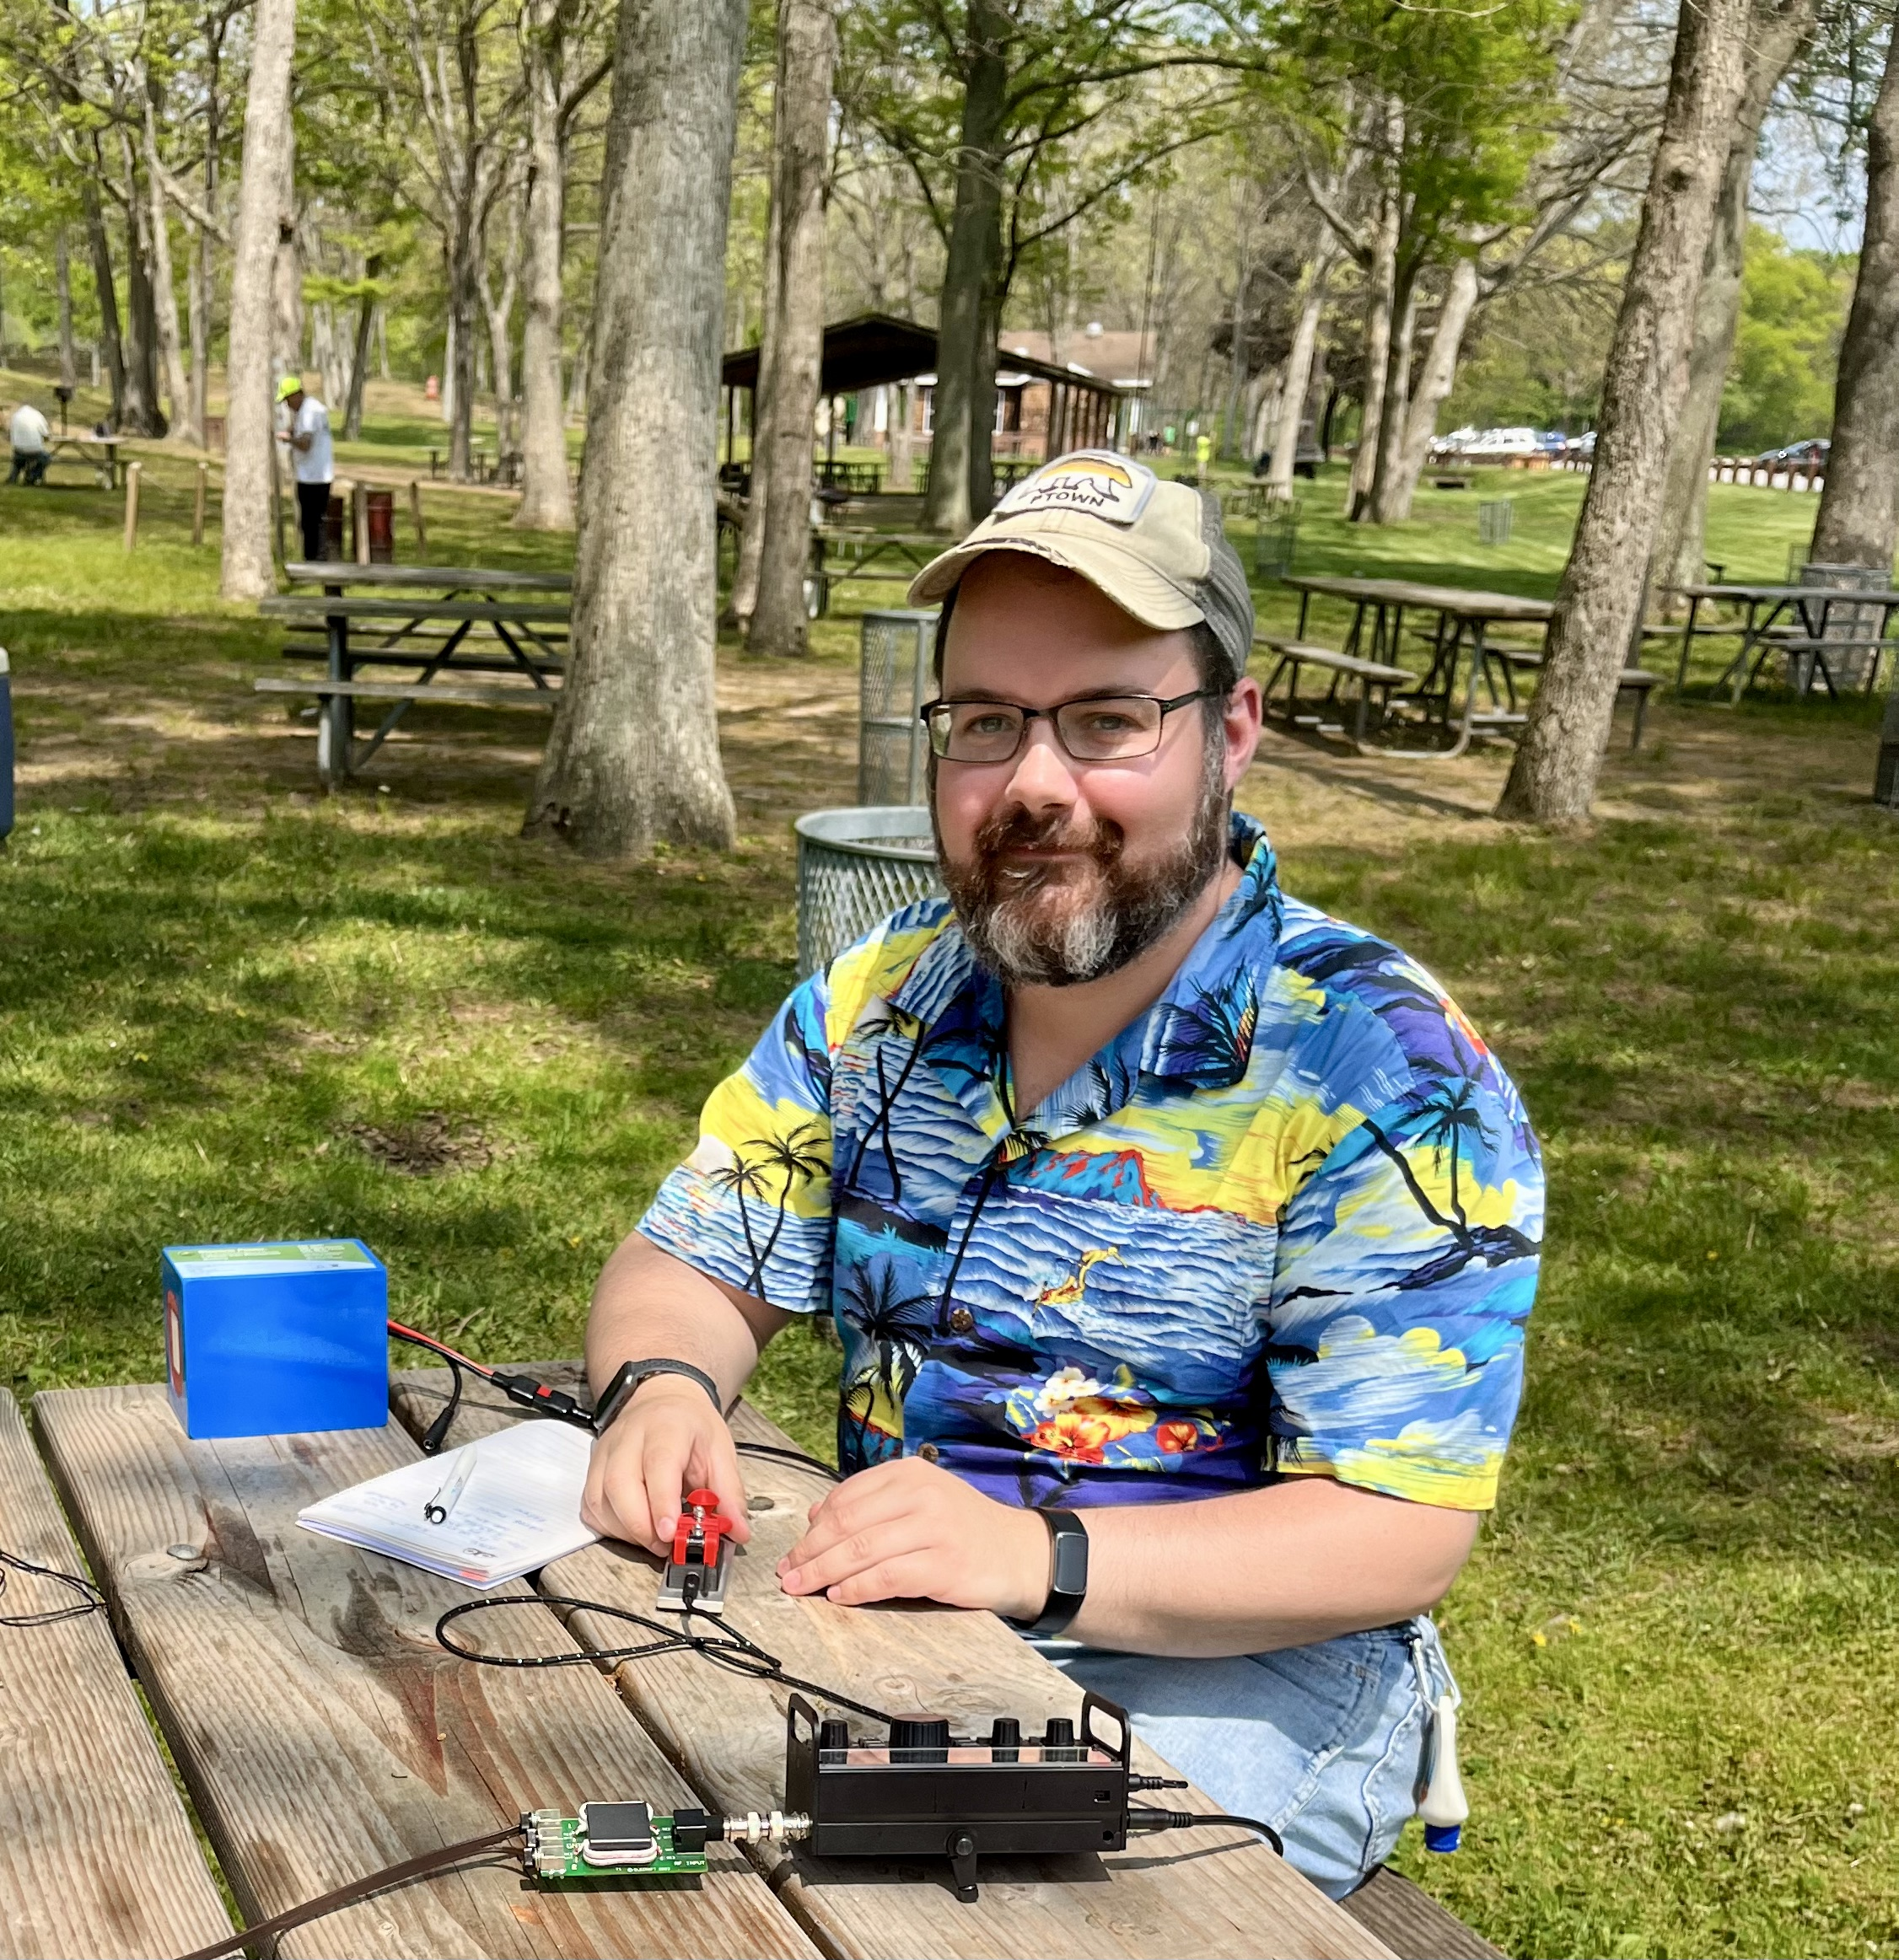
LICW ACADEMICS
Ed W4EMB
Ron KC2PSA
Notes:
Thank you Howard. Let’s begin by meeting two of our instructors. Ed W4EMB teaches our marquee beginners class on Monday night. It’s the first impression our students get of LICW academics. Ed started instructing 6 months after he started to learn CW at LICW. Ron KC2PSA has one of the most beautiful sending fists in the club. He started instructing 8 months after he started to learn CW at LICW.

Slide 9
LICW CURRICULUM DEVELOPMENT
Driven by curiosity and three recurring questions
What were the origins of the so-called Koch character sequence
What was the optimum character and effective speed for initial learning
How could we address new members desires to begin learning right away

Slide 10
RESEARCH
Bryan and Harter 1897
Thurstone 1919
Lipmann 1928
Biegel 1932
Koch 1936
Taylor 1943
Notes:
LICW looked to the past for ways it might improve its curriculum and teaching methods. Many historical documents were analyzed. Of particular interest were the 1936 study by Ludwig Koch at the Technical University in Braunschweig Germany, and the 1943 PhD thesis by Donald Taylor at Harvard. This curriculum is a unique blend of vintage training methods further modernized with techniques and exercises based on our collective teaching experience.

Slide 11
LICW TEACHING METHODS
Koch character sequence
Not in Koch report
Created by Lippmann 1919 as an aptitude test
We created our own character sequence based on QSO protocol
The Koch Method
Learning characters as single acoustic sounds
12 WPM character speed
Notes:
The recurring theme and focal point of the Koch study was that CW should be learned as total acoustic patterns and not by visual reference to a chart.
Koch experimented with methods to enhance sound patterns and rhythm in new students. One such experiment involved having students listen to code without being told what characters the sounds corresponded to. Students were asked to mark a sheet of paper by placing a dot each time they heard an acoustic shape. This introduced the learner to the rhythm and formed a connection between the acoustically recorded rhythm and the rhythm of the writing hand. We adopted the technique into the Beginners Carousel Curriculum.
Koch conducted sending and receiving experiments in order to determine the optimum character speed for learning CW. 12 WPM was found to be optimum for initial learning. Anything less than 10 WPM did not allow the student to perceive the characters as total acoustic patterns. We adopted Koch’s recommended 12 WPM in the Beginners Carousel Curriculum and increase speed from 12 to 20 WPM in the Intermediate Curriculum.
Koch offered guidance on how a sequence of characters should be constructed. We followed his guidance and developed a sequence based on the frequency each character is used in our QSO protocol. The more often a letter appears in the QSO protocol, the earlier it is introduced. This unique methodology allows us to tightly integrate QSO abbreviations and protocol into the curriculum.

Slide 12
LICW BEGINNERS CAROUSEL
Notes:
Figure 3 LICW Beginners Curriculum Flow
The Beginners curriculum groups lessons into three carousels and culminates with getting on the air. There is no designated entry point and no reset. Students get on the carousels whenever they wish and progress when they feel ready. The carousel concept accommodates a broad range of student performance. Fast learners may take just one rotation while those wanting a more relaxed pace may take a couple of rotations before progressing.

Slide 13
BEGINNERS CAROUSEL 1
6 Lessons
18 Characters
Notes:
BC1 is comprised of 18 characters in six lessons. Students learn how to hear and associate the acoustic CW sounds with a character. We begin at a character speed of 12 WPM and an effective speed of 8 FWPM (Farnsworth WPM) 12/8. Three new characters are introduced per lesson using the Koch Method. New characters are played without identifying what character the acoustic sound is associated with. Students are directed to mark a paper with a dot when they recognize the acoustic sound. Then the acoustic sound is associated with a character. From then on, students are directed to say, write, or type the character when they recognize it. The process is repeated with each new character. After the new characters have been introduced, students will verbalize them for the instructor to ensure they are being heard as single acoustic sounds.

Slide 14
BEGINNERS CAROUSEL 2
9 Lessons
26 Characters + 18 from BC1
Notes:
BC2 is comprised of 26 characters in nine lessons (including numbers, prosigns, and BK) bringing the total number of characters up to 44. Character speed remains at 12 WPM. Effective speed is increased to 10 FWPM (12/10). Koch found that once students learned how to learn code as acoustic sounds, it was unnecessary to introduce new characters without identifying what character the acoustic sound was associated with.
The new characters combined with the 18 carried forward from BC1 enable QSO words to form.
Sending is an integral part of BC2. Students should now possess foundational sending skills. Sending will focus on proper element formation, consistent spacing, and rhythm.

Slide 15
BEGINNERS CAROUSEL 3
8 Lessons in direct support of our five weekly on air activities
Live QSO Assistance on Tuesdays
Live DX QSO Training on Wednesdays
SKCC Night on Thursdays
LICW Challenge Assistance on Saturdays
K1USN SST (Slow Speed Contest) on Sundays
Notes:
BC3 is the culminating portion of the Beginners Carousel curriculum. It is comprised of eight preparatory lessons for on-air activities:
LICW QSO Protocol (Starting the QSO)
LICW QSO Protocol (Protocol 2)
LICW QSO Protocol (Ending the QSO)
LICW QSO Protocol (Combining Protocols - How to send & answer a CQ)
LICW Challenge
SKCC
SOTA/POTA (Summits and Parks on the Air)
K1USN SST (Slow Speed Contest)
Like BC1 and BC2, there is no designated entry point and no reset. Each lesson is comprised of a briefing followed by interactive practice of the associated protocol or exchange.
Additionally, LICW hosts five Get On The Air (GOTA) classes weekly. These are instructor led gateways to on-air activities, which are ideally suited for first on-air QSOs. Students are encouraged to continue participating even after progressing to the Intermediate curriculum.
Live QSO Assistance on Tuesdays
Live DX QSO Training on Wednesdays
SKCC Night on Thursdays
LICW Challenge Assistance on Saturdays
K1USN SST (Slow Speed Contest) on Sundays

Slide 16
Notes:
The LICW Morse Practice Page is a web-based, cross-platform tool that will function on any PC, Mac, tablet, or smart phone. It was designed and developed by Randy KN4YRM.
The LICW Morse Practice Page has been optimized for screen readers used by the visually impaired and contains functions to assist the hearing impaired using our haptic device.

Slide 17
THE LICW METHOD
Notes:
The LICW Method is a structured and incremental approach to achieving conversational head copy proficiency. The early stages focus exclusively on achieving effective and effortless communication skills we term fluency and fluidity. Particular emphasis is placed on quality sending with proper element formation, spacing, and rhythm.
Increasing effective speed is critical to achieving proficiency in conversational head copy. Speed is time. Slow speed means more time is needed to hold characters during word building, which can overtask mental capacity.
Once sufficient effective speed is achieved, the slow and methodical ramp-up to head copy is begun. The enabling skills of word building and retention with proper focus are presented with unique demonstrations and reinforced with highly effective exercises designed to stimulate fluid receiving of code and the mental dynamics of conversational head copy.

Slide 18
CRITICAL SUCCESS FACTORS
Aptitude
Motivation
Practice
Notes:
The determinant factors responsible for differences in student performance are:
Aptitude
The degree of motivation
The distribution and quality of practice
LICW firmly believes every student is capable of learning CW. We accept there will be a variance in time to achieve proficiency based on aptitude and we design our curricula accordingly. Our students should feel totally comfortable regardless of how long it takes to achieve their CW goals.
Motivation is one of the dominant forces affecting the learning process.
Students should evaluate their CW goals, assess their motivation, and set realistic expectations before commencing with our academics.
Learning CW requires time and commitment, but it should be fun and rewarding. Make sure you are motivated for the right reasons. For example, students feeling undue pressure to meet a standard or progress at a certain rate will not enjoy the journey. Conversely, students with a desire to learn CW for self-fulfillment and enjoyment are more likely to succeed and have fun along the way.
The distribution and quality of practice are the most important variables affecting student performance. Learning to practice effectively and following a productive practice regimen are critical success factors.
According to Koch, half an hour of continuous practice is the most favorable duration of practice. Furthermore, practice in the morning and in the afternoon for half an hour each yields the best and fastest success.

Slide 19
QUESTIONS FOR HOWARD AND MIKE
Notes:
Q&A

