Slide 1


Advantages of Computer Logging
Tom Carrubba KA2D

Slide 2
INTRODUCTION
…from ARRL
The reasons for logging your amateur activity fall into three categories: legal, operational and personal. Legally, a log of your transmissions would be invaluable in providing details in an interference complaint. Operationally, having a log of past contacts is a resource when filling out that DX QSL card that may have taken months to arrive. Personally, a log is like a personal radio history reminding you of the people and places you’ve talked to, the nets you participated in and contests you worked.

Slide 3
WHAT’s IN A LOG
Information needed for your log.
DATE, TIME in UTC, CALLSIGN, Frequency/BAND, MODE, Signal report.
Notes: Power output, name of contact, QTH and rigs, antenna etc....
For DX contacts; QSL route, direct, Buro , QSL Manager or online QSL service.
This is also good for Stateside (WAS), (VUCC) awards

Slide 4
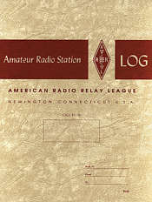
PAPER or COMPUTER
The hardcopy paper logbook is the traditional keeper of the contacts.
Searching contacts thought paper logs is very time consuming especially if you have many logbooks..

Slide 5
PAPER or COMPUTER
Computer logging programs are widely available. There are many choices freeware or commercial in PC or MAC format. Also, for a tablet or cellfone..
Computer logging programs are configurable and can keep track of a wide range of your logged information. Applications include tools to control radios, antenna rotors and other station functions and devices.
Computer logging programs will automatically log the date, time and when used with rig control track frequency/band, mode. No need to keep calendars and clocks..
When linked online you can connect to the worldwide spotting networks. Your logging program will alert when a new DX is needed. It will also alert you to new band/mode.. With a click it will insert the needed call into your program.. And provide detailed information for that call, like beam heading, distance, sunrise/sunset.

Slide 6
ADVANTAGE of COMPUTER LOGGING
Computer logging programs will log the date, time and when used with rig control track frequency/band, mode. No need to keep calendars and clocks
Ease of tracking QSLs sent and received; easy lookup
Callsign lookup from CD or online like QRZ, HAMCALL, HAMQTH and other available services.
Easy Tracking of awards; WAS, VUCC, DXCC, WAZ, IOTA, Parks on the Air, US Counties and host of other awards available.
Export/Import to LoTW, Clublog, eQSL. and QRZ

Slide 7
LOGGER SETUP
Every Logger Program needs to be setup with your personal information.
NAME along with City and State
CALLSIGN
LOCATORS: *TIME ZONE, LAT/LONG, GRID SQUARE, CQ AND ITU ZONE.
This info can be found on sites like QRZ or HAMCALL…
* FOR RIG CONTROL: RADIO ID, RADIO BAUD RATE, COMPUTER COMPORT.
*Radio info will be in the manual.
NOTE: Comport will be controlled via the radio’s USB connection or serial port.
ComPort info will be displayed in your computer’s device manager.
Each program will also have a list of preferences..
Bands, modes to name a few..

Slide 8
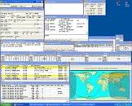
WHAT YOU SEE
All Windows are configured by user
Station Worked Before
Talk Messages
CW Keyer
Digital Keyer – various modes
Logger Window >
< country band worked grid
Stations Needed >
< Grayline Map
DX Spots >

Slide 9
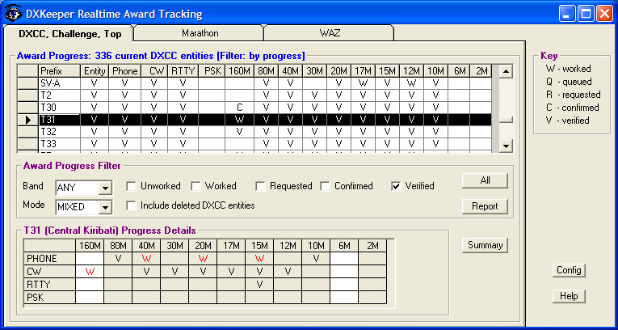
IMAGE of AWARDS TRACKING

Slide 10
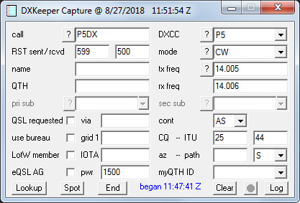
TYPICAL LOGGER WINDOW

Slide 11
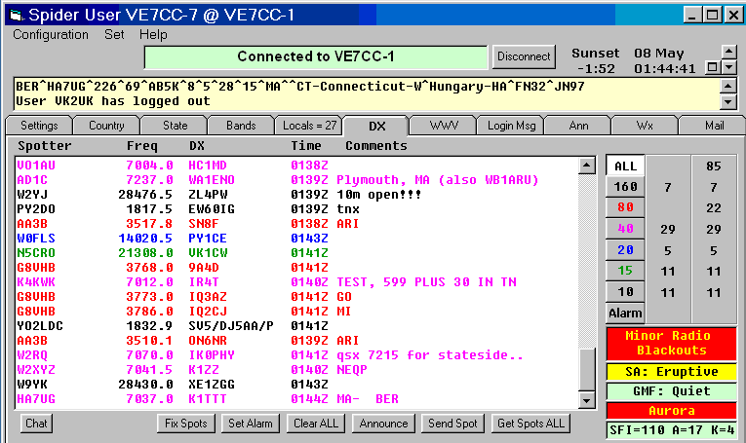
DX Spotting Network

Slide 12
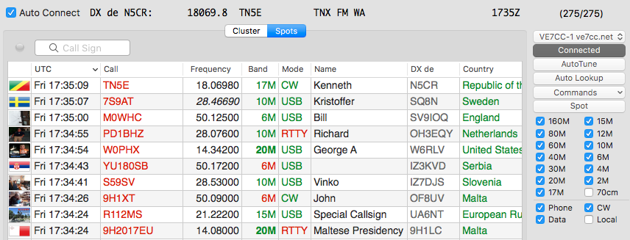
DX Spotting Network Window
Clicking on a needed call will propagate your logger callsign window

Slide 13
QUICK LIST OF COMMON FEATURES
EASE OF RECORD KEEPING
QSL SENT/RECEIVED
SEARCH BY CALL, DATE, BAND, MODE
*Great tool when you receive that envelope from the QSL buro..
AWARD TRACKING – DXCC, WAS, VUCC, WAC, IOTA, PARKS AND MANY MORE
IMPORT/EXPORT TO LoTW, QRZ, Eqsl, CLUBLOG , etc.
Import contacts from WSJT, FT8, FT4, JT65 etc
PRINTING QSL LABELS AND OR CARDS

Slide 14
POPULAR LOGGING PROGRAMS
Amateur Radio Contact Log by N3FJP - Easy to use, well written contact logging program.
DXLab by AA6YQ - Integrated suite of programs for logging and station management
Log4OM by IW3HMH – Complete Logging program
Logger32 by K4CY- a 32bit logging program
DX4Win - Comprehensive logging software for Windows
Ham Radio Deluxe – Integrated suite of programs for logging and station management
Listing of the many programs along with details, links and reviews;
https://www.eham.net/reviews/ see Ham Logging Software

Slide 15
CONCLUSION
There are “daily “ logging programs and “contest” loggers.
They are somewhat interchangeable. Meaning you could use the daily logger in a contest and the contest logger for daily logging…
BUT
During a contest the daily logger will not keep score, show dupes and create the proper reports for submission to contest sponsor.
The contest logger will not track QSLs and Awards.
My advice is to use them as intended. After a contest I import the contest log into my daily logger.. All of the computer loggers can import or export using the ADIF file format.
(Amateur Data Interchange Format)
ALWAYS REMENBER to BACKUP YOUR LOG

Slide 16
Q&A de Tom KA2D
Hope you enjoyed this presentation.
It was intended to give an overview of the many advantages to computer logging.
So… check out the program which fits your needs.
Confused… ask a club member for a demo..
QUESTIONS??

Slide 17
73
Tom KA2D
CU in the pileups..
ka2d@optonline.net

