Slide 1


Getting Started with
Parks On The Air® (POTA)
“Keeping it Simple”
Dennis Boyé - AH2O
Ham Radio University
04 January 2025

Slide 2
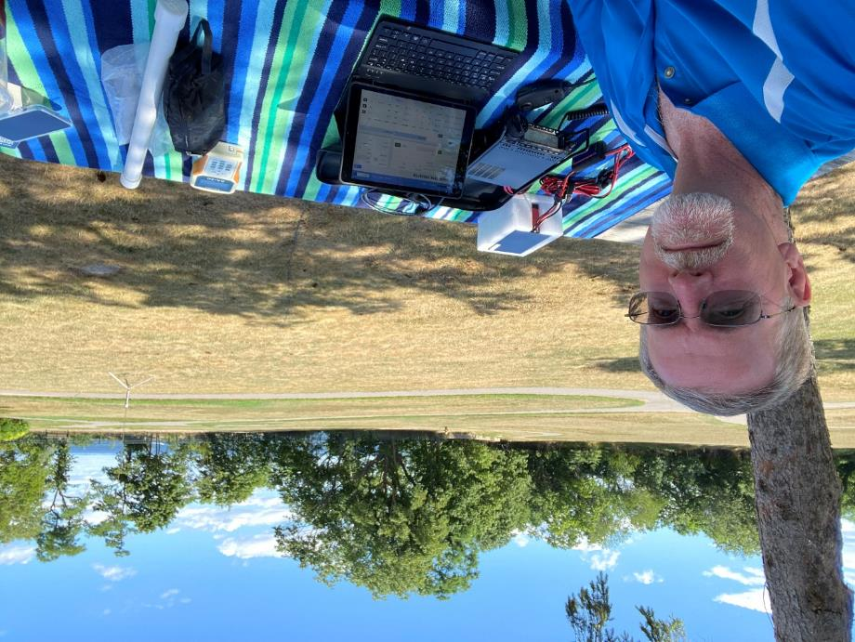
POTA – Keeping it Simple
Introduction
Creating a POTA Account
Getting Started
Operations
  Hunter
  Activator
Log Submittal
  Activators Only
My POTA Gear
Awards
References
Q&A

Slide 3

Introduction
Parks on the Air® (POTA) is a Radiosport program that encourages communications to, and portable operations from, designated parks
  All Bands and Modes
POTA started in 2017 when the ARRL’s National Parks on the Air special event ended
A group of volunteers wanted to continue the fun beyond the one-year event, and thus, POTA was born
  Field Day all year long

Slide 4









Introduction
  Originally US National Parks, it has expanded to include National Forests, National Trails, State Parks, etc.
POTA has also expanded to almost every country worldwide

Slide 5
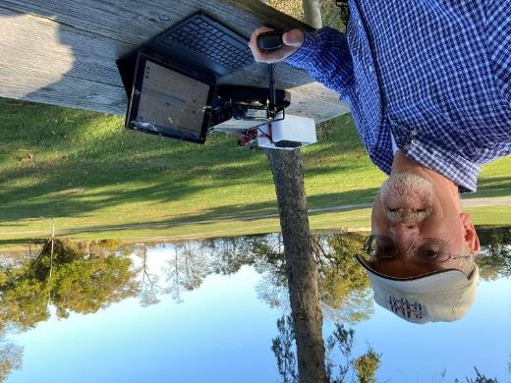
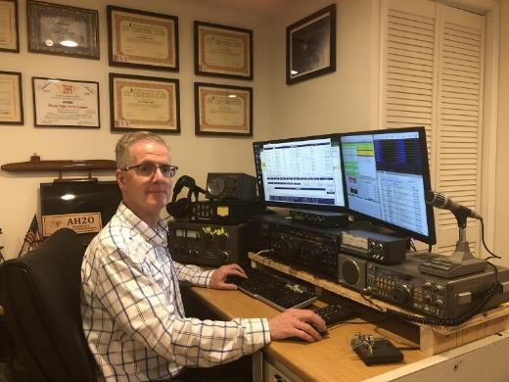
Definitions
Activators
  Individuals that pack up their portable gear and head out to a park, and set up a station
Hunters
  Individuals located anywhere, who contact the Activators in a park

Slide 6
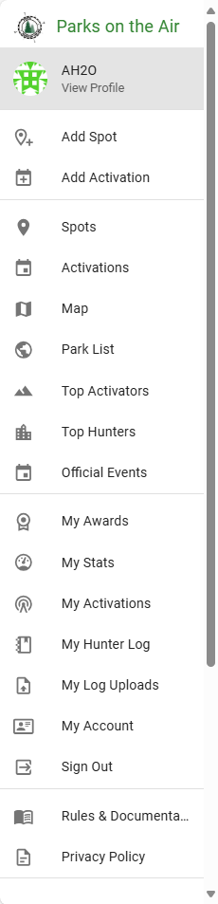
First – You need a POTA Account
One stop shop for all things POTA
Account menu highlights:
  “Spots” – Shows Activators currently operating in parks
  “Map” of all POTA parks, including park details
  “My Awards” – Shows progress towards certificates and awards
    Based on the logs Activators you contacted submit
    As a Hunter no logs submittals or QSO confirmation is required
  “Rules & Documentation” – POTA details, documentation, video
Creating an account is simple
  https://parksontheair.com/

Slide 7
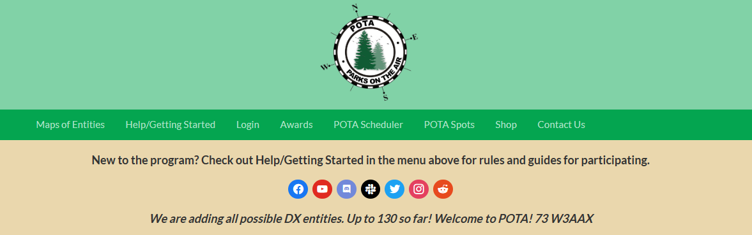

Creating a POTA Account
Follow the easy “Sign Up for POTA” instructions

Slide 8

Creating a POTA Account, Continued
POTA Account Passwords
  Authenticated against accounts you already have
    Amazon, Google, or Facebook
  Or create a unique username and password just for POTA

Slide 9
Getting Started
Getting started with POTA can happen via one of two paths
  Activator
  Hunter
The easiest way to participate in POTA is as a Hunter, so let’s start there

Slide 10
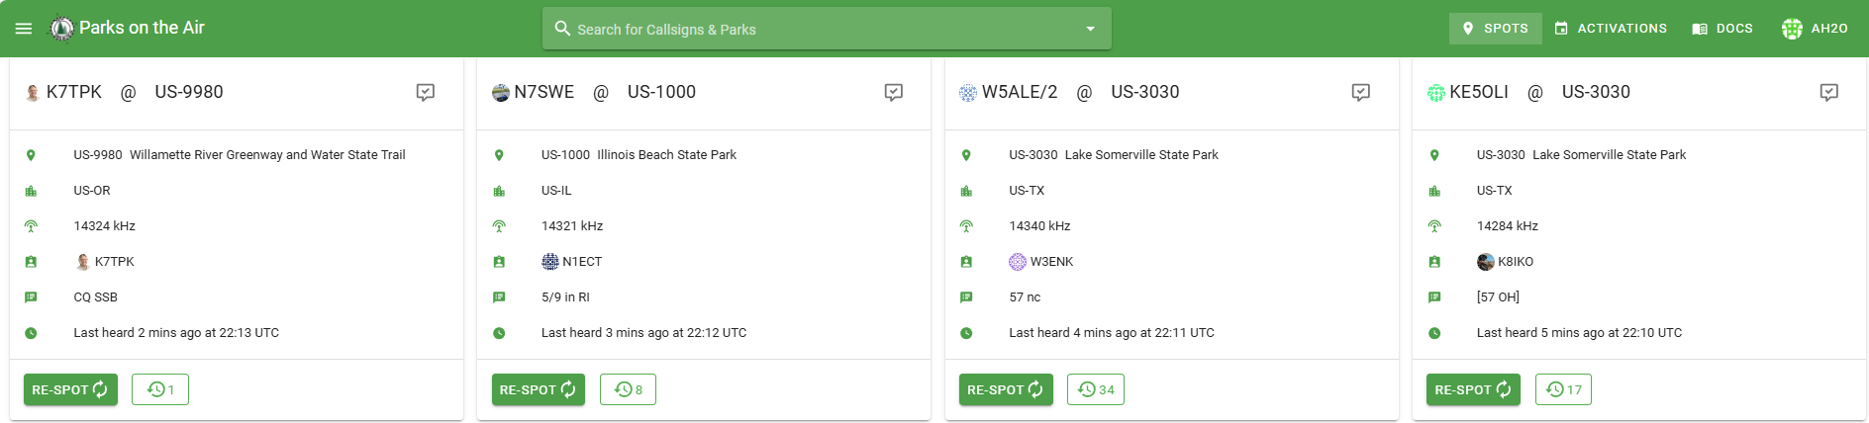
Hunter
The first place to start as a Hunter is to go to https://pota.app
The landing page will be the Spots page, which shows Activators on the air, what parks they are in, and what frequencies and modes they are operating
Call them, if you make a contact, you’ve officially started in POTA!

Slide 11
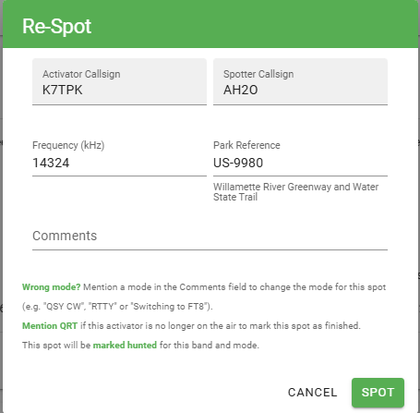
Hunter - Spotting
If so inclined, after you work a park Activator, you can “Re-Spot” them so other Hunters know they are still currently active

Slide 12
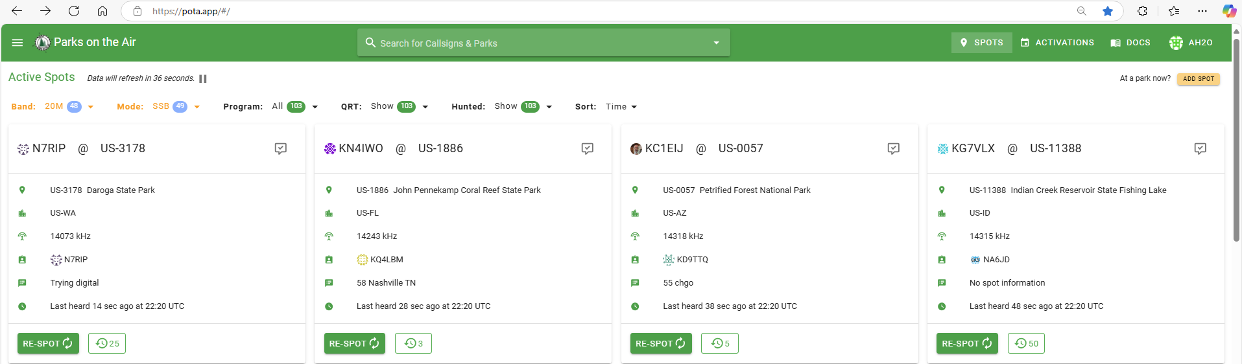
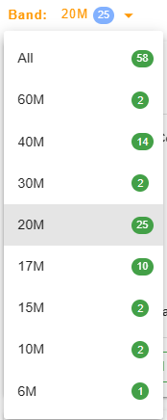
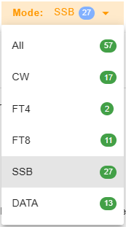
Hunter – Active Spots Page
The “Active Spots” page can be filtered; Band, Mode, etc.

Slide 13
Activators – Simple Rules
After you’ve done some hunting, you might want to try activating
Activator rules are simple:
  You must have an account registered at https://pota.app
  Pick a park near you
  You and all your equipment must be within the boundaries of the park
  Follow any instructions from park rangers you encounter
  Be courteous of others using the park – you’re an ambassador of our hobby
    Others have a right to be in the park too
  Leave no trace behind
  You must upload your ADIF log to the POTA site after your activation is complete
    Minimum of 10 contacts required to be a valid activation

Slide 14
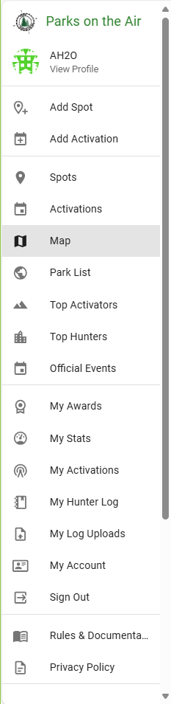
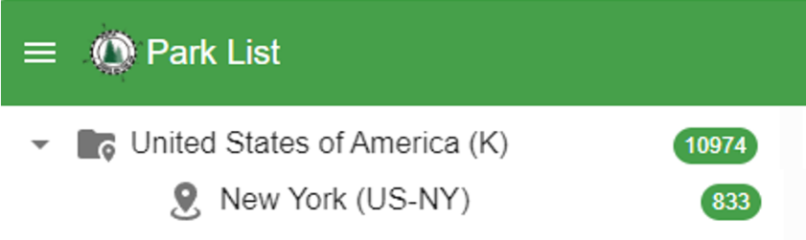
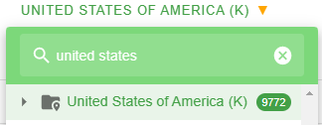
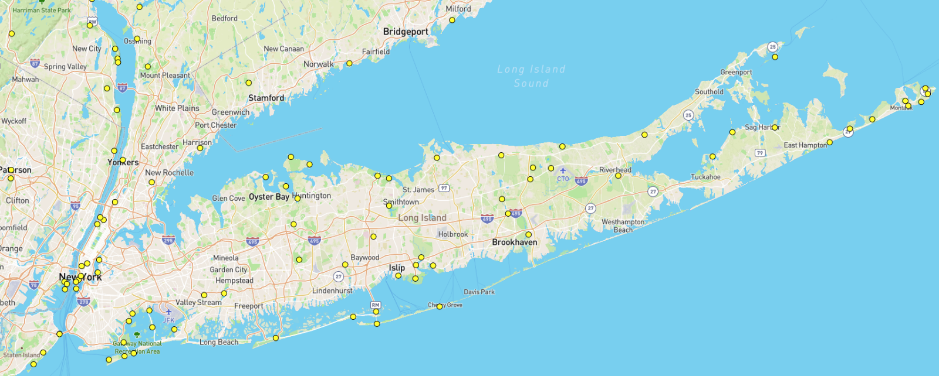
Activators – Park Selection
Go to POTA site https://pota.app
Pick a park!
The yellow dots are park locations in your area

Slide 15
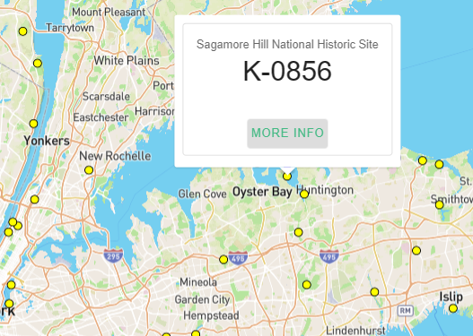

Activators – Pick A Park
You can search / move around the map for other locations
Click on yellow dots for park information
Once you chose a park, consider surveying park in advance
  Quiet spot
  Close parking
  Park bench
  Restrooms, etc.

Slide 16
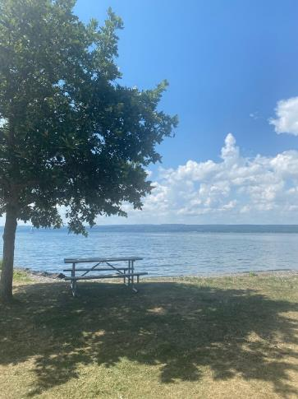



A Few of My POTA Activations
Lodi Point State Park, NY
(Finger Lakes)
Caumsett State Historical Park, NY
Target Rock National Wildlife Refuge, NY

Slide 17
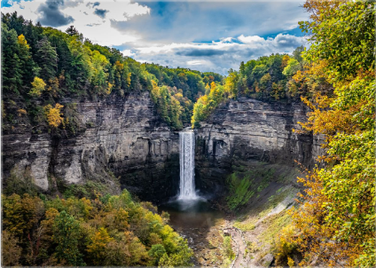


A Few of My POTA Activations
Valley Forge National Historic Park, PA
Taughannock Falls, NY
(Finger Lakes)
Trail View State Park, NY

Slide 18
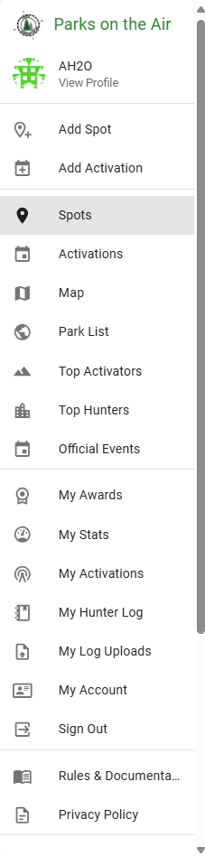
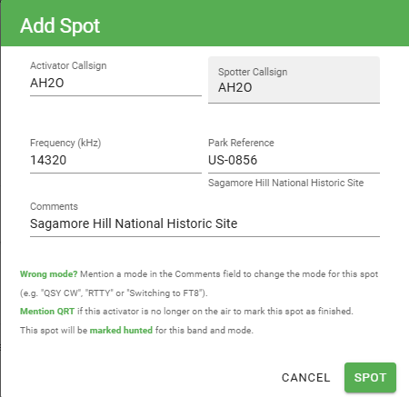
Activators – Getting Started
Once you’ve chosen a location in the park
  Set up your gear
  Set your logging program
  Find a quiet frequency
  Start calling CQ POTA!
While doing your initial CQ calls, consider going to https://pota.app to Spot yourself
  Once spotted the Hunters will pounce, so be prepared to start logging your QSOs!

Slide 19
Activators – Submitting Your Log
POTA requires Activators to submit log files in ADIF format
  Use any logging program of your choosing
Required ADIF fields
  STATION_CALLSIGN (Activator Callsign)
  CALL (Hunter Callsign)
  QSO_DATE
  TIME_ON
  BAND
  MODE
File naming convention requirements
  CALLSIGN@PARK#-yyyymmdd.adi
  An example using one of my activations:
    AH2O@US-0856-20241214.adi

Slide 20
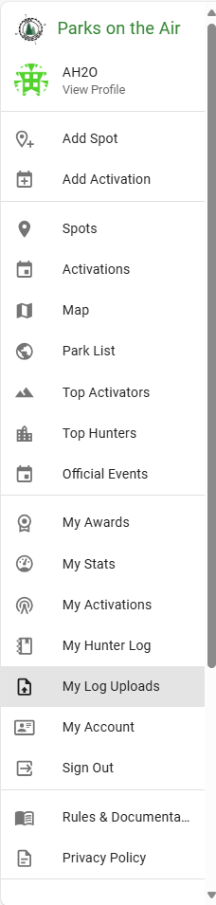
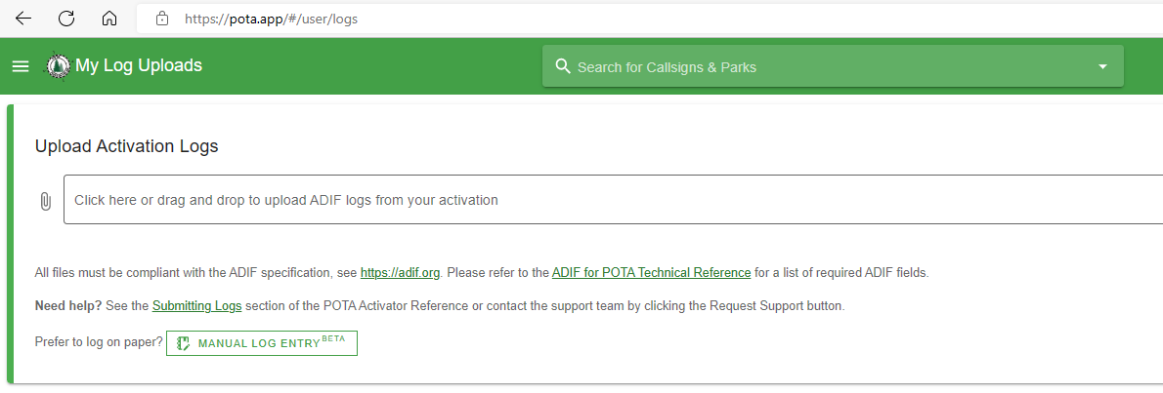

Activators – Submitting Your Log, Continued
Go to https://pota.app, then “My Log Uploads”
Drag and drop ADIF log
You get immediate “processed” confirmation
That’s it!

Slide 21
Activators – What do you need to activate a POTA site?
Any portable radio
Any portable antenna
  Wire on a self-supporting mast, Wolf River Coils, Alpha Antennas, SotaBeams, Buddipole, etc.
    Note: National Parks do not allow wires in trees or stakes in the ground
Portable power or access to AC power
Any logging program that will export ADIF format

Slide 22

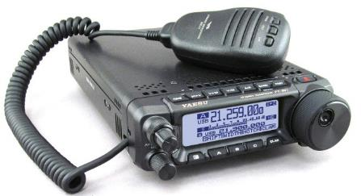


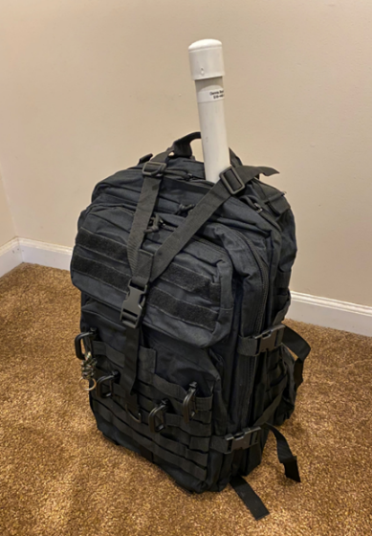
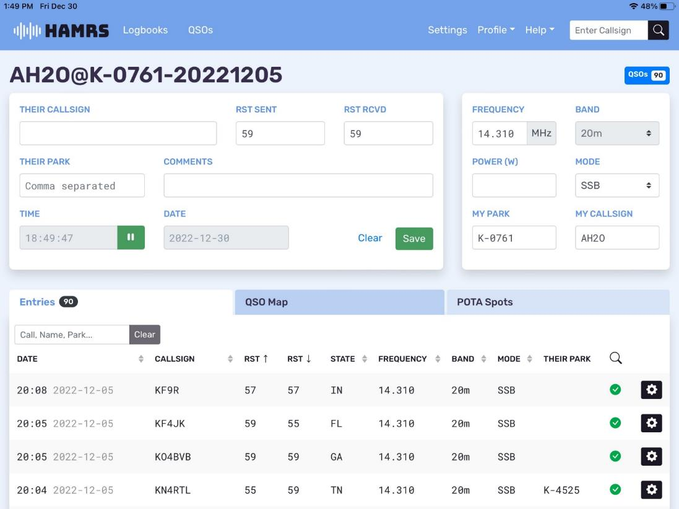
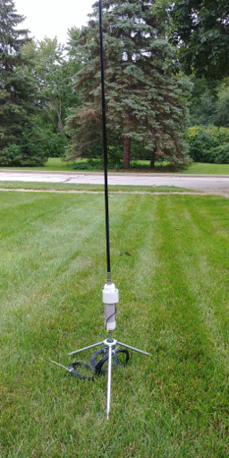
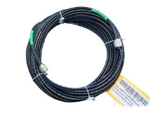
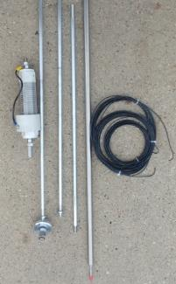
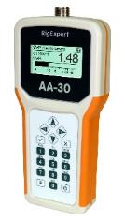
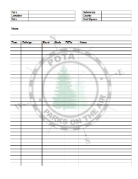


My POTA Gear
Bioenno Power
12V, 12Ah Battery
8.5 x 2.2 x 3.1”
Wt: 3.3 lbs
Powerwerx Watt Meter,
DC Inline Power Analyzer,
WattMeter-PP
3.3 x 1.7 x 1.0“
Wt: 0.18 lbs
Yaesu FT-891 (QRO)
2 x 6 x 8.6”
Wt: 4 lbs
Wolf River Coil
Take It Along 1000
80 to 10m
Collapsible 102" Whip
Three 33' radials
Footprint: 19" x 17”
Wt: 3 lb 5 oz
iPad
w/ Keyboard
(HAMRS Logging SW)
RG8X Coax - 50 ft
Antenna
Analyzer
Paper Log
”Just in Case”
Backpack
17.1 x 12.6 x 2.2”
Wt: 3 lbs

Slide 23
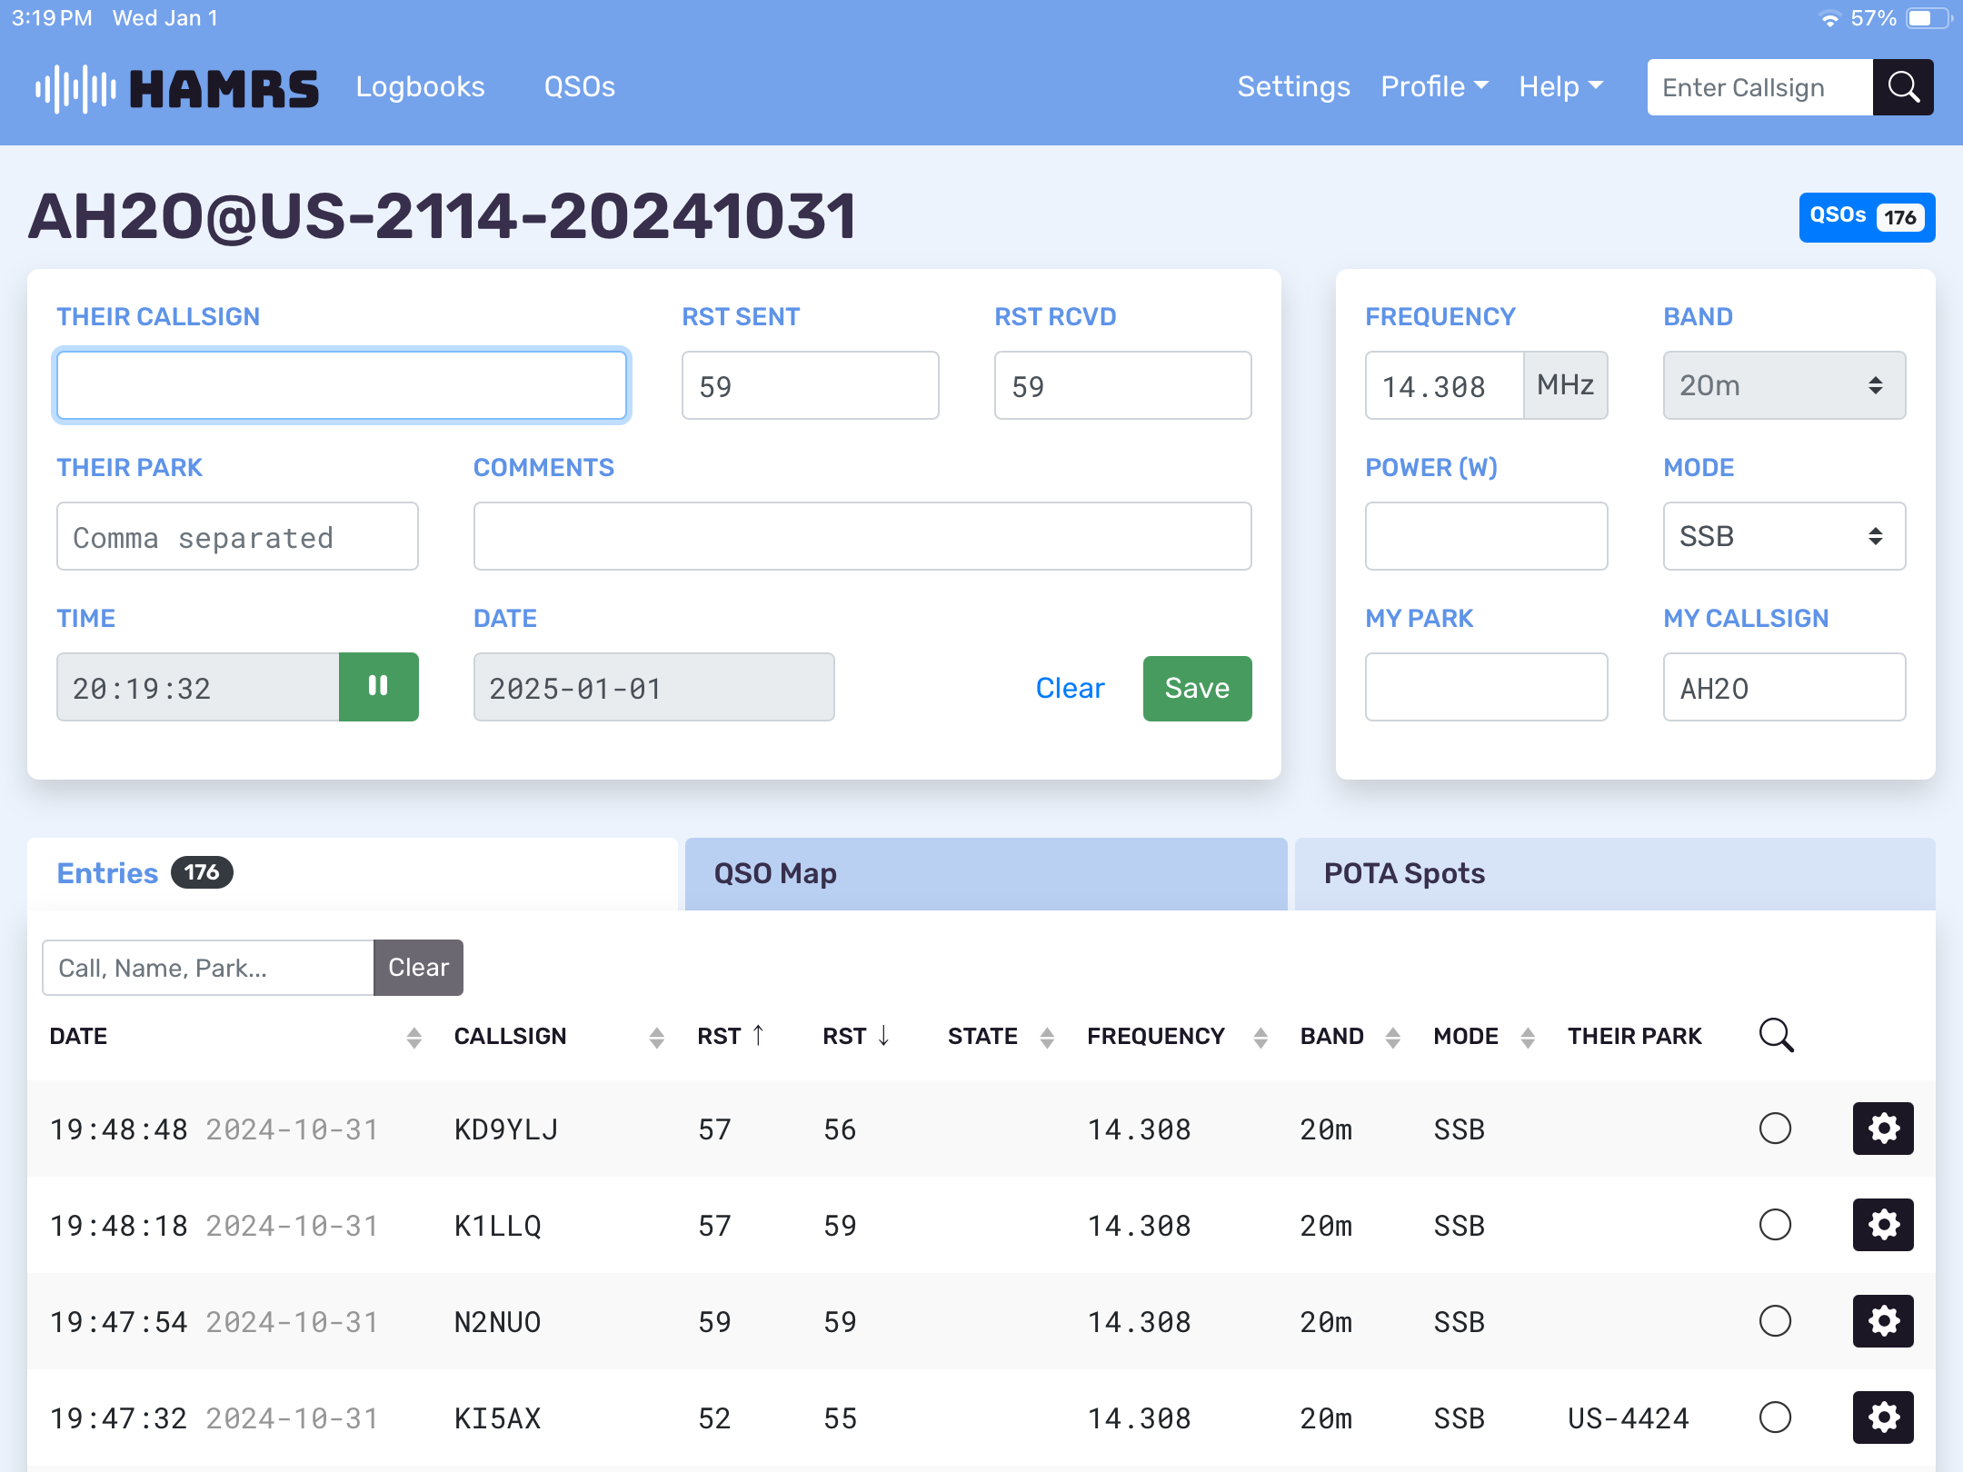
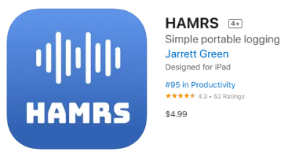
My POTA Logging Software
HAMRS
A simple logger designed specifically for portable activities, like Parks on the Air (POTA), Summits on the Air (SOTA) Field Days, etc.
Auto populates park Grid location
Available in App Store
Can log other Activations
“Park-to-Park”

Slide 24
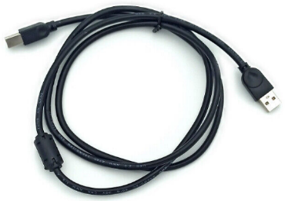

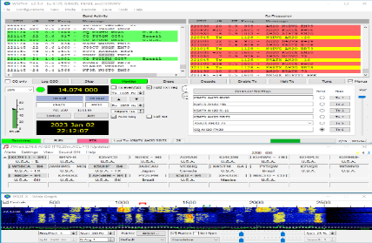
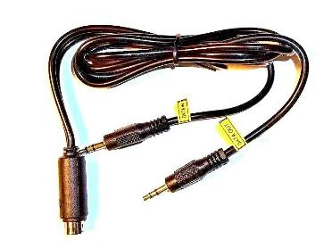
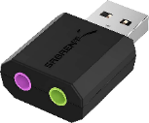
My POTA Gear – CW, FT8, FT4
Yaesu FT-891 (QRO)
2 x 6 x 8.6”
Wt: 4 lbs
CAT Cable
iPad
w/ Keyboard
(HAMRS Logging SW)
USB External Stereo Sound Adapter
Laptop
N3FJP Logging SW
WSJT-X
JTAlert
Audio Interface Cable

Slide 25
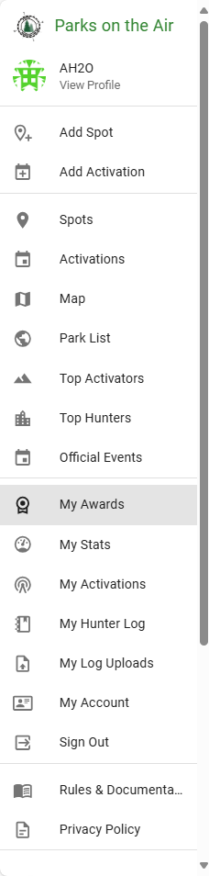
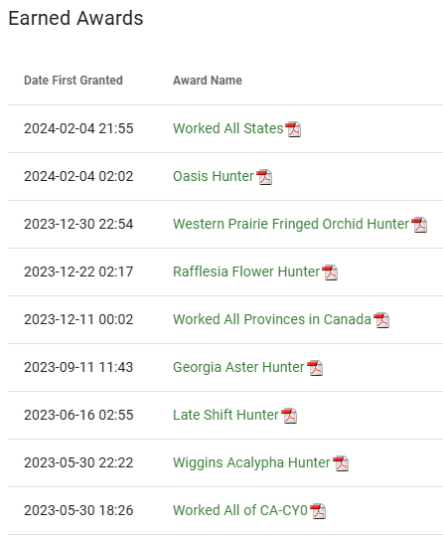



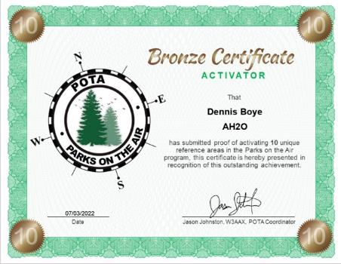
Awards
Shows your progress towards certificates and awards based on the logs that Activators you contacted submit
  As a Hunter no logs submittals required

Slide 26
More than “Keep it Simple”
To interact with the POTA community online:
  POTA Facebook group
  Twitter
  Mastodon

Slide 27
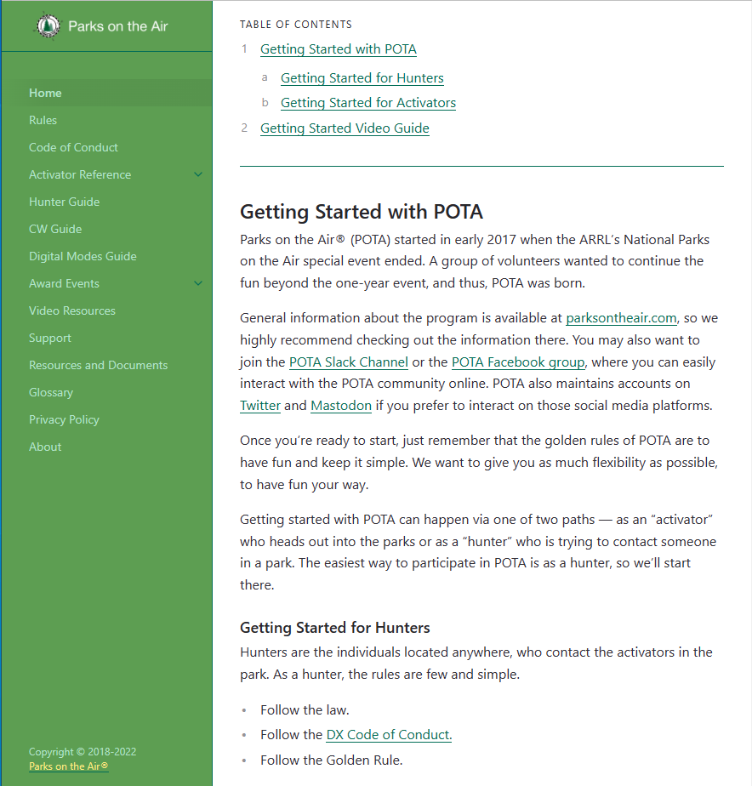

References
Parks on the Air Documentation (pota.app)
Parks On The Air (sparc-club.org)
ARRL POTA Book

Slide 28
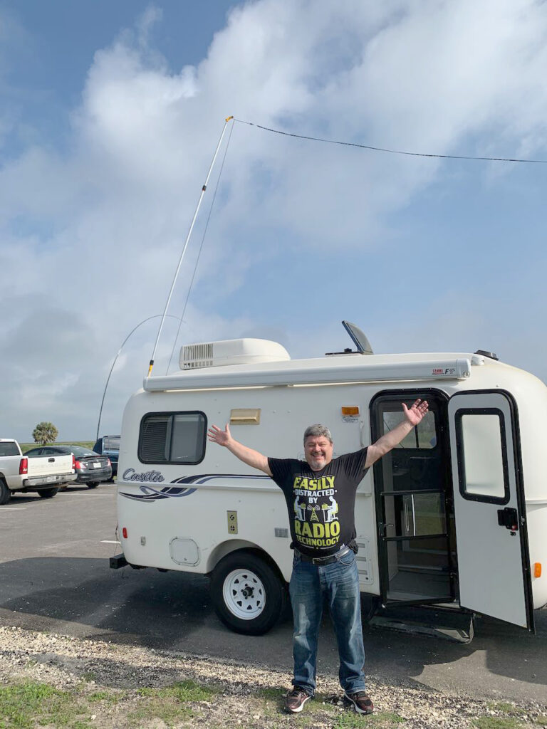
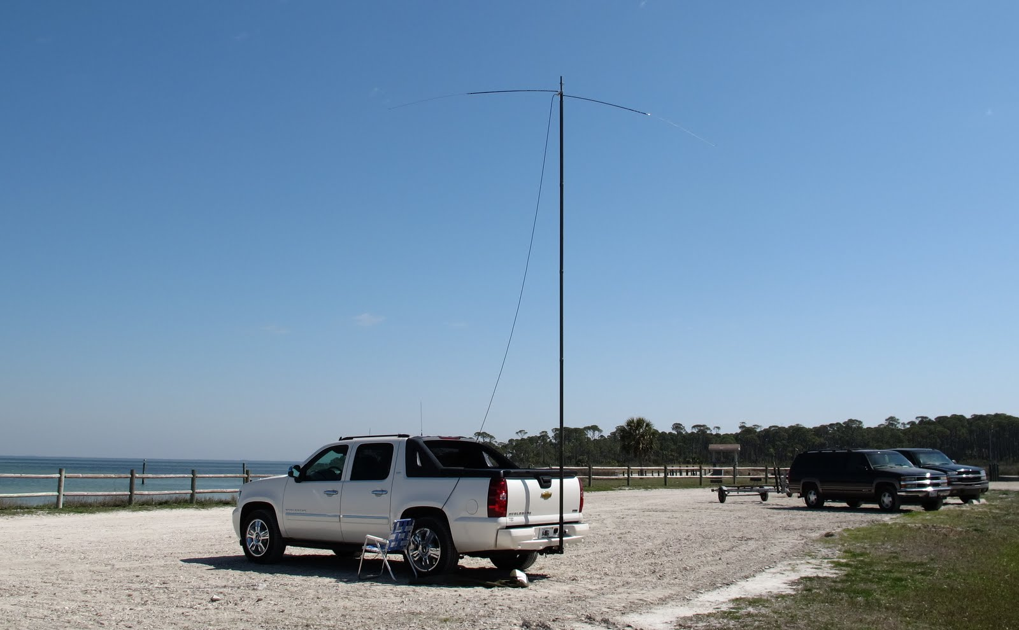
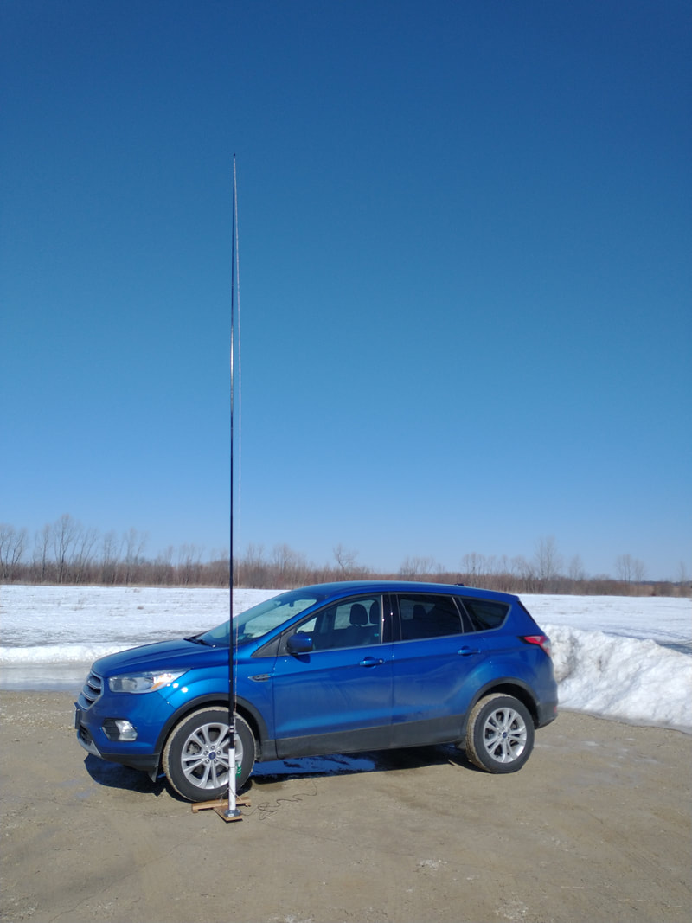
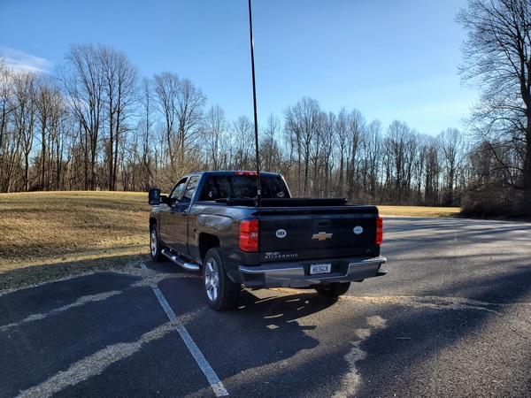
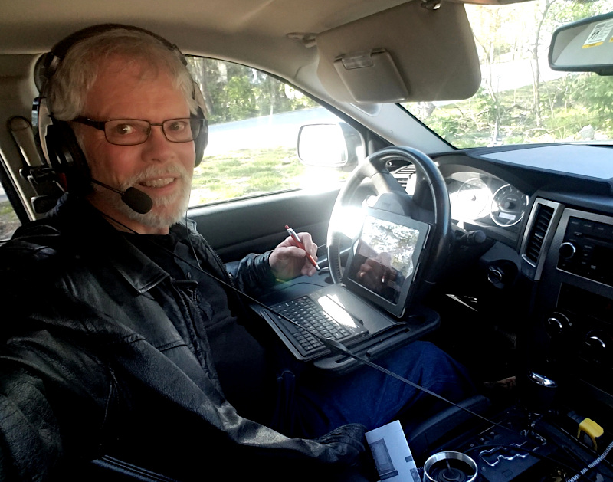
Now Go Out and Enjoy POTA!
Park Bench or Vehicle
  As long as you’re “within the boundaries of the park”

Slide 29
Questions?
Dennis Boyé – AH2O
AH2O@ARRL.NET
AH2O@OPTONLINE.NET

