Slide 1
Batteries for Portable HF Operations
AF2SC – Stu Cohen
Ham Radio University - January 4, 2025

Slide 2
Agenda
History
Terminology
Types, Construction & Chemistry
Selection & Comparisons
Safety & Assembly
Charging & Solar
Q & A

Slide 3
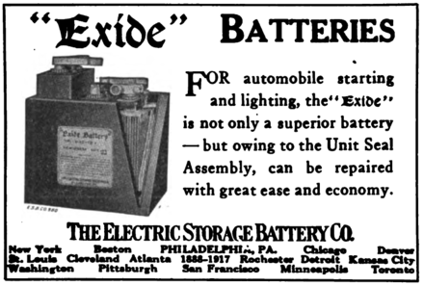
Battery History
1800 Invention of the voltaic cell by Allesandro Volta
1859 Invention of the reusable lead acid battery by Gaston Plante
1899 Nickel cadmium battery
1949 Alkaline battery
1990 Nickel metal hydride battery
1991 Reusable alkaline battery
1992 Lithium-Ion battery

Slide 4
Primary and Secondary Batteries
Primary cell - is designed to be used once and discarded.
The electrochemical reaction occurring in the cell is not reversible. As a primary cell is used, chemical reactions in the battery use up the chemicals that generate the power; when they are gone, the battery stops producing electricity.
Secondary cell - is recharged with electricity and reused.
The reaction can be reversed by running a current into the cell with a battery charger, regenerating the chemical reactants.

Slide 5
Battery Terminology
Cell Voltage – [V]
Open Circuit Voltage (OCV) – the cell voltage under no load
Nominal Voltage – the voltage under load
Capacity – [Ah] (Current [A] x Time [hours]) - total stored electrical charge
Nominal Capacity – the rated capacity of a cell given by the manufacturer
Capacity is rate and temperature dependent
C rate – Proportional rate of charge or discharge related to rated capacity
1C = Current when charged or discharged / Capacity
State-of-Charge - [SOC], %, SOC is a measure of the energy content remaining in the battery
Depth-of-Discharge - [DOD], % DOD is measure of energy amount taken out of battery
Life
Cycle life, [cycles] – USAGE, depends on rate, DOD, SOC and temperature
Calendar life, [years] – STORAGE, depends on SOC and temperature
Self-discharge – [mV/day or % over Time] – LEAKAGE, reversible loss of capacity over time

Slide 6
Lead Acid Types
Batteries are usually grouped into two categories, based on the intensity and length of their electric current.
Starter battery - Capable of short duration, high current. These have thinner electrode plates that maximize reaction surface area but can’t withstand long, deep discharges without being damaged.
Deep Cycle battery - Has thicker plates that, while less intense, can discharge electric current for longer periods.
Starter batteries rated in CCA
Deep Cycle batteries rated in Ah
Flooded Lead Acid
SLA or VRLA - Sealed Lead Acid or Valve Regulated Lead Acid
Liquid or Gel
AGM - Absorbed Glass Matt

Slide 7
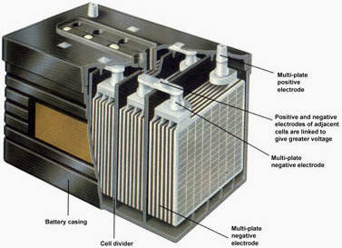
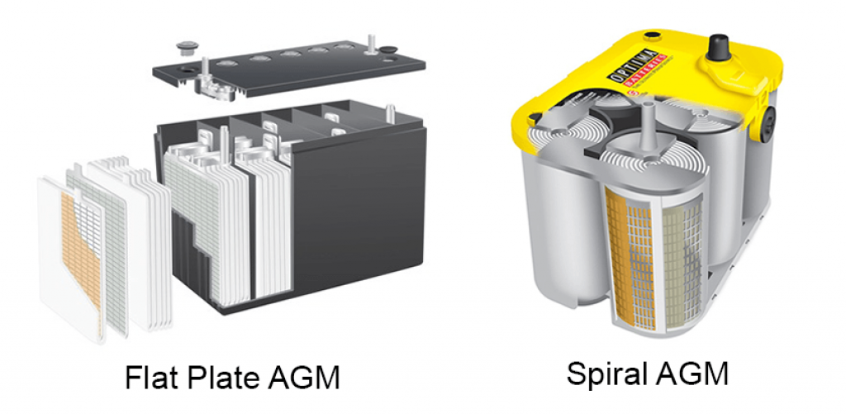
Lead Acid Construction
Flooded Lead Acid

Slide 8
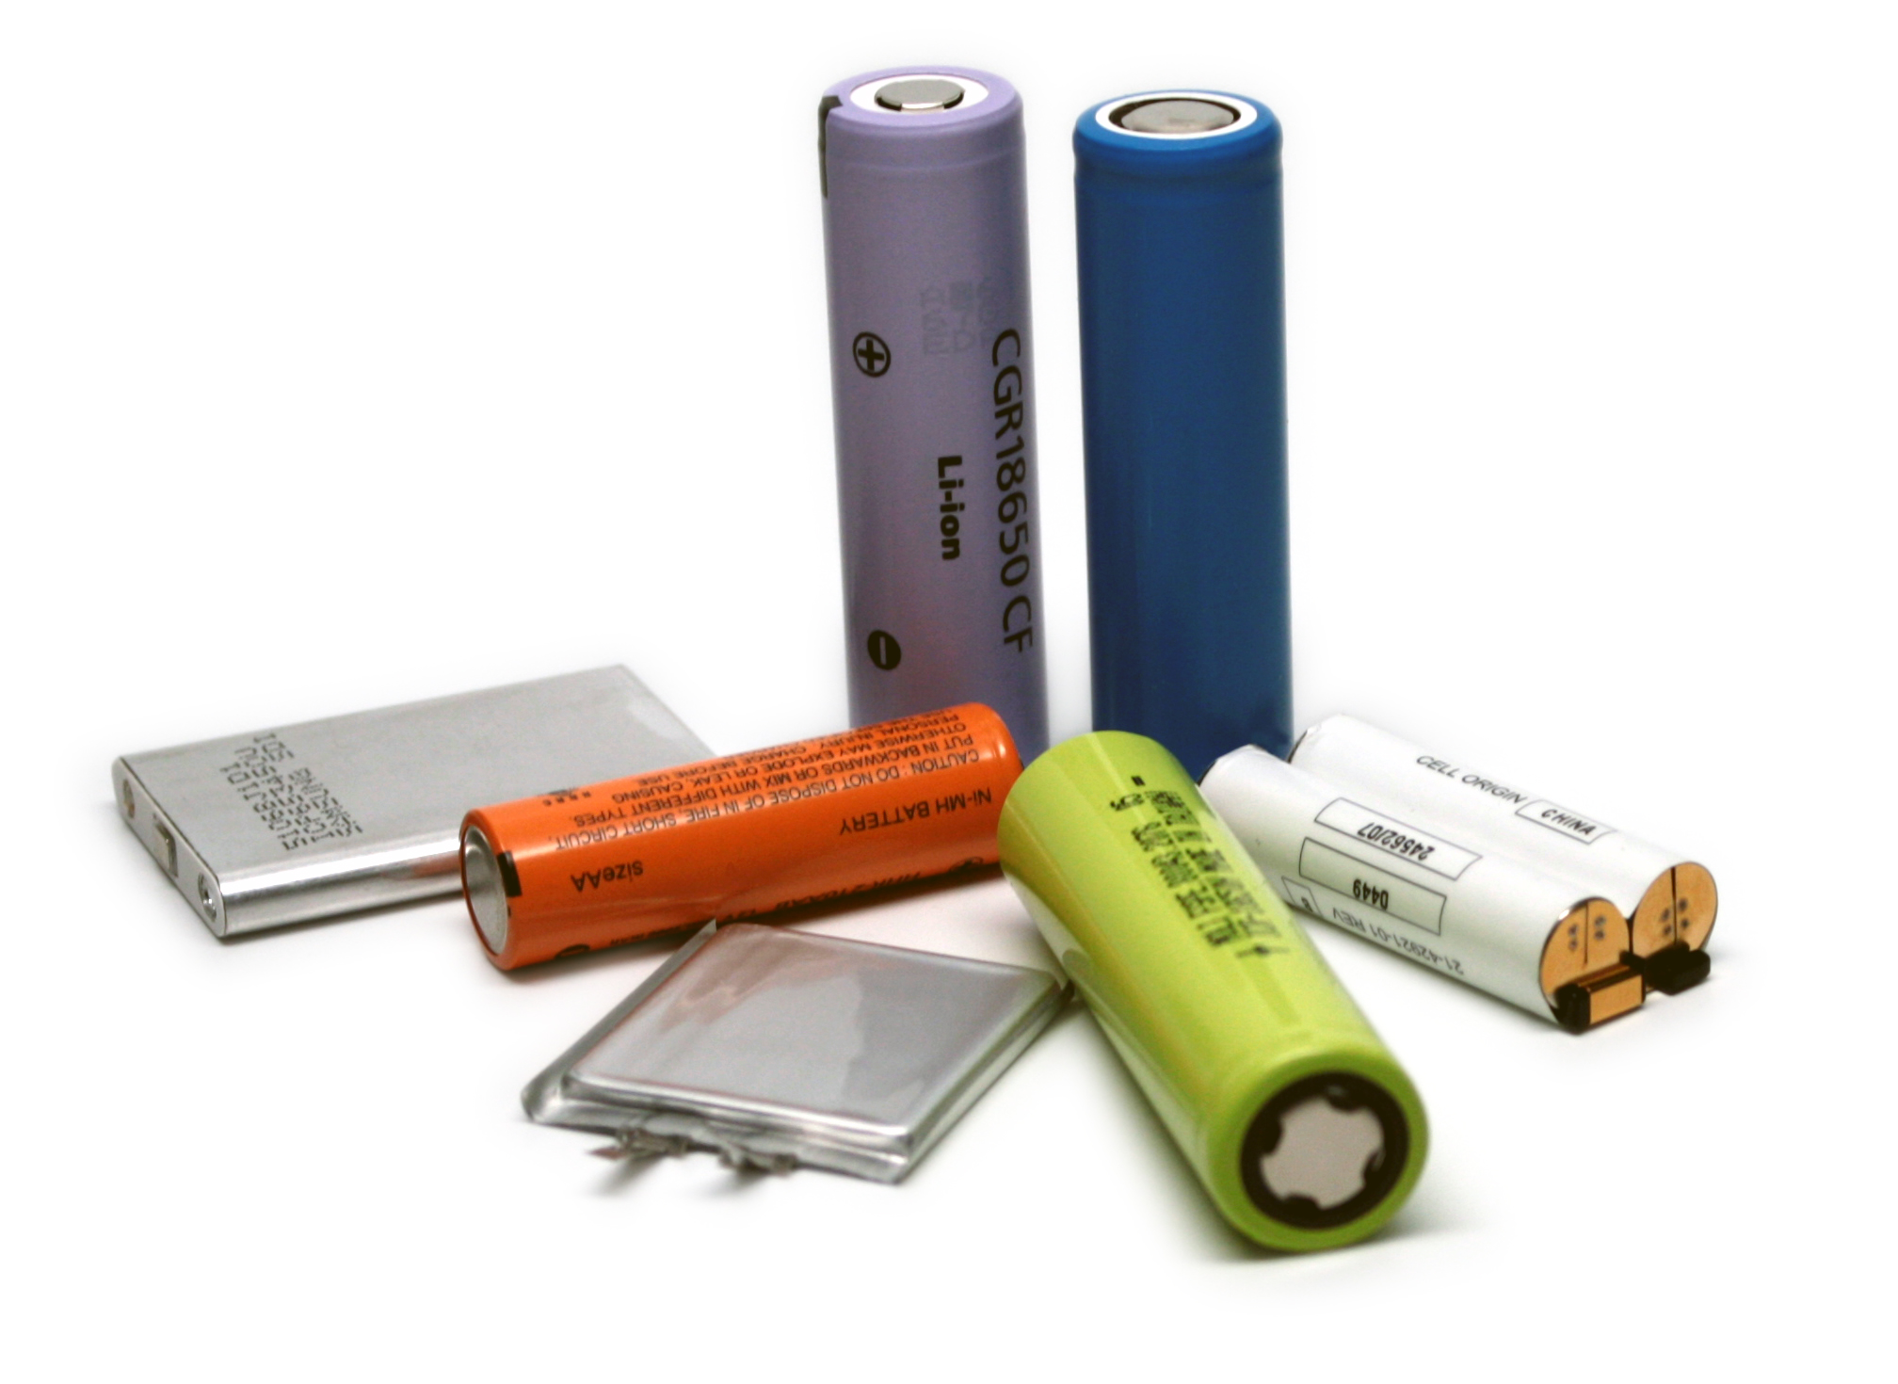
Lithium Construction
Cell:
Although it looks like a “battery,” a lithium cell cannot be used individually
Not to be confused with “Alkaline Replacement” batteries.
Requires protection circuitry to prevent thermal runaway
Battery Pack:
A connection (circuit) of one or more cells and the appropriate protection circuit
Cells could be connected in series or parallel or a combination of both
Series connection increases pack voltage
Parallel connection increases pack capacity

Slide 9
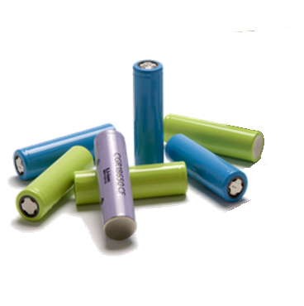
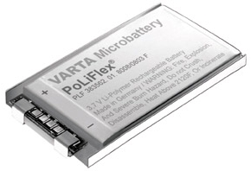
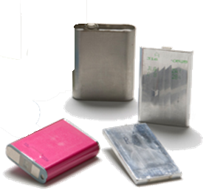
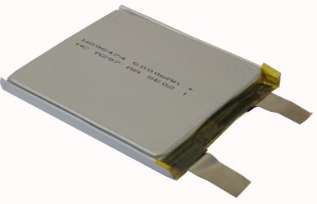
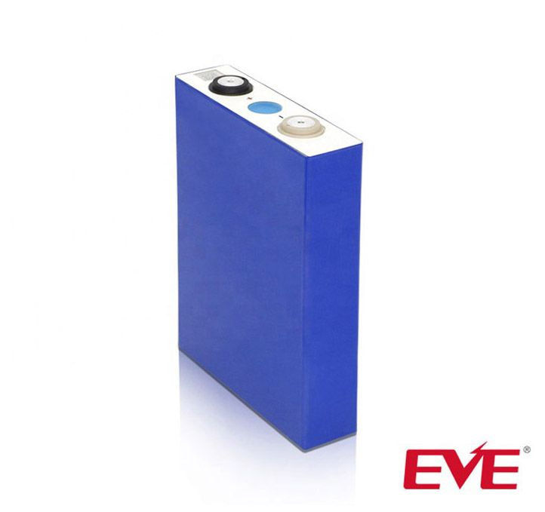
Lithium Cell Types
Polymer Pouch
Laminate
Button Cell
Prismatic
Cylindrical

Slide 10
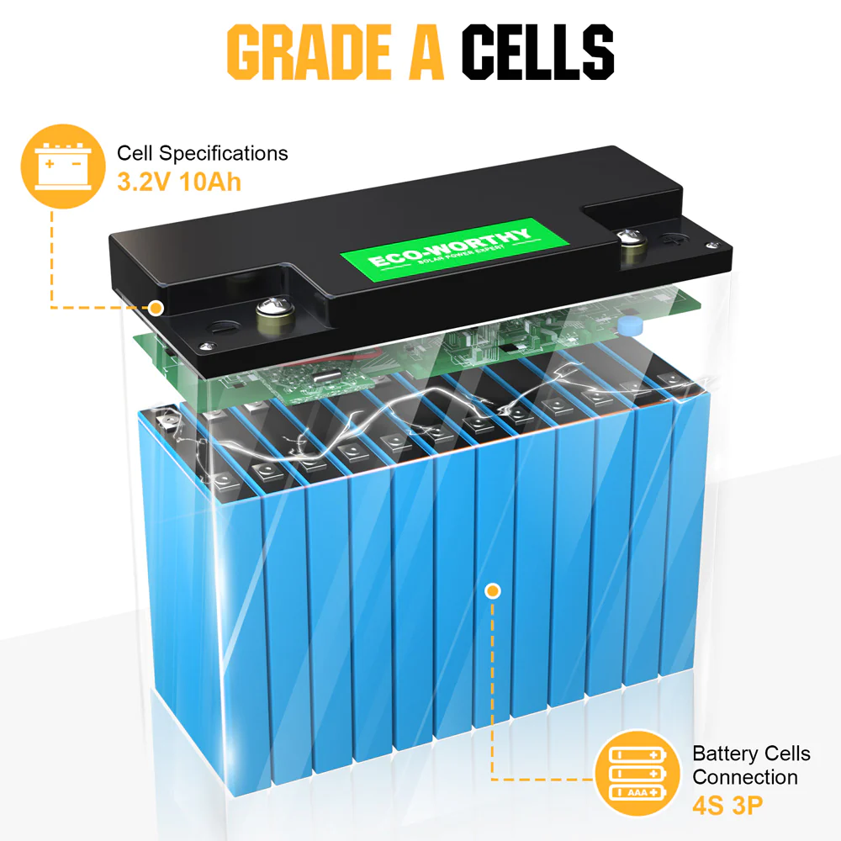
Battery pack building blocks
A typical rechargeable battery consists of 4 major elements:
Cells - Different form factors, different types of chemistries
BMS - Electronics to manage the battery
Housing - Plastic, sheet metal, shrink, etc.
Connection System – Terminals, Connector, pigtail wires

Slide 11
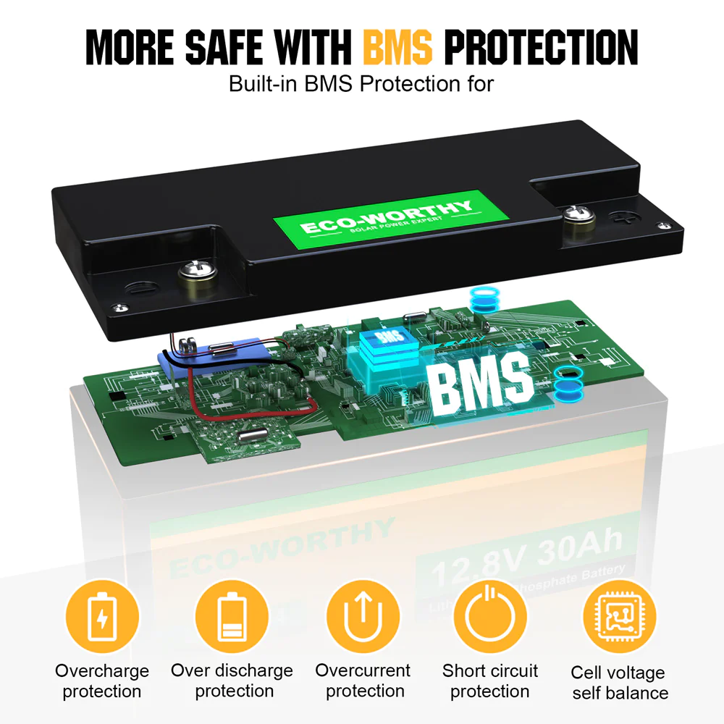
BMS / BPS Functions
Protection Circuit
Turn off Charge when any cell voltage is too high
Turn off Discharge when any cell voltage is too low
Turn off Discharge/Charge if current is too high
Protect against high / low temperature
Smart batteries
SOC measurement (gas gauge)
Communication (I2C, SMBus, CAN or MOD)
Authentication
Charging

Slide 12
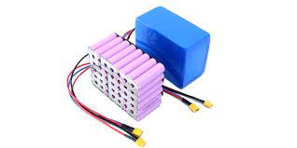
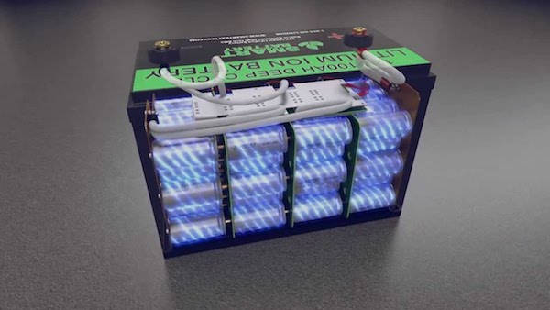
Battery Pack Assemblies
Batteries are an assembly composed of multiple cells.
12V Lead acid batteries have six cells with a nominal voltage of 2.1~2.2V/cell
LiFePO4 battery cells have a nominal voltage of 3.2~3.3V
To achieve a 12V battery you'll typically have four cells connected in a series (4S).
This will make the nominal voltage of a LiFePO4 12.8V.

Slide 13
Lithium Cathode Materials
 | Li-Co | Li-NMC or NCA | LiFePO4
Common Name | Li-Cobalt | Li-Nickel Manganese Cobalt Li-Nickel Cobalt Aluminium Oxide | Li-Iron Phosphate
Voltage | 3.7 V | 3.6V - 3.7V | 3.3V
Internal Resistance | Low | Low | Lowest
Energy Density | Highest | High/highest | Lower
Max Discharge | 1-2C typical | 2-10C | 10C typical
Max Charge | 0.7 C | 0.3-0.7C | 2C - 4C
Self Discharge | Low | Low | Lowest
Cycle Life | 300-750 cycles | 300 - 750 cycles | 2-5k cycles
Safety | + | ++ | +++
Primary Application | PC Notebook, Mobile phones (mostly polymer) | Mid-high rate (E-bikes, power tools) | Power tool/Energy Storage

Slide 14
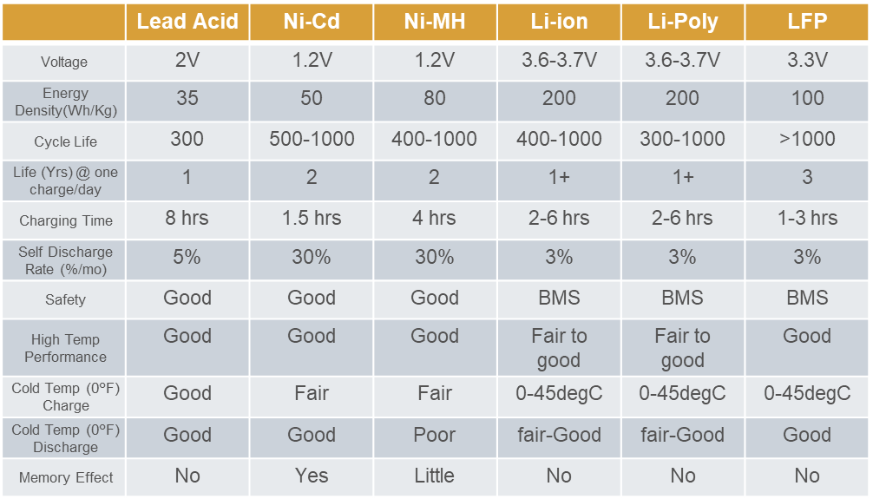
Chemistry Comparison

Slide 15
Operating a Ham Radio from a Battery
Transmit Power Consumption
Receive Power Consumption
Percentage of Time Transmitting & Receiving (Duty Cycle)
How long do you want to operate?
(Transmit Power Consumption x Percentage of Time Transmitting)
+
(Receive Power Consumption x Percentage of Time Receiving)
Weighted Average Current Draw
X
Hours of Operation
Ah Required

Slide 16
Calculation for typical 100W unit
Radio | Vin | TX Current | RX Current
FT-891 | 13.8Vdc +/-10% (12.42 ~ 15.18) | 22A @ 100W | 1.5A / 2A
20% / 80% - Hunt and Pounce
50% / 50% - Field Day or Pile Up
Transmit Power: 22A
Receive Power: 2A
(22A x 20%) + (2A x 80%)
4.4A + 1.6A = 6A
Transmit Power: 22A
Receive Power: 2A
(22A x 50%) + (2A x 50%)
11A + 1A = 12A

Slide 17
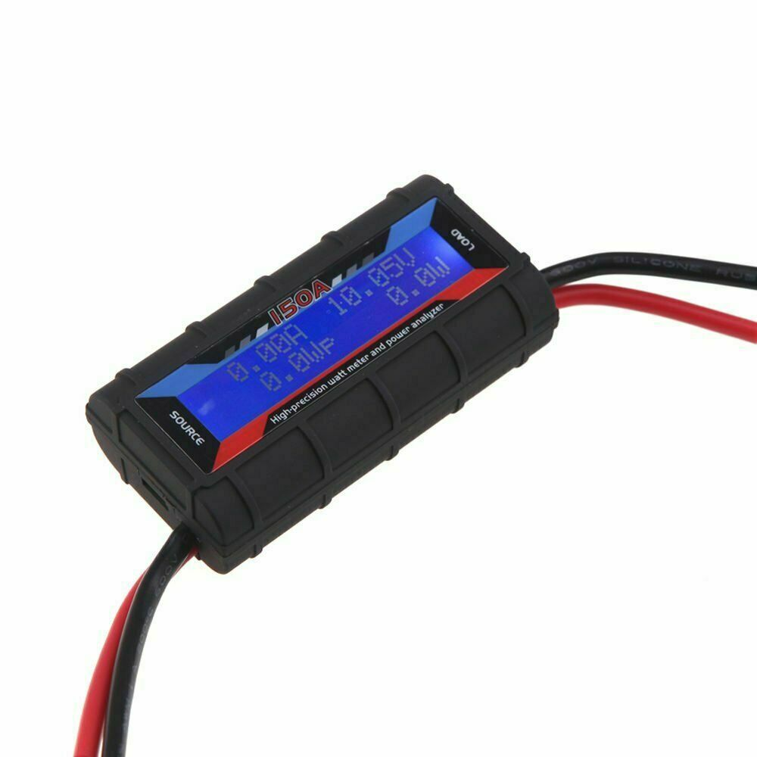
Variables to Consider
Actual Duty Cycles are not easily calculated
Lower output power saves some energy
Not linear
Monitor Voltage and Consumption
Transmit current vs. C rate current
Depth of Discharge limits

Slide 18
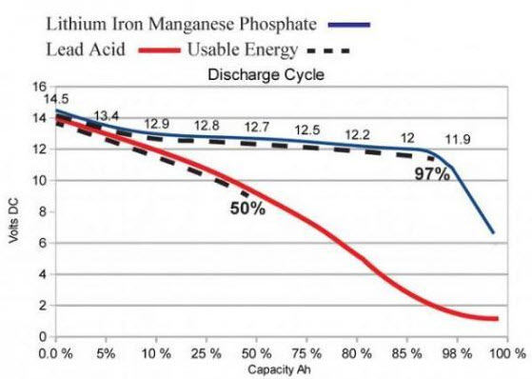
Lead Acid vs. LiFePO4 Discharge Curve

Slide 19
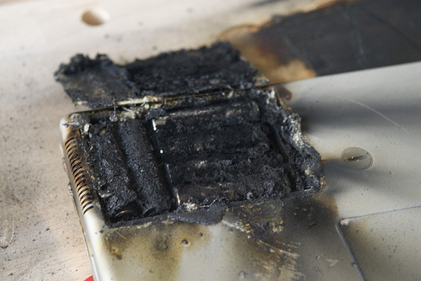
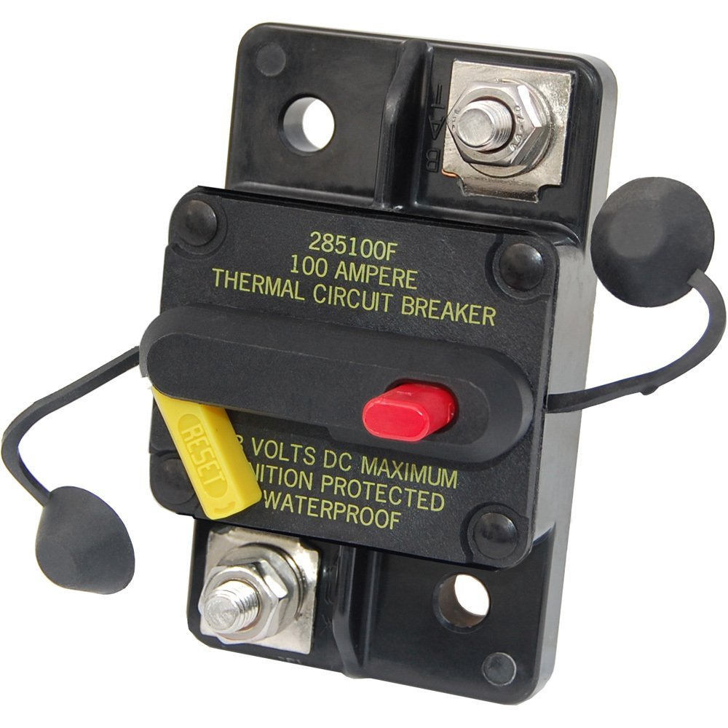
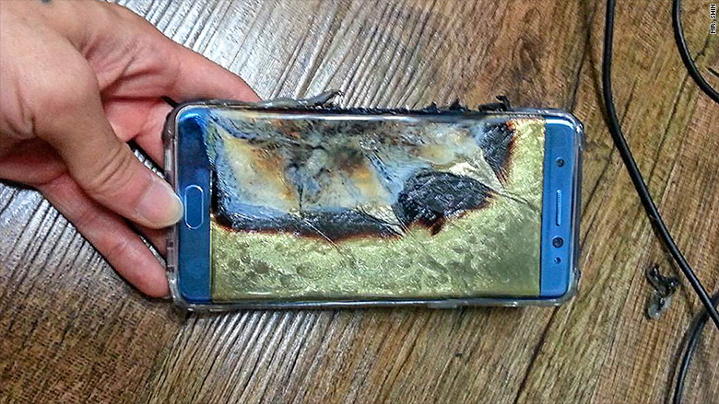
Safety
Respect batteries
Fuse the Battery Lead near the source
Fuse or Circuit Breaker
Types of dangerous conditions to avoid:
Overcharge / Over discharge
Crush / Mechanical damage
Overheating

Slide 20
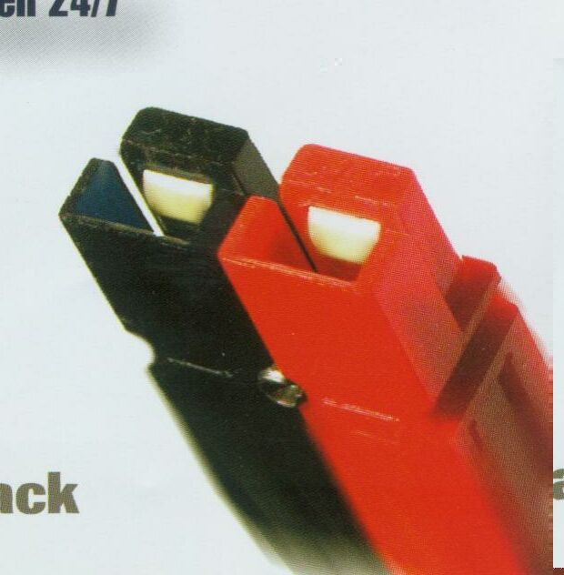
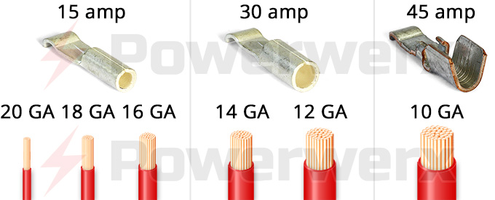
Assembly
Use quality wire
Use quality connectors
T&B
Powerpole ?
Use quality crimpers

Slide 21
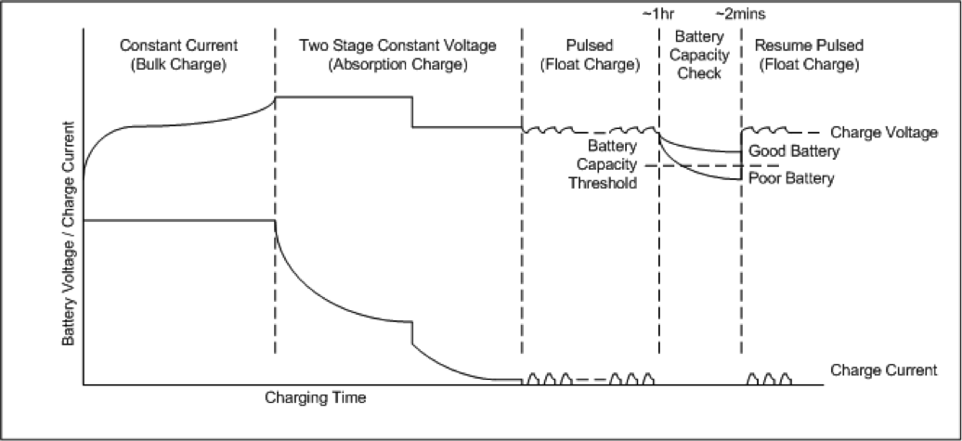
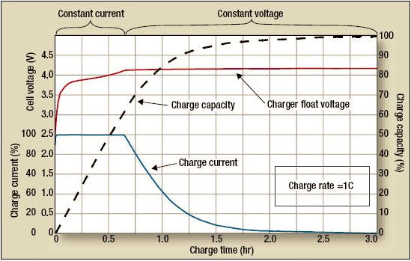
Every chemistry has different charging requirements
Lead Acid
Li Ion

Slide 22
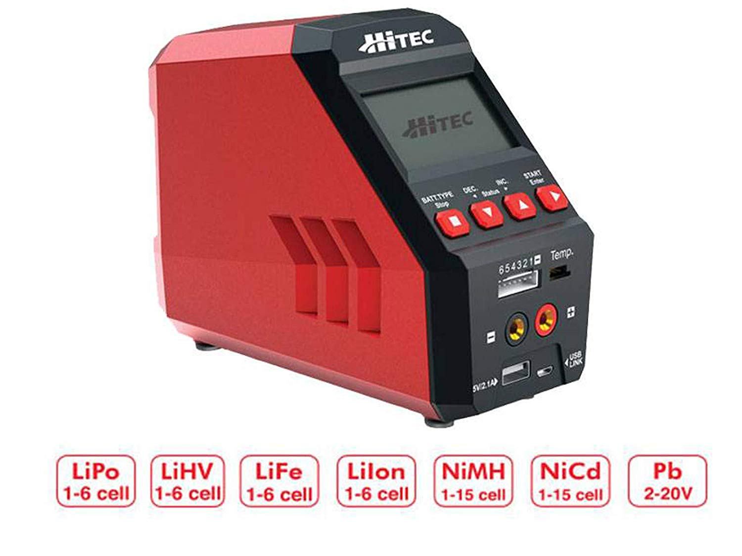
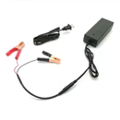
Charging Options
Standard Charger – Select by chemistry
Universal Charger

Slide 23
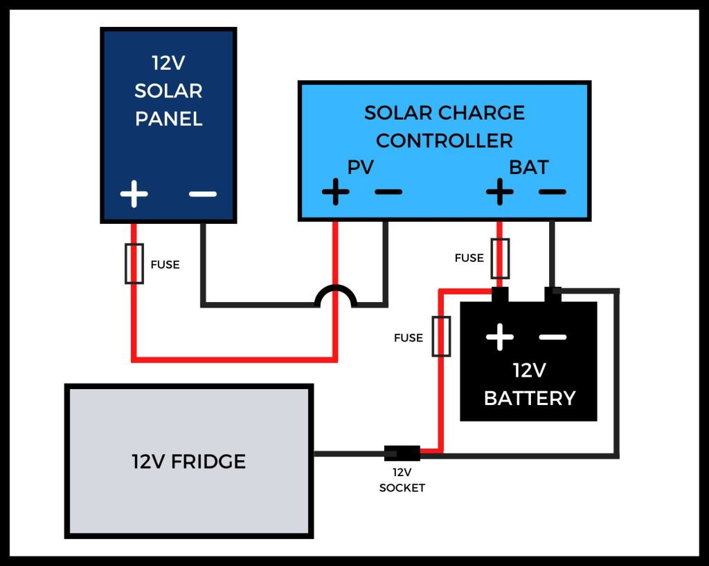
Solar Power System Overview
RADIO

Slide 24
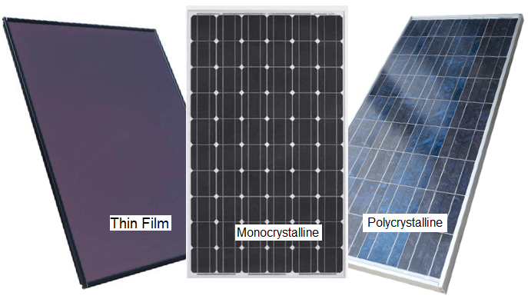
Solar Panels
Panel Type | Advantages | Disadvantages | Efficiency
Monocrystalline | Higher effiency & Performance | Higher cost | To ~ 20%
Polycrystalline | Lower cost | Lower efficiency & performance | 15% ~ 17%
Thin-film (Amorphus) | Portable & Flexible | Highest cost Lowest efficiency & performance | 13% ~ 15%

Slide 25
Charge Controllers
PWM – Pulse Width Modulated | MPPT – Maximum Power Point Tracking
Simple DC-DC Converter Lowest cost Higher reliability | Complex multi-stage converter Higher cost Higher effiency in larger systems

Slide 26
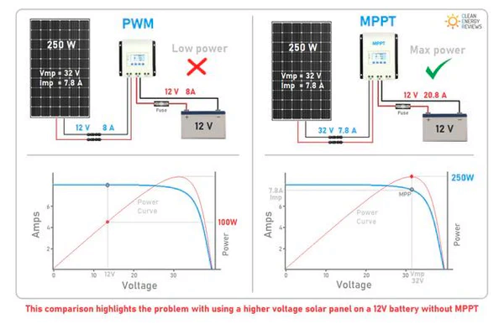
Charge Controllers

Slide 27
Q & A

