Slide 1
NEW SDR-BASED TRANSCEIVERS
HRU 2025 Neil Goldstein, W2NDG

Slide 2
WHO IS W2NDG?
Licensed in 2012
Live in Upstate NY
Sr. Research Systems Engineer at Memorial Sloan Kettering Cancer Center
Maintains the kit directory radiokitguide.com

Slide 3
WHAT IS THIS ALL ABOUT?
SDR Technology is getting more advanced and efficient
Processors are getting faster and more efficient
The convergence of these technologies and available hardware are creating very interesting, high-performance, economical, and super efficient radio designs

Slide 4
FIRST, LET’S DEFINE SOME THINGS:
SDR
Software Defined Radio
Microcontroller (including single board computers, and FPGAs)
DSP Radio (Radio on a chip)

Slide 5
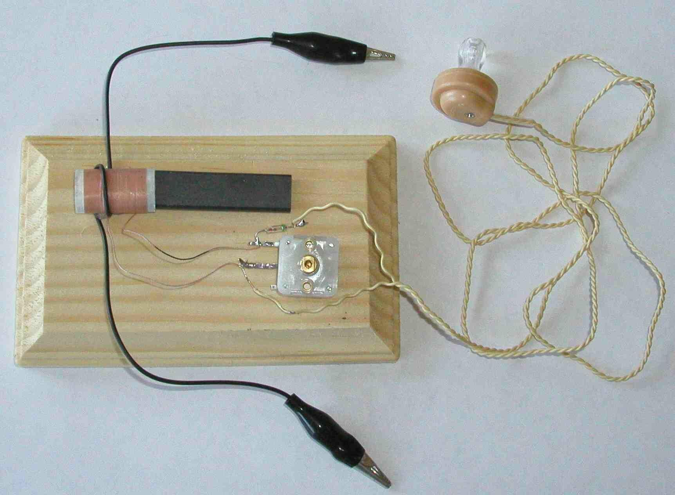
SOFTWARE DEFINED RADIO
What is a radio?
RF — Signal Processing — User Interface
In its most basic form:

Slide 6
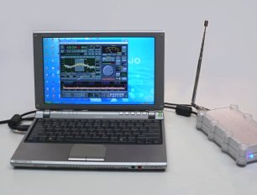
SOFTWARE DEFINED RADIO
RF — Signal Processing — User Interface

Slide 7
WHAT ARE MICROCONTROLLERS?
Also, FPGAs and Raspberry Pi-style boards

Slide 8
LET’S TALK BRIEFLY ABOUT RADIO-ON-A-CHIP
DSP technology in radio is related to sdr, but not the same thing
It’s also a way to make low cost, and efficient designs
This is why baofeng uv-5 and related radios exist and are so inexpensive
DSP is also why modern portable radios work so well with very few components
Doesn’t have to be that sophisticated (analog mimicking)
DSP radios are a great example of efficiency and value in radio design
Let’s do the same thing with SDR!

Slide 9
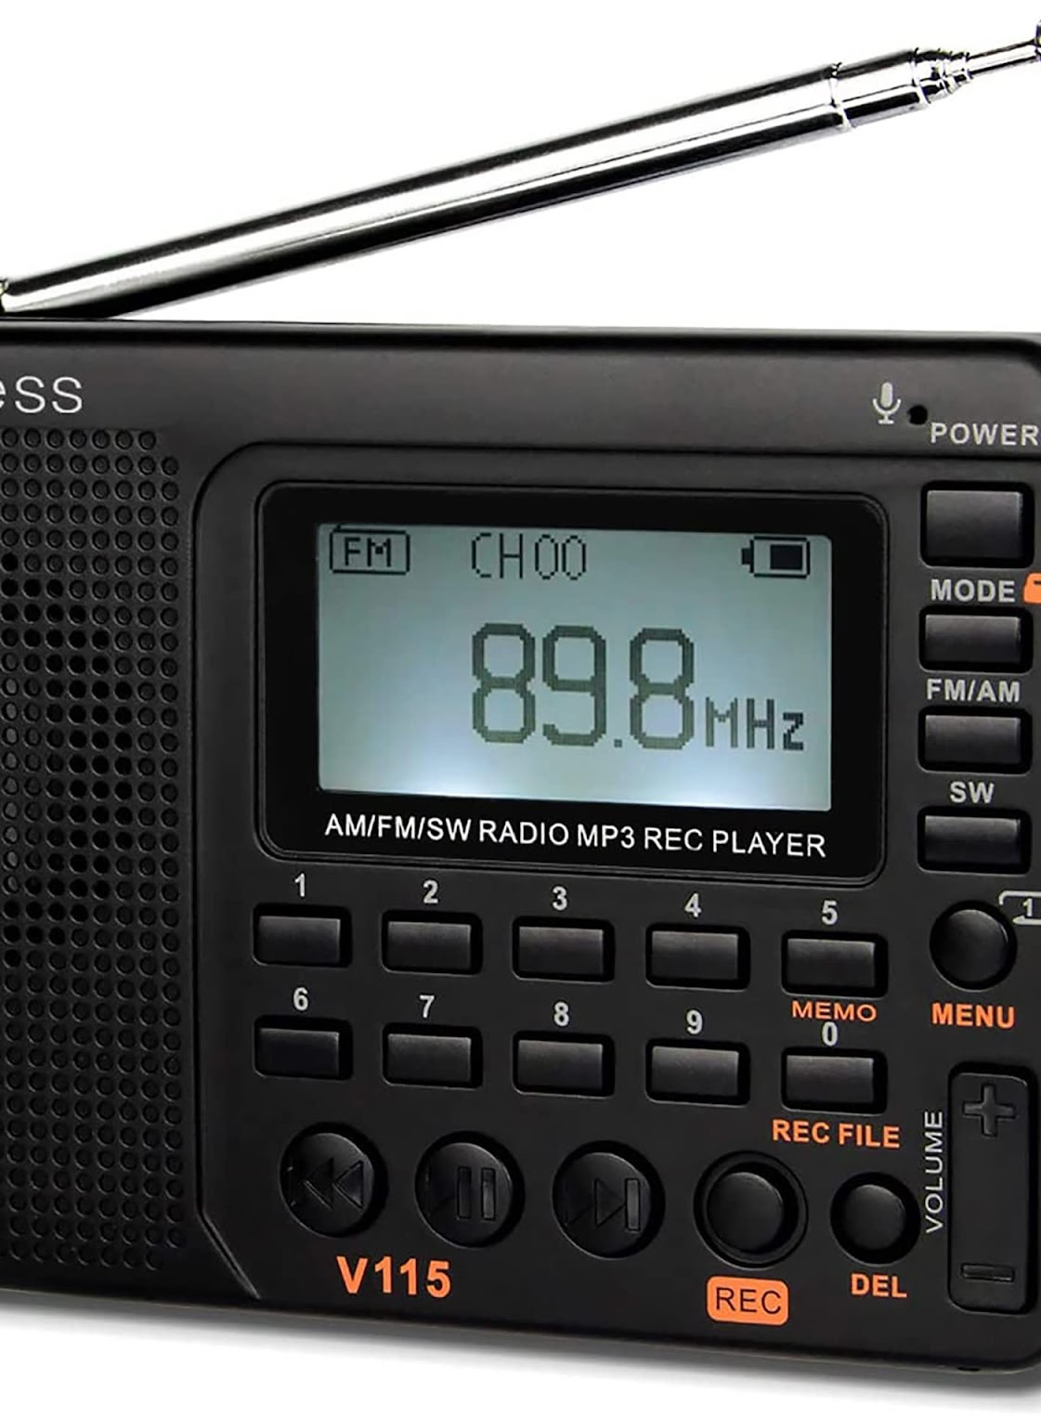
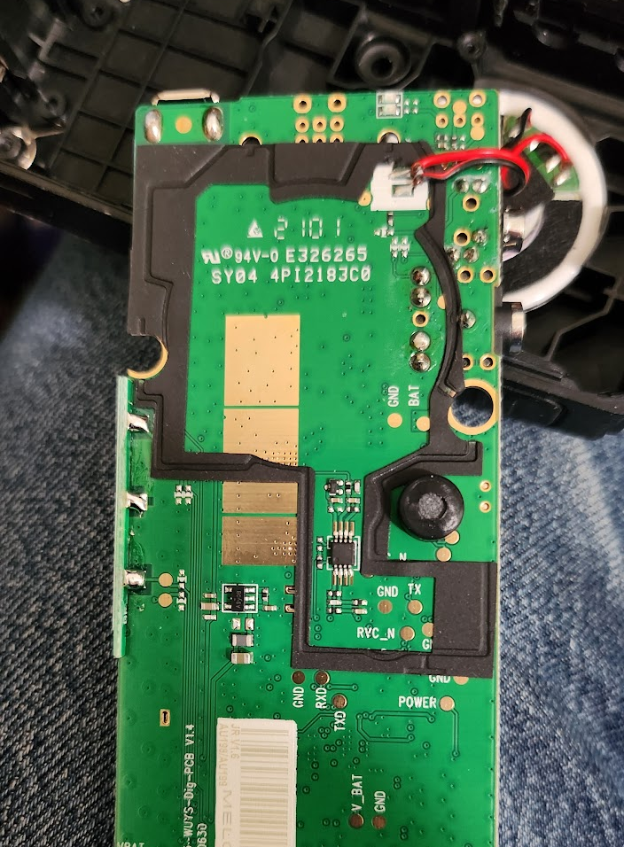
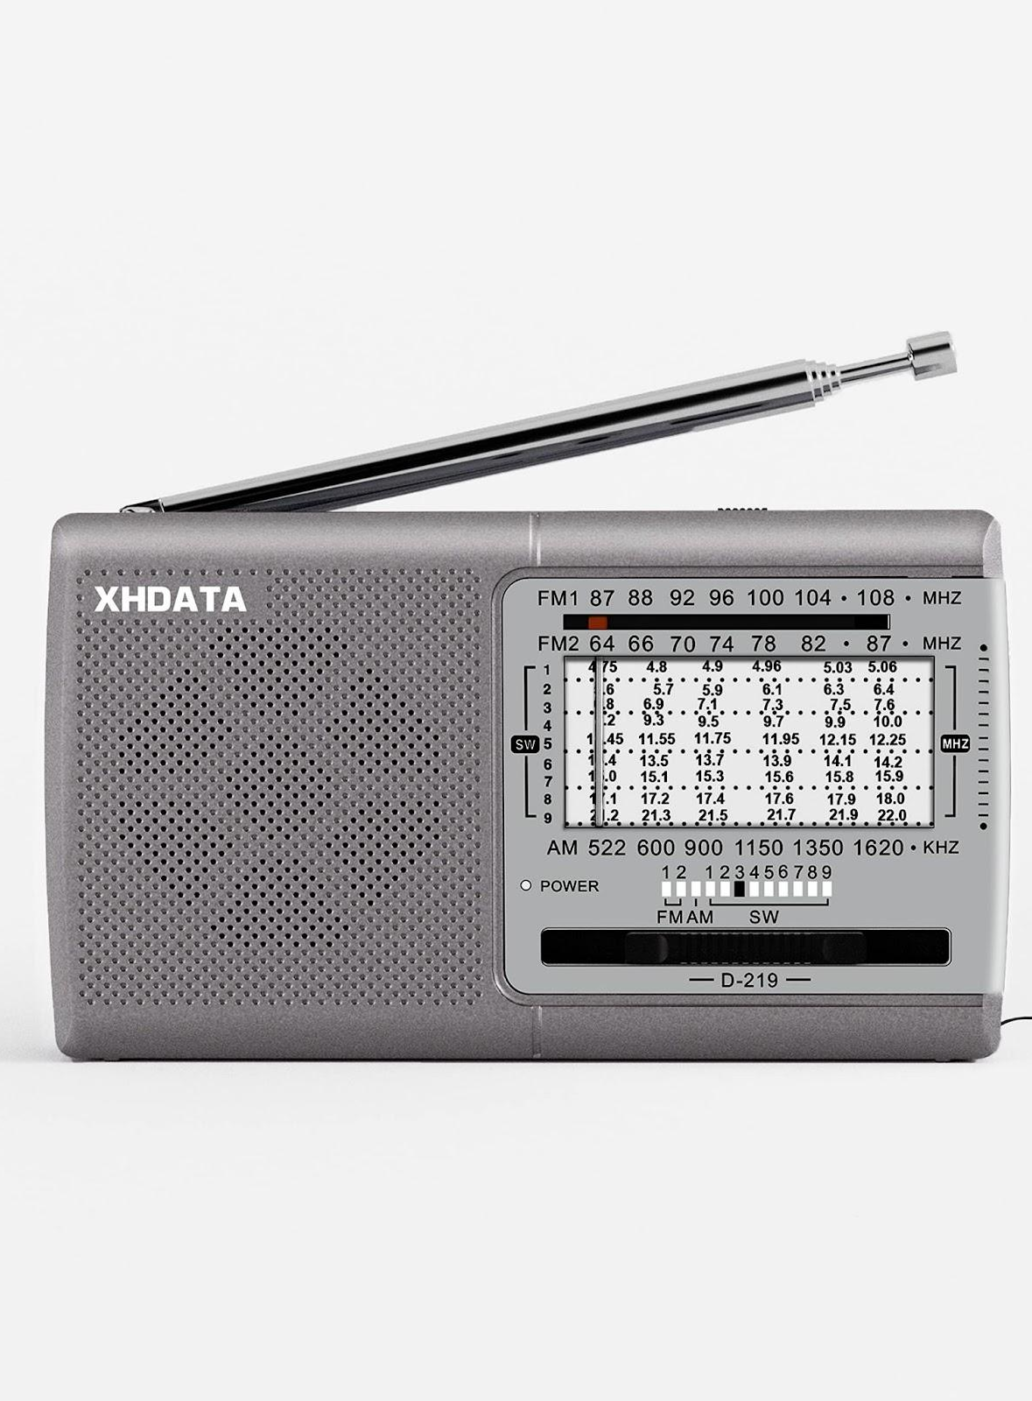
SOME DSP EXAMPLES

Slide 10
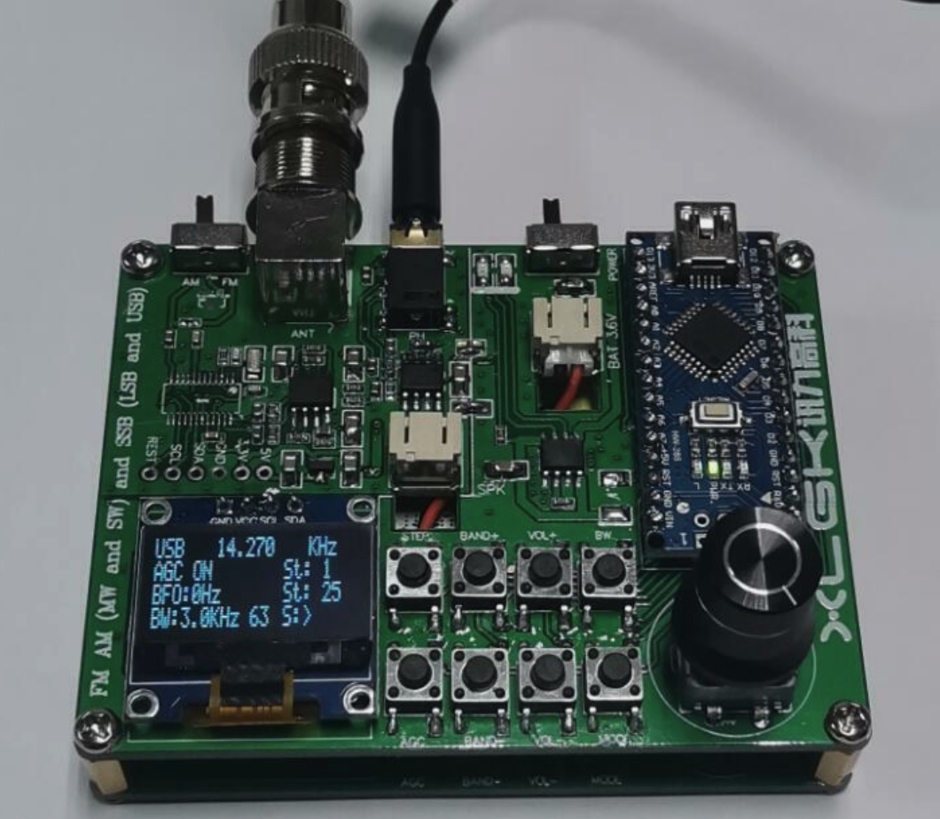
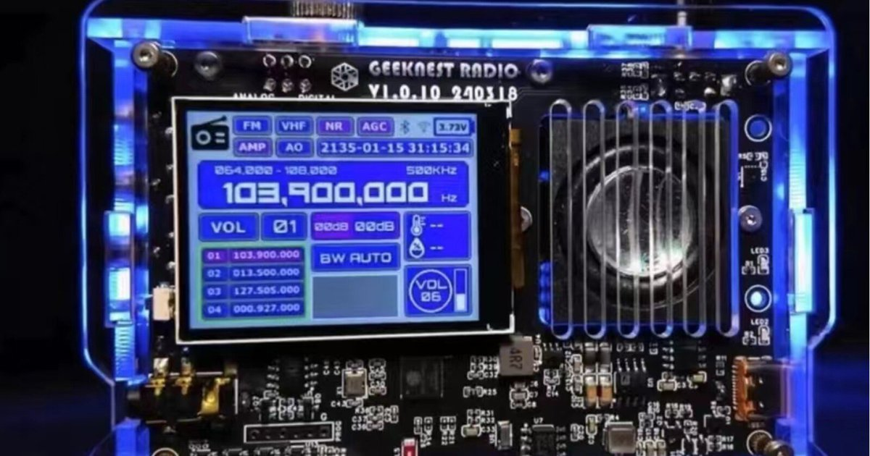
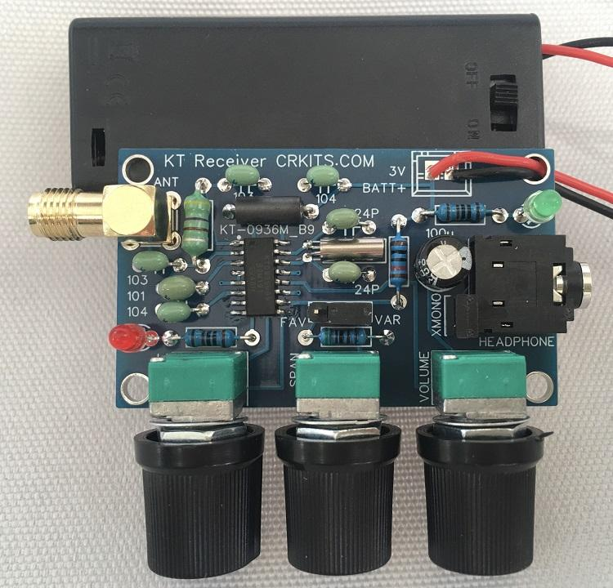
DIY DSP RADIOS
“V5A” Multi-band ESP-32 based radio
DIY Si4732 Receiver kit (eBay, AliExpress)
The CPK-3 from CRKITS.COM $14.50 from Adam Rong

Slide 11
MICROCONTROLLERS IN RADIO
Nothing new: PIC processors, Arduino
Not for actual processing of signals, but control and interfacing
Commercial radios using sdr with more advanced cpus (FPGAs)
IC-7300, FTDX 10, KX2
Four projects that went in different directions than this:
QDX/QMX from QRP-LABS – Hans Summers
Tr(u)-sdx from Manuel Klaerig and Guido Ten Dolle
sBitx / zBitx from HF Signals – Ashar Farhan
T-41 from 4SQRP – Jack Purdum and Al Peters

Slide 12
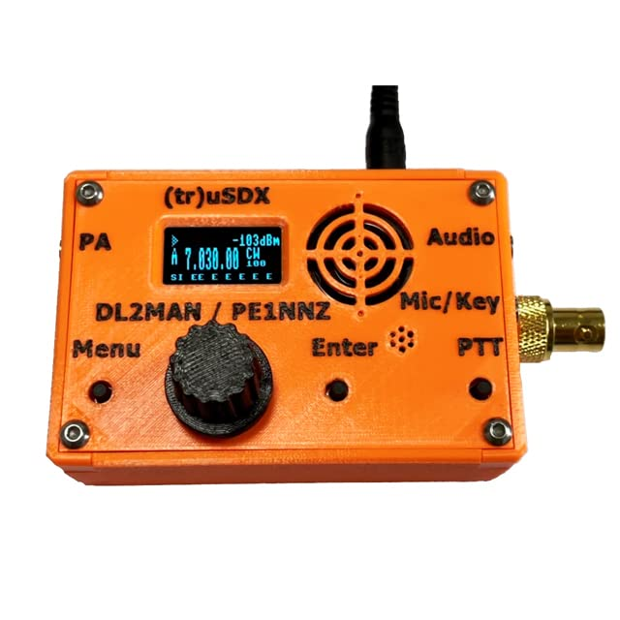
THE (TR)U-SDX: IT ALL STARTED WITH HANS SUMMERS – QRP-LABS
Hans brought us the highly-regarded and best-selling QCX which is not really an sdr transceiver but uses some of the same principles. Then, Guido and Manuel figured out how to modify the circuit into a full sdr transceiver using only the supplied atmega 328 processor (Arduino NANO). The firmware uses some serious trickery to pack a cw, and ssb transceiver into such a small package, but it works. It’s also VERY efficient. This project eventually evolved into the separate product the (tr)u-SDX. This radio costs $140 assembled, covers 80-20M with some decent features, all in a package about the size of a pack of cigarretes.

Slide 13
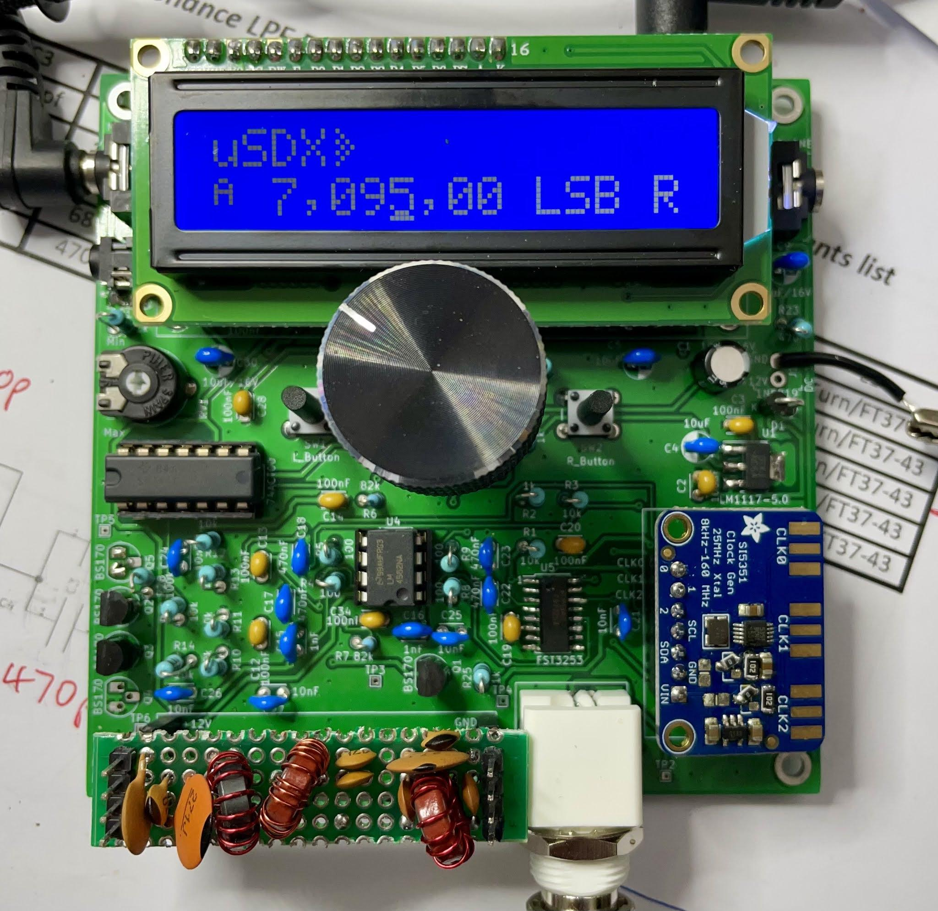
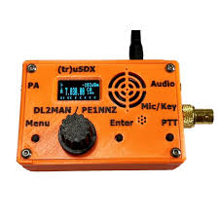
EVOLUTION: (TR)U-SDX
The QCX-SSB The uSDX The (tr)u-SDX

Slide 14
USDX TO (TR)U-SDX AND THE CLONE WARS
At the point where the uSDX was becoming a decent multiband rig, the Chinese clone manufacturers grabbed the design and started selling the uSDX/uSDR radios through eBay and AliExpress. The sourced design is decent, but there were problems with these radios (and still are). They changed some of the components without re-engineering the LPF circuits, so these radios are not as efficient, and may not be legal on all bands. They are also frequently poorly built and cannot be firmware updated without hardware modification. Manuel and Guido briefly considered ending the project since they were getting bombarded with requests to support radios that they were not selling or getting any sort of royalties for, and they did not want to be seen as responsible for these terrible radios. They CLOSED the project and locked the firmware to only officially produced or homebrewed radios based on their final design: The (tr)u-SDX
You can only update these radios with official firmware by providing a proper serial number

Slide 15
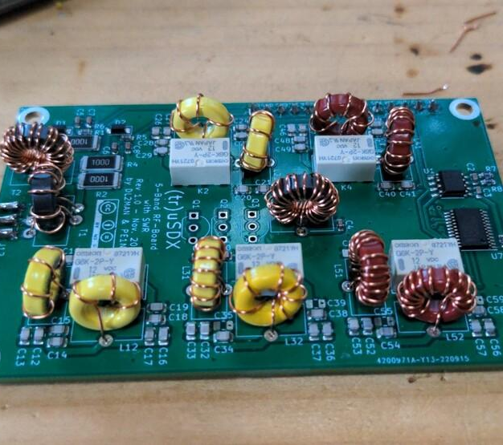
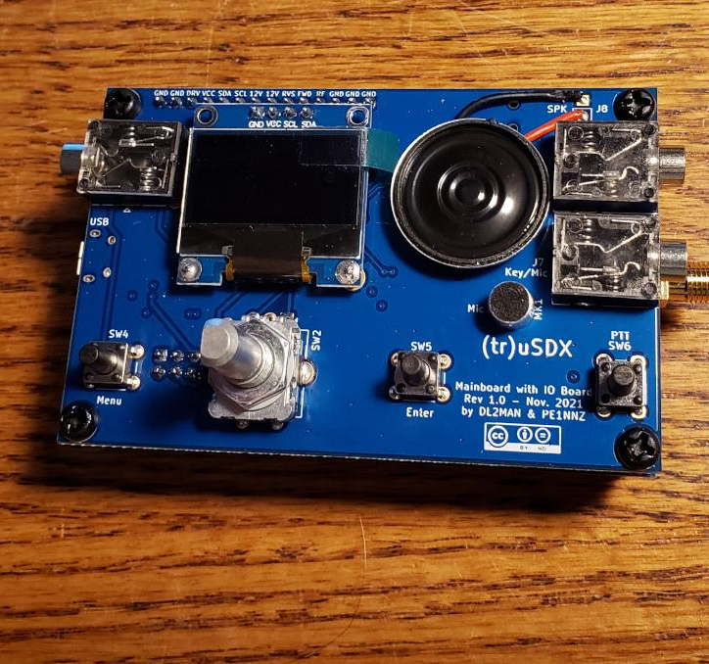
THE FINAL VERSION (STILL EVOLVING THOUGH)
80 – 20 Meters (classic 80 – 10, and highband 20 – 10 available as kits
5 Watts output CW and SSB (typically between 4 and 7) on 12V
750 mW output on 5V USB power. Fully USB upgradeable, and CAT
Built in mic. Pitch a resonant antenna, grab a battery and GO!

Slide 16
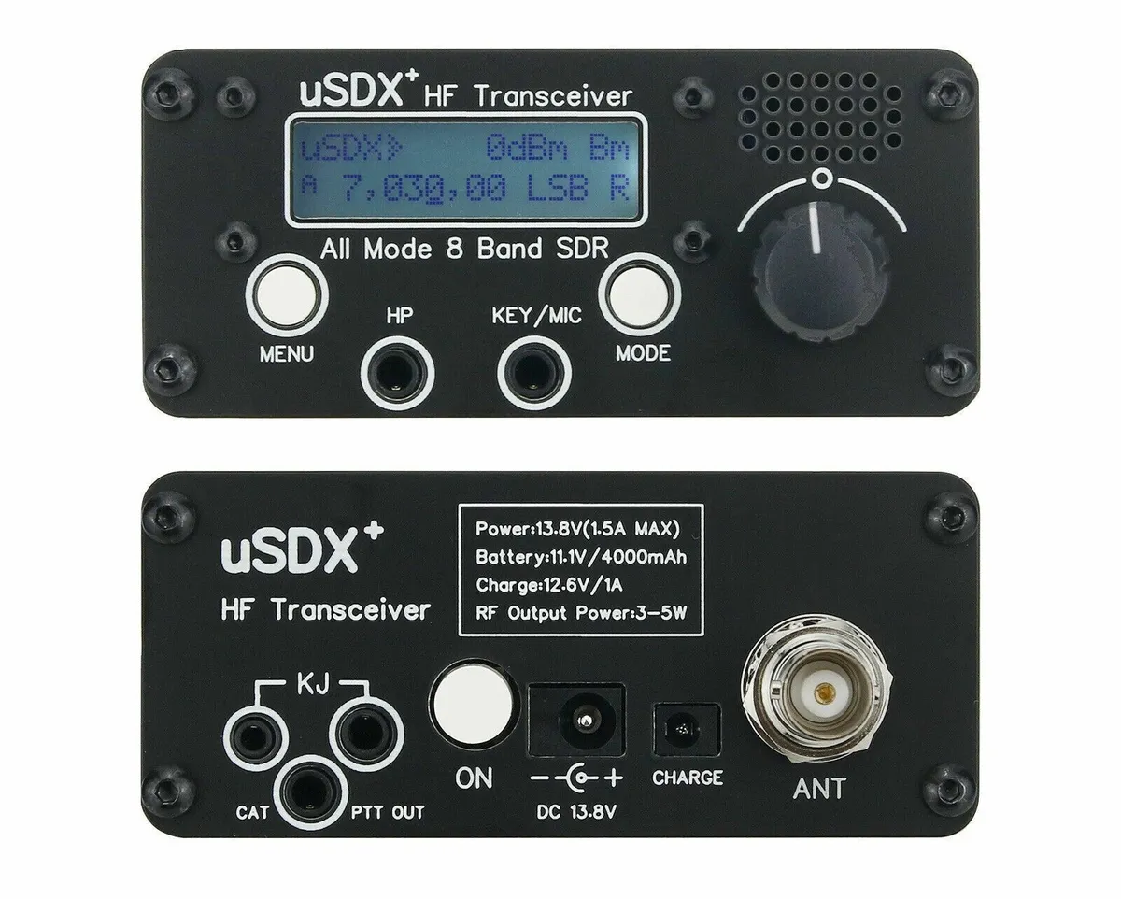
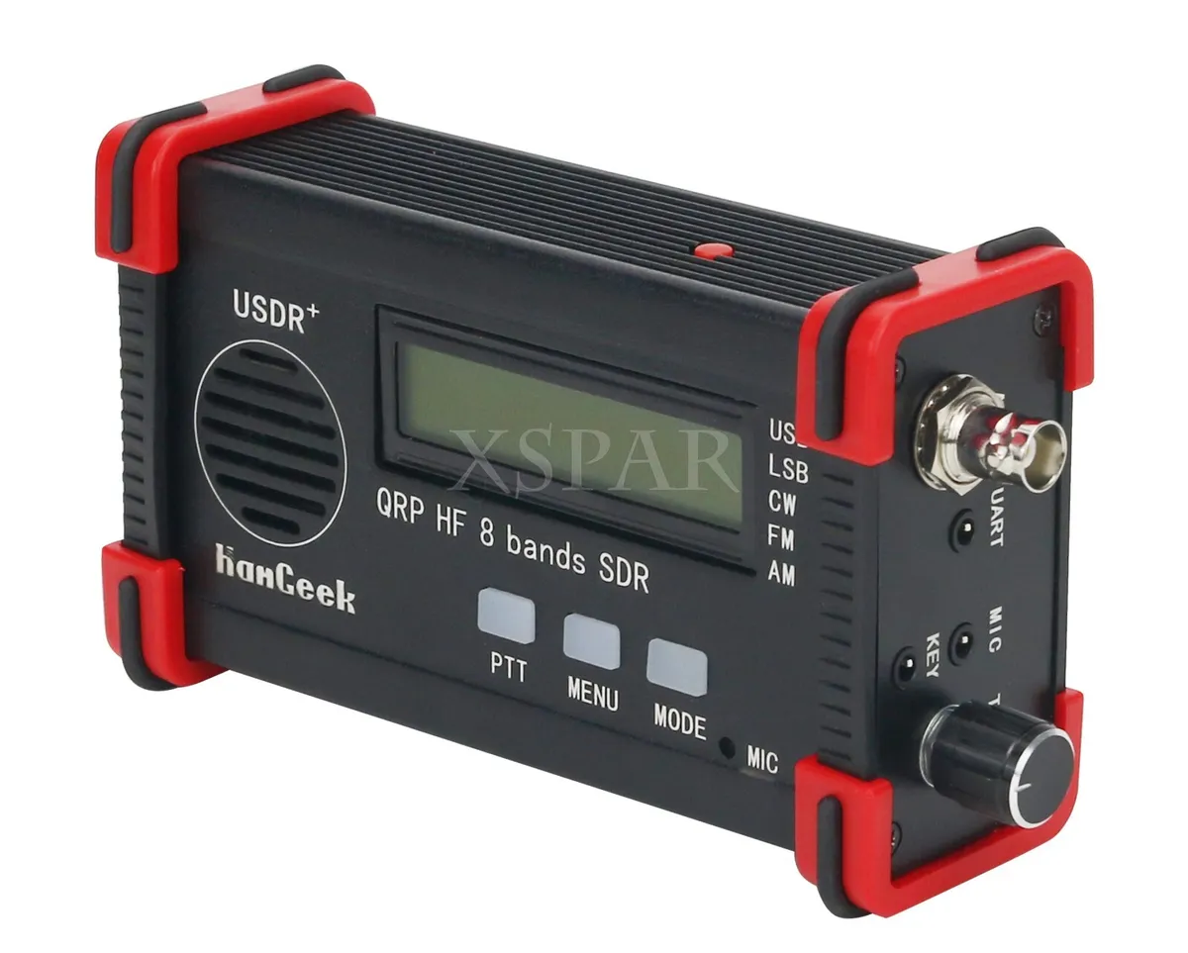
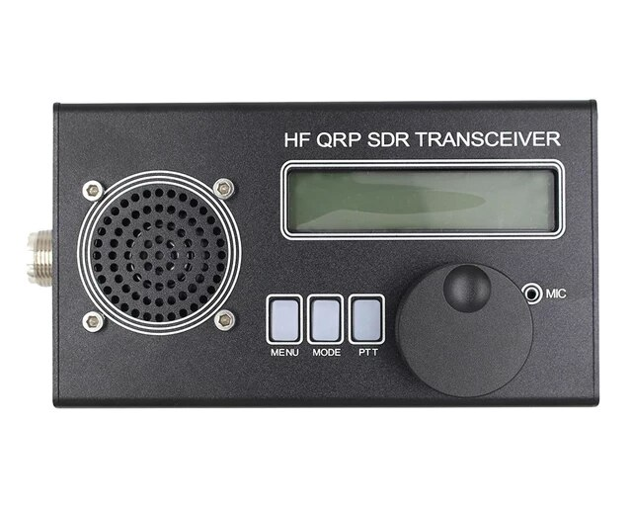
WHERE TO BUY?
Go to dl2man.de and look for “approved sellers” (next day from Amazon)
Beware of the clones!

Slide 17
QRP-LABS FROM HANS SUMMERS: QDX, QMX, AND QMX+

Slide 18
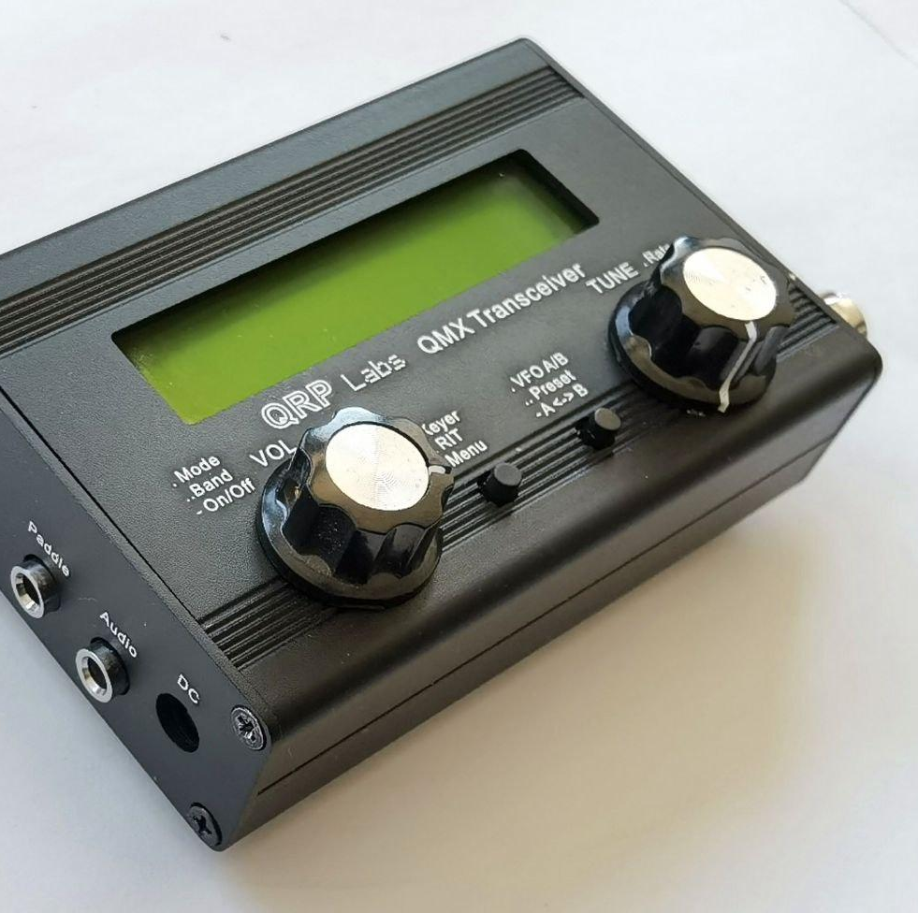
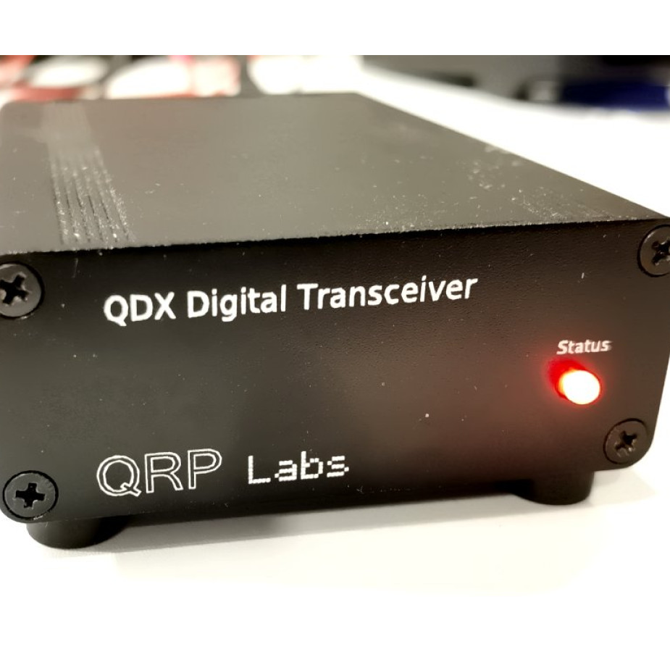
THESE RADIOS ARE SDR-BASED DIGITAL, AND (FOR NOW) CW OPERATION. SSB MAY ARRIVE THROUGH FIRMWARE UPGRADES
QDX: digital mode transceiver
STM32 Microcontroller
SDR based – will even operate as a usb-based SDR receiver
QMX: cw and dig mode transceiver
STM32 Microcontroller
Functions as BOTH QCX and QDX
May operate as SSB XCVR through future upgrades using similar theory to (tr)u-sdx
Tiny and Efficient!
QMX+ Larger and More Bands!
QRP-LABS.COM

Slide 19
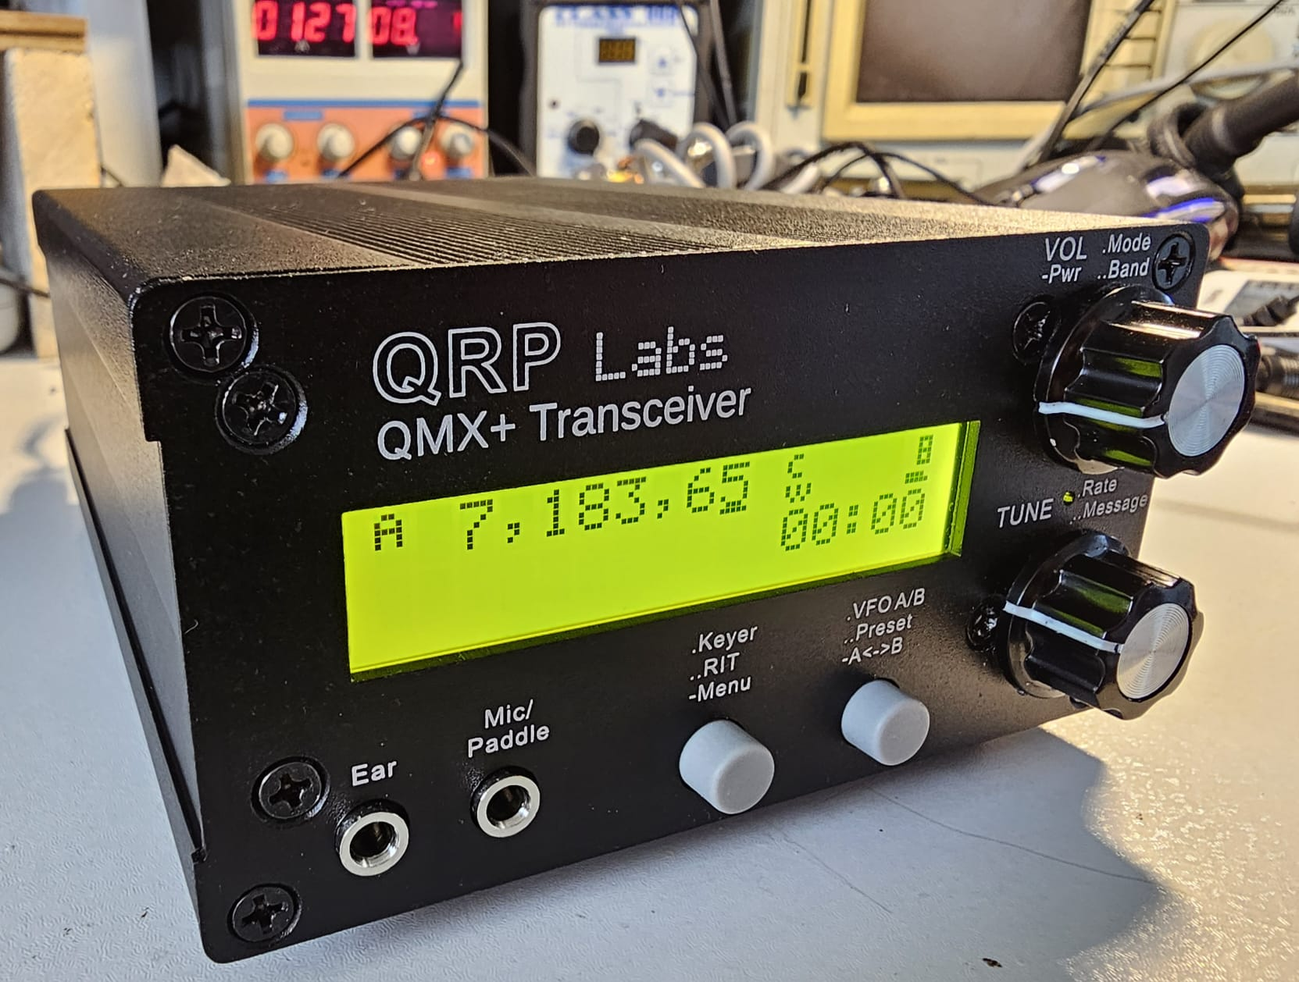
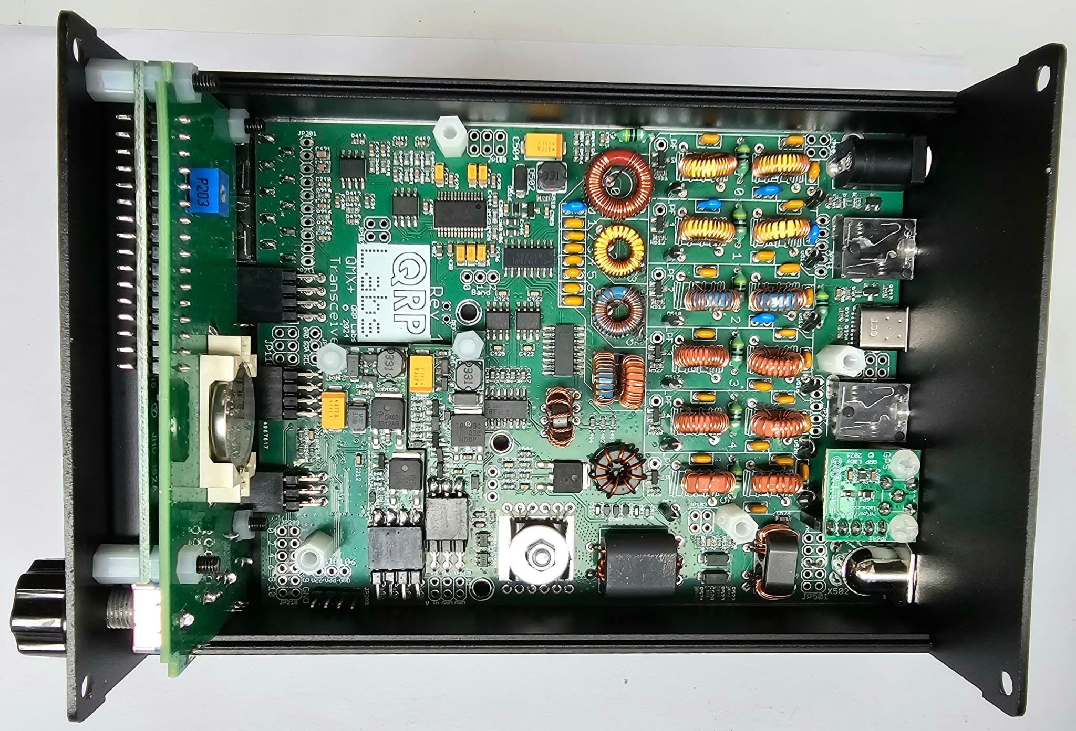
New QMX+ Larger, More Bands, SSB coming soon.

Slide 20
SBITX RASPBERRY PI-BASED SDR TRANSCEIVER

Slide 21
A LITTLE HISTORY
Ashar Farhan, VU2ESE designed the BITX transceiver about 20 years ago
It was offered as a homebrew design, and in kit form from several companies
Farhan started the company HF Signals in 2016 to build and sell his designs
The first product was the monoband BITX40 at $59. A modular kit
Then the uBITX multiband series, now at ver 6. A complete transceiver for $209
Now HF signals is selling the sBITX SDR transceiver. Version 3 complete for $429
$199 for the board only – you supply the case, display and Raspberry Pi

Slide 22
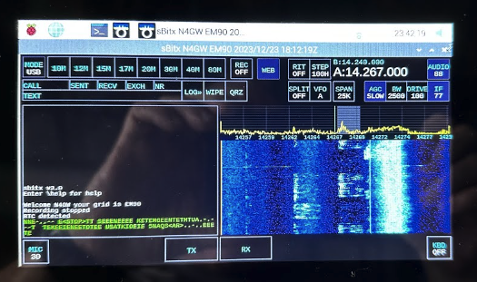
FEATURES:
7-inch touchscreen
Integrated logging
Fanless design
Band-stacking VFOs
Typical SDR features
Real Time Clock
Web-based remote operation
Second screen output
Built-in upgrade function
Complete with case, knobs, speaker
Easy assembly for board version
Fully modifiable code
Native FT8 (and other dig modes)
10 to 25 watts output 80 – 10 M

Slide 23
VERSION 3 INTERFACE

Slide 24
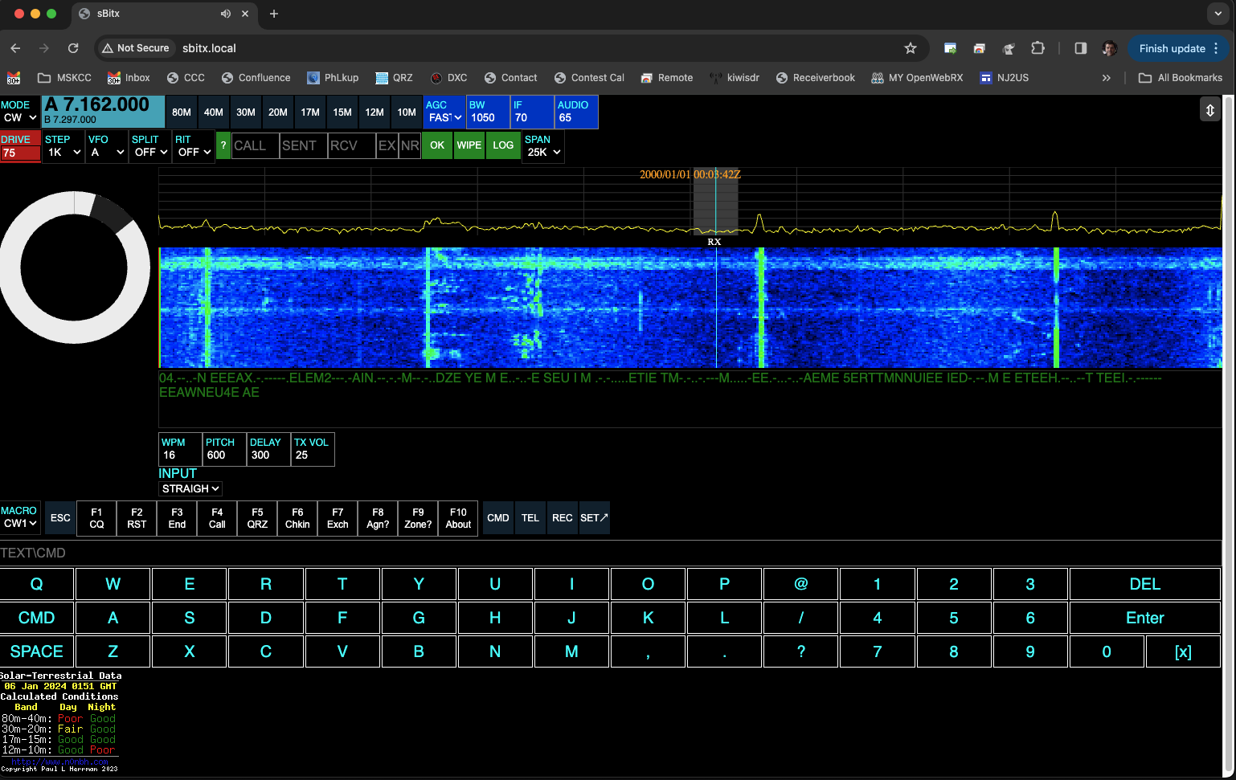
VERSION 3 WEB INTERFACE

Slide 25
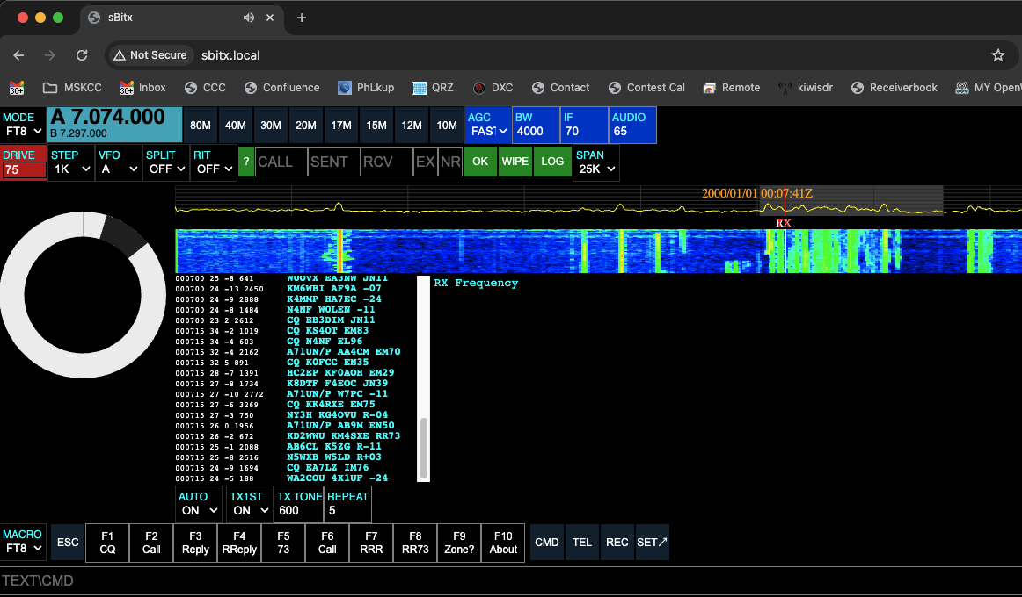
NATIVE FT8 CLIENT

Slide 26
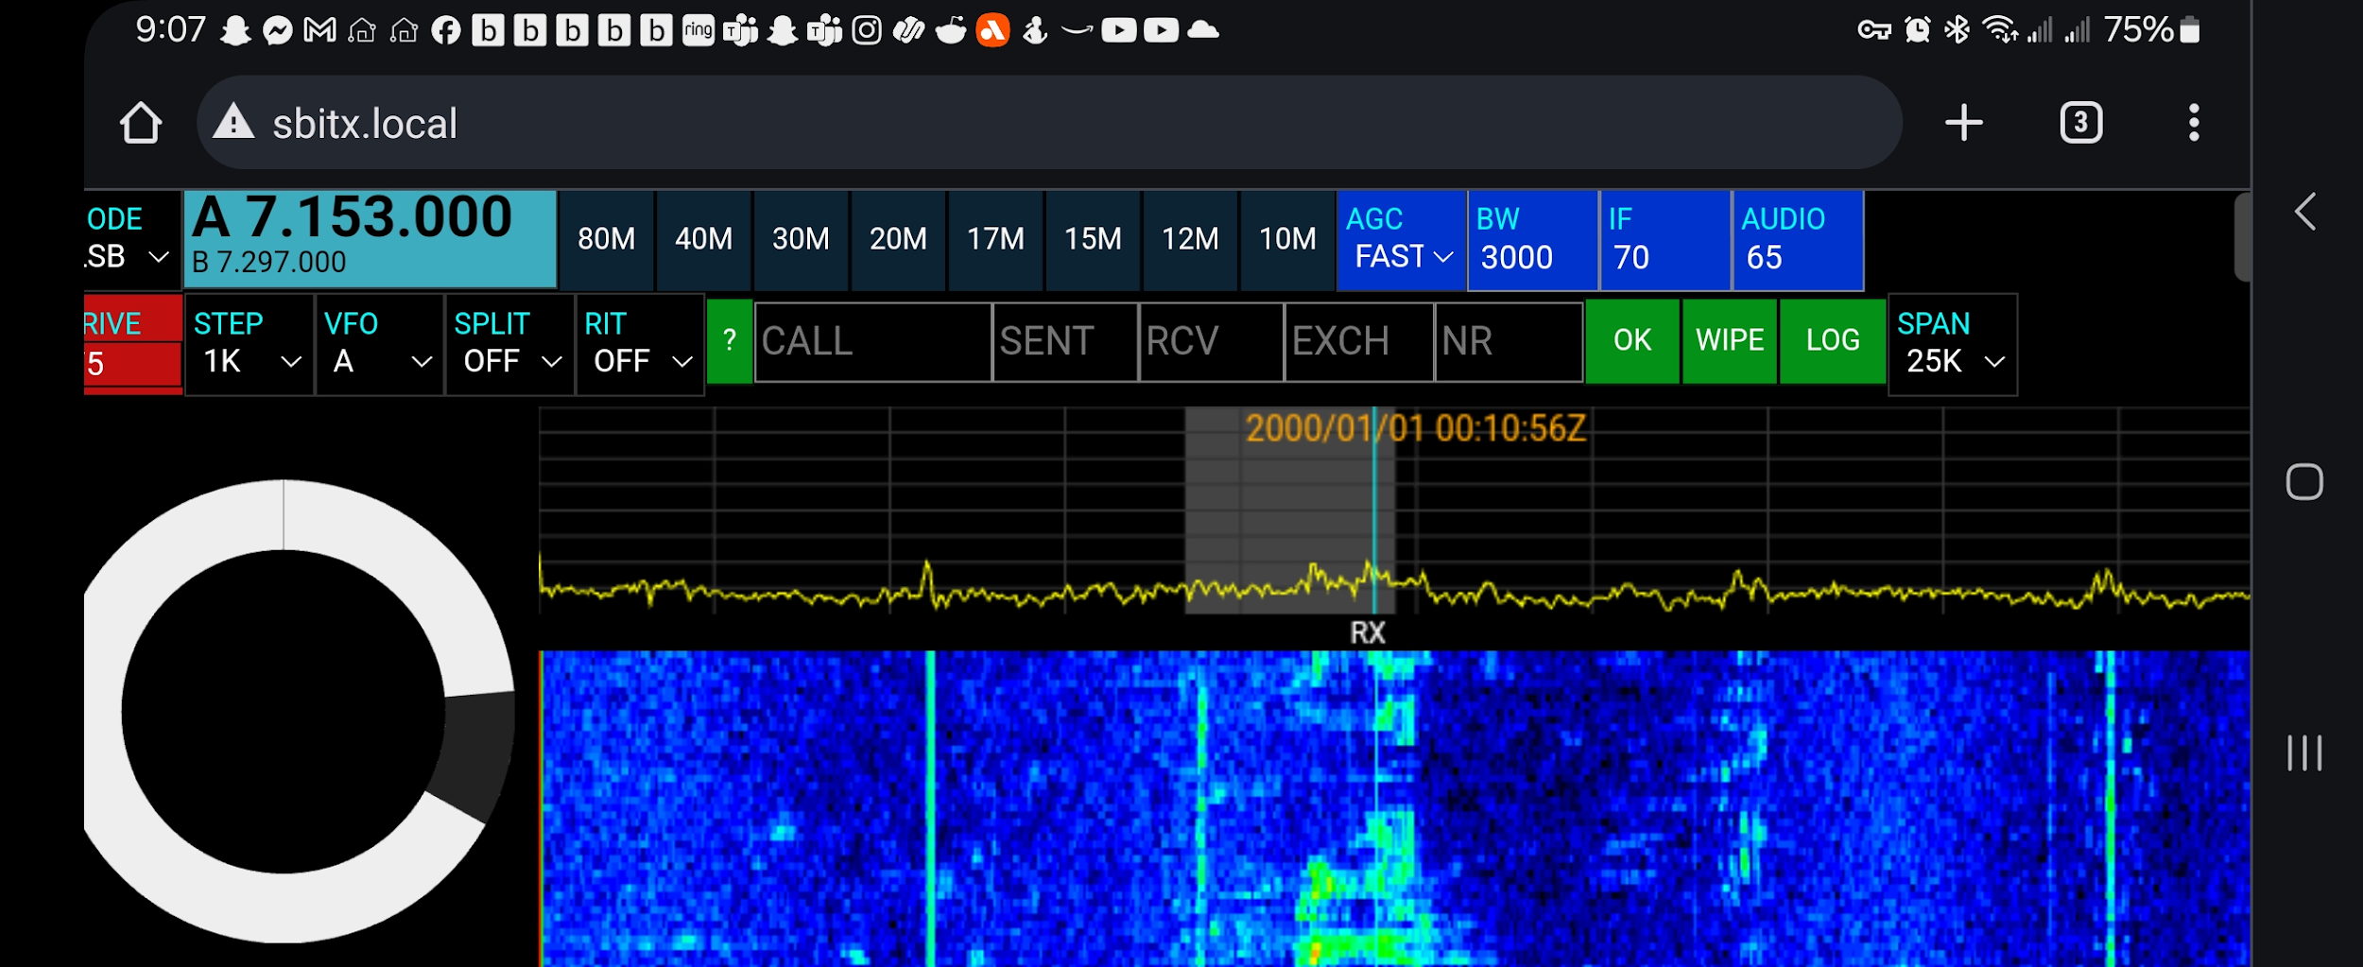
ON A CELL PHONE OR TABLET
HFSIGNALS.COM

Slide 27
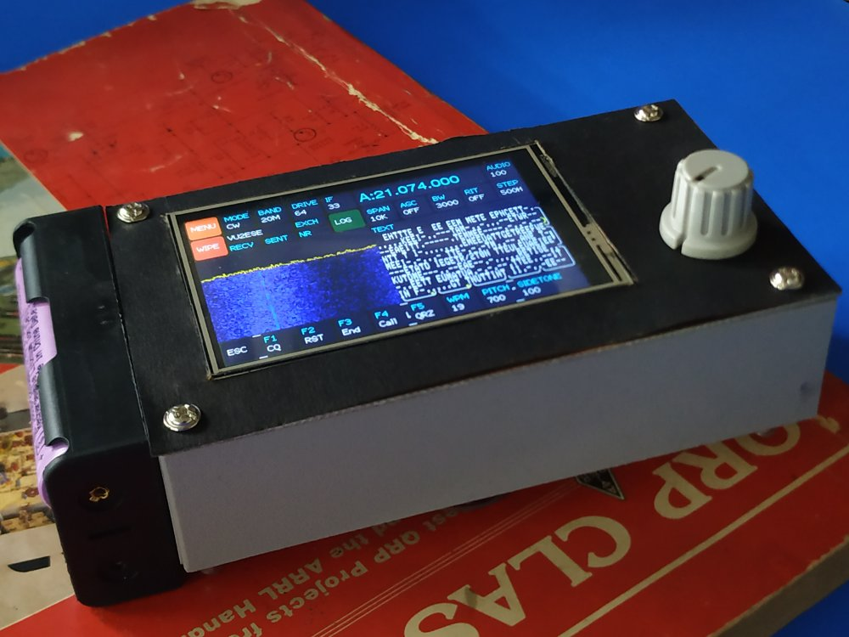
NEW!!! zBitx
5.5” x 3” x 1.25”, 250gms/9 ounces
capable of 10 watts of power from two standard 18650 batteries

Slide 28
4SQRP T-41 TRANSCEIVER BY JACK PURDUM AND AL PETERS

Slide 29
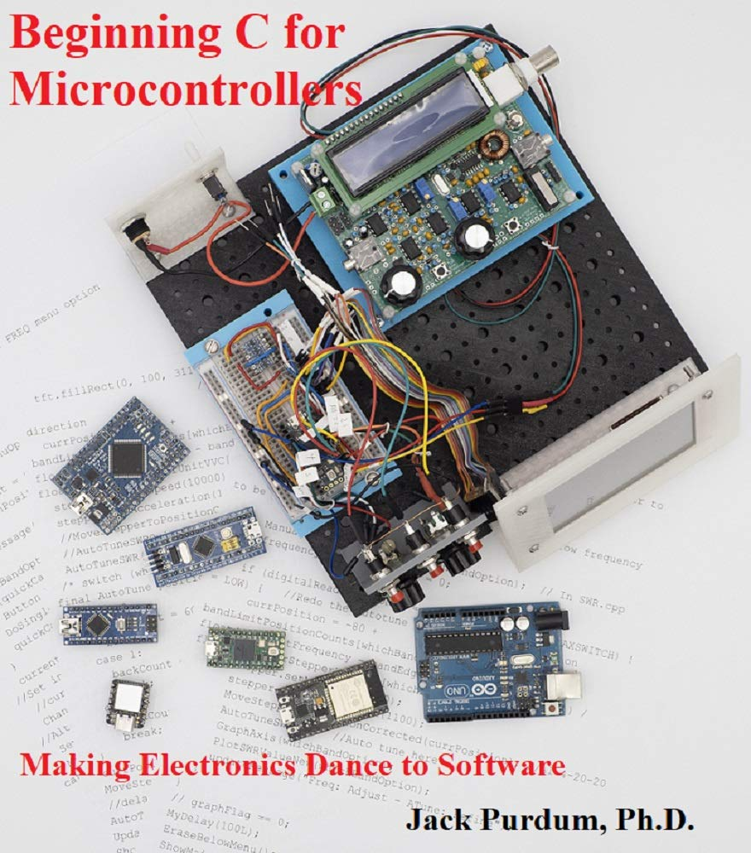
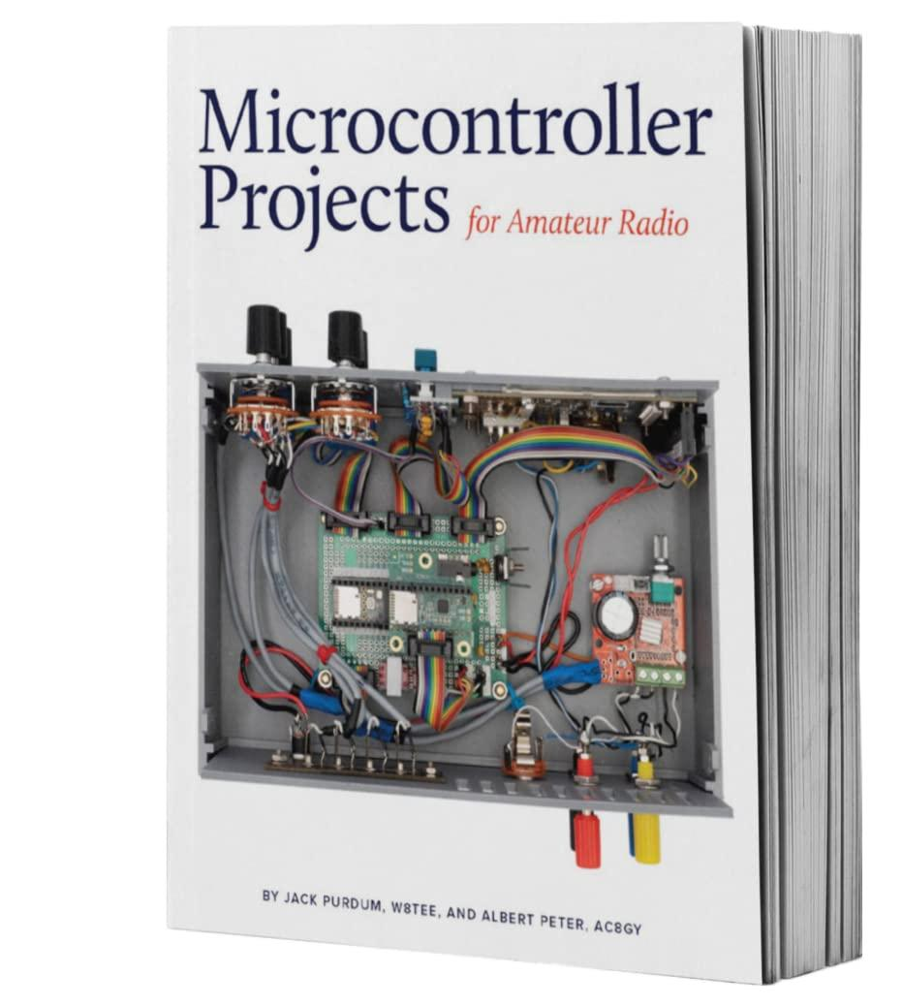
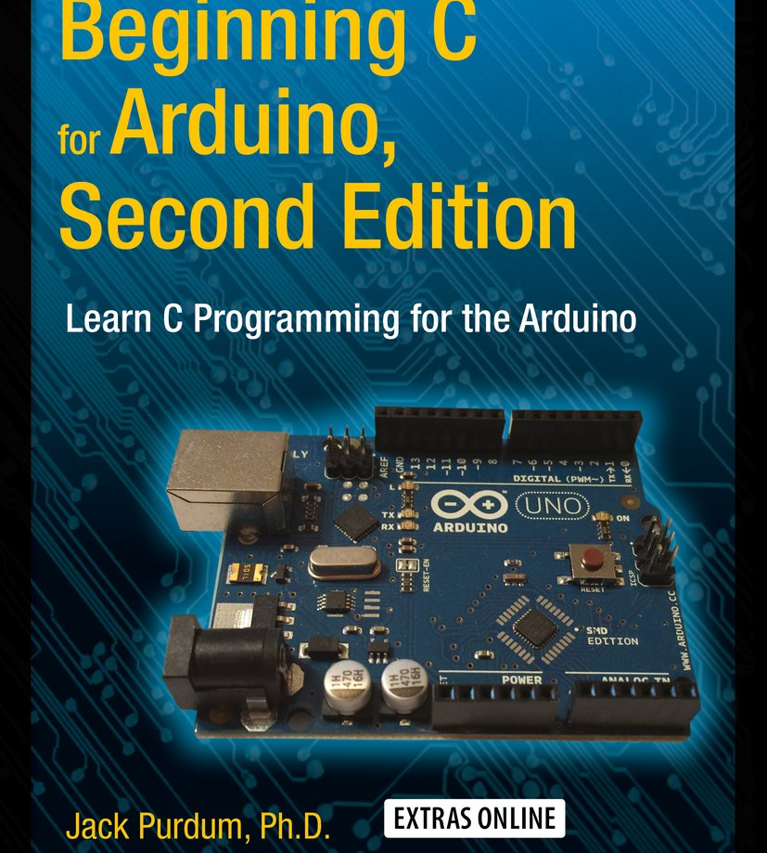
JACK IS THE AUTHOR OF SEVERAL BOOKS ON PROGRAMMING AND MICROCONTROLLER PROJECTS FOR HAM RADIO

Slide 30
JACK AND AL HAVE COLLABORATED ON SEVERAL PROJECTS AND HAVE WRITTEN A BOOK TOGETHER ABOUT THE T41 PROJECT

Slide 31
SEVERAL PEOPLE BEGAN PRODUCING BOARDS AND SHARING PROGRESS ON HOMEBREWING THE T41. THEN 4 STATE QRP DECIDED TO KIT THE RADIO

Slide 32
MODULAR DESIGN FOR EASY UPGRADES

Slide 33
VERY RICH FEATURE SET 80 -10 LESS 30 AND 60 M 20-WATT OUTPUT ADJUSTABLE DOWN TO 1 WATT
Based on the Teensy 4.1 Microcontroller
5” Color display (non-touch)
192 Khz waterfall and spectrum display
Too many features to list!
First run of kits is sold out
Order boards and get BOMs from the groups.io group: softwarecontrolledhamradio
Watch 4SQRP for the next kit run

Slide 34
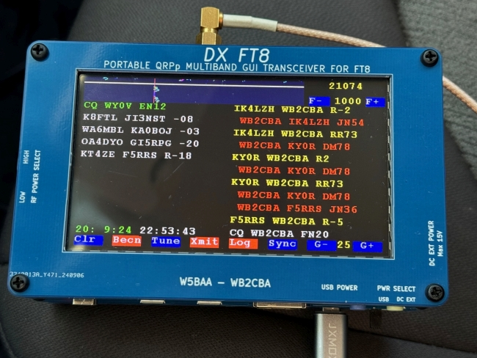
Something New: DX FT8
Touchscreen Interface
5 Band FT8 Transceiver
Interactive and Auto “Beacon” Modes
Saves ADIF log to micro-SD
Evolving Firmware
Runs on 5V USB or 5 – 15V AC Adapter

Slide 35
CONTACT W2NDG
neil@neilgoldstein.com
Presentations will be posted on neilgoldstein.com : Click on “FOFIO”

