Slide 1
Radio Frequency Transformers Theory, Construction, and Testing, and their applications in Ham Radio Mike Kozma WY2U

Slide 2
Transformers:
Magnetically Coupled Inductive Networks:
Step Up or Down Voltages and or Currents
Provide Impedance Matching between a Source and Load
Provide Isolation between a Source and Load for Common Mode Currents
Combine all in one circuit

Slide 3
Generally there are two main types of transformers for RF applications:
Conventional Transformer – where the coupling path is solely done by magnetic flux linkages, usually by inducing flux into a ferromagnetic core material.
Transmission Line Transformer – where the coupling is via a TEM (transverse electro magnetic) wave induced by proximity between conducting media, (e.g. coaxial cable or twisted pair wire) A ferromagnetic core may or may not be required.

Slide 4
Conventional Transformers generally are used in lower power RF applications, tuned circuits, where high efficiency is not a main concern. Core materials can be powered iron or ferrite, depending on the application. Efficiencies can approach 90% in some circuits.
Transmission Line Transformers are used when high efficiency is required, in addition to compact size. They can be broadband devices spanning many octaves in frequency. Efficiencies can approach 98% or better. Powdered iron usually is not used for high power applications.

Slide 5
Transformer theory – the Ideal Transformer:
Ideal transformer is 100% efficient, no resistive loss, coupling coefficient is unity, and no parasitic inductive or capacitive reactives to limit the bandwidth.
Consider only two windings, primary and secondary, and a Resistive load.
Since there are no losses, Pin (primary power) = Pout (secondary power)
Primary voltage and current are v in and i in respectively, and
Secondary voltage and current are v out and i out

Slide 6
Ideal Transformer continued …..
Primary Power = v in x i in, and,
Secondary Power = v out x i out
Since there are no losses:
P primary == P secondary,
v in x i in == v out x i out
Recall that the voltage relationship between Primary and Secondary is governed by the turns ratio, N
N = number of secondary turns / number of primary turns, or
N = Ns / Np

Slide 7
Ideal Transformer

Slide 8
If N >1 step up transformer
N < 1 step down transformer
Since P in == P out, then i out = i in / N
Since Resistance (also valid for any impedance, Z) = v /i, then
Z in = v in / i in; Z out = v out / i out,
since: v out = v in x N and i out = i in / N; then:
Z in / Z out = (v in / i in ) / (v in x N / i in / N )
Or Z in / Z out = 1 / N²
Z out = Z in x N²

Slide 9
Therefore, the transformer can be used to transform (match) impedances by controlling the turns ratio
Examples:
A transformer with a turns ratio of 2 can transform an input impedance of 50 ohms to an output impedance of 200 ohms;
(4 times 50)
A turns ratio of 3 will match a 450 ohm load to 50 ohms
A turns ratio of 0.25 will match a load of 12.5 ohms to 50 ohms, etc.

Slide 10
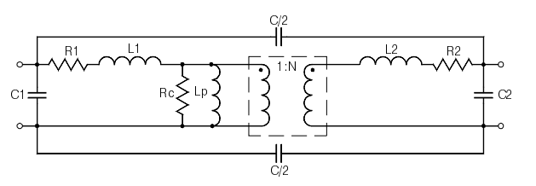
Practical Transformer
The actual transformer consists of several embedded circuit elements that limit power handling capability and frequency response.

Slide 11
Area in dashed line border is Ideal Transformer
R1 and R2 primary and secondary wire losses
Rc Core Loss Resistance
L1 and L2 Leakage inductances
Lp magnetization Inductance
C1 and C2 shunt input and output parasitic capacitances
C/2 are inter-winding capacitances

Slide 12
Leakage Inductance – Equivalent Inductance that does not contribute to flux coupling. Leakage inductance contributes to transformer insertion loss by magnetic field expansion, whereas, Core Loss and Wire resistances conversely are thermal losses. Magnetization Inductance – the inductance due to the windings and permeability of the core material. Magnetization inductance determines the low end frequency response of the transformer. The input , output, and inter-winding capacitances determine the high frequency response of the transformer.

Slide 13
Leakage Inductance is significant in a conventional
transformer, as much as 10% to 20% of the total circuit inductance.
It does not contribute to transformer temperature rise, but limits
the coefficient of coupling between the primary and secondary windings.
It generates an external magnetic field surrounding the
Transformer, and produces a vector field that does not align with the
axis between primary and secondary windings.
In addition, leakage inductance subtracts from the calculated
magnetization inductance limiting the low end frequency response.
The parasitic capacitances are due to the physical geometry of the
windings, stray coupling, and mounting.
Also, the conventional transformer depends on infusing flux through
the core; the core introduces losses due to eddy currents, where some
magnetic poles do not properly align within the core material. These eddy
currents produce an in-phase voltage drop producing heat.

Slide 14
Conversely, a transmission line embeds inductance and capacitance between wires as part of the line Characteristic Impedance. Therefore, leakage inductance and external parasitic capacitances are much less in a transformer when transmission lines are used as couplers. Coupling is very close to unity, (typically 0.98 to 0.99), so leakage inductance is typically less than 2% of the total circuit inductance; magnetization inductance is 99% calculated value base on core permeability.
Also, much lower flux flows through the core, since most of the coupling is between wires in the transmission line.
This allows for the design of a high power transformer using surprisingly small cores.

Slide 15
History of Transmission Line Transformers:
Gustav Guanella (1944) introduced a new technique for balanced transformer
design (Baluns), by forming transmission lines into a coiled structure
to improve bandwidth and balance. Prior to his design study, baluns
used half wave or quarter wave structures to transition from unbalanced
to balanced, and suffered from poor performance and narrow bandwidths.
His design goal was to construct a 16 to 1 step-down transformer to match
a 100w VHF push-pull vacuum tube amplifier, with a 960 ohm
output impedance, to a 60 ohm coaxial transmission line.
Measured data on his prototype was within 10% of his calculated values
from 100 to 200 MHz, which validated his design.
His approach was to use four 240 ohm transmission lines connected
in series at the high impedance side, while combining the lines in parallel
at the low impedance side.

Slide 16
Guanella 1: 1BALUN Building Block:

Slide 17
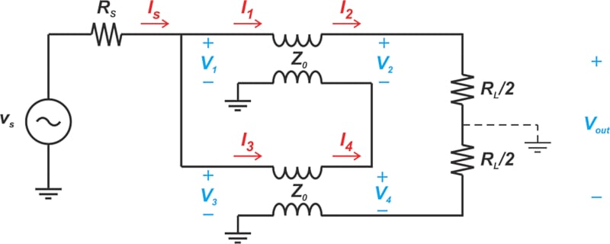
Guanella’s 1: 4 prototype building block is shown in the following figure:
Guanella connected 4 of these prototype networks in series /parallel
to achieve the 1 to 16 balun network.

Slide 18
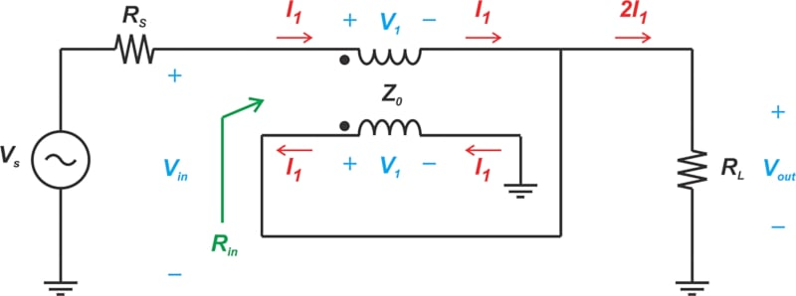
Clyde Ruthroff (1959) introduced a new approach to the transmission
line transformer, by summing a direct travelling voltage with a delayed
voltage in a single transmission line. His novel approach yielded a 1:4
building block that could function as an unbalanced to unbalanced
(UNUN) network, or BALUN, depending on the external connections.
His 4:1 UNUN prototype is depicted in the following figure:

Slide 19
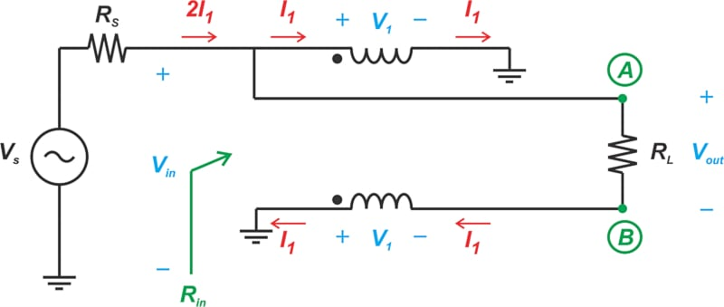
Ruthroff’s 1:4 Balun prototype connection is shown
in the following figure:

Slide 20
Autotransformer Discussion:
The Autotransformer is a version of the Standard transformer which
uses a single continuous wire instead of a separate primary and
Secondary winding.
A tap connection on the wire forms either the input
or output terminal (tap input for Step-up, tap output for Step-down).
The turns ratio (N) is the total number of turns divided by the
number of turns from tap to common.
N = N total / N tap
Voltage, Current, and Impedance relationships are the same
as the Standard Transformer.
N can never be equal to unity, because of the tap.
Note that the Ruthroff designs are actually transmission line
versions of the Autotransformer.

Slide 21
UNUNS
Commonly used to transform impedances from Antennas with a common return (Ground Mounted or Counterpoise) to unbalanced coaxial cable.
They provide impedance step up or step down depending on how they are connected
Usually uses the Ruthroff transformer design in conjunction with a ferrite core material.
UNUN Parameters:
Impedance matching ratio
Frequency Range
Insertion Loss
Power Capability
VSWR limits
Core type, size, and material
Wire type, gauge and insulation type
Operating Environment / temperature range

Slide 22
Build your own ... Design Procedure
Initial Design Investigations
Impedance Ratio (Step up or Step Down) (Determine the type and gauge of wire, as well as tap location)
Frequency Range (help determine the core type and core material, as well as indirectly determining total number of turns and wire gauge)
Insertion Loss – Power Level (to determine the core size and type)
VSWR Limits
Operating Environment (Indoor / Outdoor/ Enclosure, etc)
Iterative process, may require several back and forth attempts

Slide 23
Design Choices for Transformer Core
Ferrite Rod or Toroid?
Measurements show no significant performance differences between the two
But points to consider ……..
Little magnetic property data exists for ferrite rods, whereas manufacturers
decided to focus on toroids
Because of this, the users must obtain their own data by measurements to support
a rod design
Also, external component placement in a rod design is more critical than for a toroid,
since the rod has a leakage magnetic field like a bar magnet, whereas a
toroid mostly confines the leakage field within the material

Slide 24
Fine Tuning the Design
Determine total number of turns for required Magnetization Inductance:
Based on selected VSWR limit, calculate the minimum Inductive Reactance (X_{L}, at
Lowest Frequency, and Maximum Impedance:
VSWR Limit Minimum X_{L} at f min
2.0 2.5 x Z max
1.5 4.0 x Z max
1.2 8.0 x Z max
1.1 10.0 x Z max
Calculate minimum Inductance (nano Henries) based on X_{L}:
L nh= 1000 x X_{L} / (2 x Pi X f min)
where f min is MHz, L in nano henries
Determine total number of turns based on core AL value:
N total = √ L nh / AL
Table of Common Core AL values given on next slide

Slide 25
AL values for common Toroid Cores:
Toroid P/N Material Mix Size ( inches OD) AL value +/- 20%
FT50-43 43 0.5 440
FT50-61 61 0.5 69
FT82-43 43 0.825 470
FT82-61 61 0.825 79
FT114-43 43 1.14 510
FT114-61 61 1.14 75
FT140-43 43 1.40 850
FT140-61 61 1.40 150
FT240-43 43 2.40 1075
FT240-52 52 2.40 330
FT240-61 61 2.40 170
AL = nano Henries per Turn squared, then:
____________
L nh = N² x AL or N = √ L nh / AL
L nh is Magnetization Inductance, and N = number of turns

Slide 26
Number of Turns cont …..
The maximum turns number appears across the highest impedance side of
the transformer, but is not necessarily the number of turn passes through the core.
For example, consider a 1:9 unun for a 50 ohm to 450 ohm transformer, that must operate down to 3.5 MHz, with a VSWR no greater than 1.5. An FT140 Mix 61 was tentatively selected for the core, with an AL value of 150. From the VSWR chart, the
minimum inductive reactance must be 450 x 4 = 1800 ohms.
Solving for Inductance in nano henries:
L = 1000 x 1800 / (2 x Pi x 3.5)
L = 81890 nH
__________
Then N = √ 81890 / 150 = 23.36 turns, rounded up to 24 turns
___
The unun is a 1: 9 impedance step up, therefore the turns ratio = √ 9 = 3.
Since 24 turns are required, the unun will be constructed with a trifilar winding,
with 24 / 3 = 8 turn passes through the toroid.

Slide 27
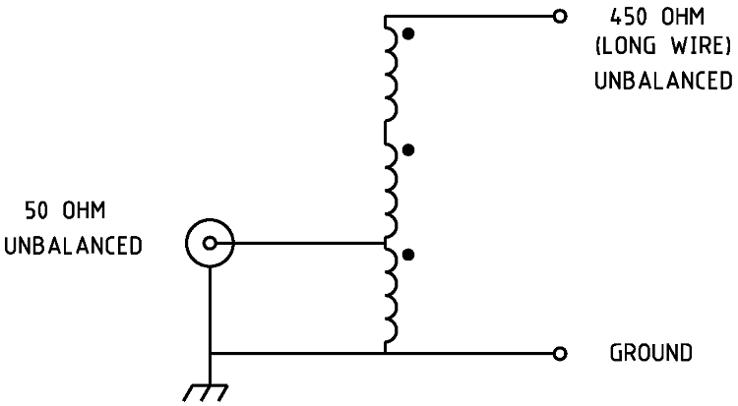
The 1:9 UNUN schematic is depicted in the following figure:

Slide 28
1:9 UNUN Circuit Description:
This 1:9 unun is constructed using a 3 wire twisted transmission line (trifilar),
where the dots in the figure depict nodes of the same phase. It would be
convenient to use 3 different colors for the wires to aid in connecting.
Thus, if the top wire is red, middle wire white, and bottom wire blue:
Red start end (dot) is output (high side, 450 ohms)
Red finish connects to White start (dot)
White finish connects Blue start (dot), and is the input tap connection for 50 ohms
Blue finish is ground
Did not yet consider power capability or wire gauge,
whether wire fits on core, maybe use a different core, etc.

Slide 29
Session # 2 Continuing with UNUN Design …..
Next step is determine if our chosen core is suitable for our rated power:
Add a Power Spec and mode :
500 watts SSB from 3.5 Mhz to 30 MHz
Following table shows maximum linear flux vs frequency for ferrite materials:
Frequency (MHz) |  | Ma Linear flux (gauss)
0.1 |  | 500
1 |  | 127
3.5 |  | 80
7 |  | 60
14 |  | 46
21 |  | 41
30 |  | 37

Slide 30
Maximum Linear Magnetic Flux for a ferrite material is given as:
Flux units are Gauss, performed at multiple Frequencies, and results
are compared to the maximum values listed in the prior table .
This equation applies to sinusoidal voltage input, it must be modified
to accommodate other waveforms (e.g. SSB)
Calculations are facilitated using a computer spreadsheet.

Slide 31
Flux units greater than the maximum indicate that the core is operating in
a non linear region, which produces distortion, and in severe cases, burnout.
Linearity threshold is defined as the point on the transfer function curve where flux
is 1 dB below the best linear straight line (1 dB compression).
Refer to the following graph, showing compression and saturation
on a normalized transfer function.

Slide 32
When the ferrite operates below the 1 dB compression point, core temperature rise
should be a minor concern (will be qualitatively tested later)
Curie Temperature limit – physical quantity of ferrite material.
Ferrite materials change characteristics from ferromagnetic to paramagnetic
(become slightly magnetized, and lose some of their permeability) when ferrites
reach their Curie Temperature
Curie Temperature is different for different ferrite mixes, but usually well above
200 degrees C.
Hams need not be concerned about Curie limits because our power levels and
operating environments should be well below Curie. It is mentioned only for
information purposes.

Slide 33
Spreadsheet Data for FT140 mix 61 core (500 watts, PeP, SSB mode)
3.5 Mhz 80.29 Gauss vs 79.5 Gauss max (marginally out of spec)
7 MHz 40 Gauss vs 61 Gauss max
14 MHz 20 Gauss vs 47 Gauss max
18 MHz 15.6 Gauss vs 42.7 Gauss max
21 MHz 13.3 Gauss vs 40.25 Gauss max
25 MHz 11.24 Gauss vs 37.7 Gauss max
30 MHz 9.37 Gauss vs 35.15 Gauss max
Marginal performance at 3.5 MHz
Design Alternatives:
1 Examine other core mixes or choose larger core, re-evaluate
using spreadsheet
2 Stack two FT140 mix 61 cores , new AL value ≈ 1.8 x AL single core
new Eff area ≈ 1.5 x Eff area single core
3 Accept the performance as is, back off power level

Slide 34
Important points to remember:
Anytime a new core is considered or if the same core is double stacked:
Recalculate the new number of turns on Spreadsheet (same Inductance)
Use the new AL value and new core Eff area as per the
preceding slide
2 Re-evaluate at several frequencies
Repeat as many times as necessary until performance is acceptable.
When core choice is acceptable, next step is choose wire type and gauge.

Slide 35
Wire selection:
Ruthroff UNUN impedance ratios with associated winding methods:
1:4 or 4:1 2 wired bifilar 50 to 200 or 50 to 12.5
1:9 or 9:1 3 wire trifilar 50 to 450 or 50 to 5.555
1:16 or 16:1 4 wire quadrafilar 50 to 800 or 50 to 3.125
1:24 or 25:1 5 wire quintufilar 50 to 1250 or 50 to 2.0
1:2.25 or 2.25 :1 3 wire trifilar 50 to 112.5 or 50 to 22.22
1:1.777 or 1.777:1 4 wire quadrafilar 50 to 88.85 or 50 to 28.138
1:1.5625 or 1.5625:1 5 wire quintufilar 50 to 78.125 or 50 to 32
Recommended wire gauge:
Choose wire gauge for AC resistance no more than 2% on lowest impedance side for required wire length (perform calculation at f max).
AC resistance is greater than DC resistance due to skin depth; function of resistivity and frequency. For a toroid, use Wire Length ≈ 5 x toroid surface face x N + soldering pigtail
Refer to Java Script AC Resistance Calculator

Slide 36
Estimating Power Loss in Windings
Calculate Current from Power Level:
_______________
i = √ k x PeP / ( Z min) amps
where k = mode duty cycle:
CW = 0.4
SSB = 0.5
RTTY = 1.0
Calculate power loss in windings, P_{w}:
P_{w} = i² x R_{w} watts
where R_{w} = wire loss determined from AC wire resistance app
Wire loss expressed in dB:
P_{w} dB = 10 x LOG [ PeP / (PeP – P_{w} ]

Slide 37
Forming the windings into Transmission Lines:
Optimal Line Impedance is geometric average between Z _{in} and Z _{out}:
Z _{opt} = √ ( Z _{in} x Z _{out} )
Twisted wires:
Low leakage inductance tightly coupled lines
Typically less than 2% of Magnetization Inductance
Characteristic Impedance 30 to 45 ohms where Z_{o} is inversely
proportional to twists per inch (tpi) (Can be modified during tuning ext elements)
Parallel Lines:
Higher Z₀ than twisted pairs (50 to 300 ohms)
Higher Leakage Inductance (up to 4 or 5% of Magnetization Inductance
Typical Lamp extension cord # 18 gauge wire, Z₀ ≈ 100 ohms

Slide 38
Coaxial Lines:
Best Choice to minimize Leakage Inductance – virtually negligible
Example:
50 ohm to 200 ohm UNUN up to 600 watts PeP
FT240 mix 43 core wound with 5 turns of 93 ohm coaxial cable (RG-62/U)
VSWR less than 1.2 from 1.8 to 40 MHz +
Insertion Loss 0.15 dB max
No external capacitors or inductors elements needed

Slide 39
More Comments about Windings:
Remember that the dots in the above figure represent nodes of equal phase
Implies that each single line has zero length (Zero dispersion)
Try to keep lengths less than 0.05λ , = 18 degrees (less than 13 inches** at 30 MHz),
or if the multi-filar turns do not fit within the core material, there is no choice …
Either use less turns and choose a bigger core to try to recover the AL value, or,
reduce the number of turns, use same core, but accept higher VSWR on
the lowest frequency.
**Velocity factor of twisted pair approx 0.7

Slide 40
UNUN Performance at the High End of the Frequency Range:
Limited by the series leakage inductance and parasitic shunt capacitances
Physics presents opposing construction techniques:
Leakage inductance minimized by spacing turns close together
Shunt capacitance is minimized by spacing turns farther apart.
More about this will be covered in the section on tuning.
Designing UNUNs with high impedance transformation ratios:
1 : 49 -- > 50 ohms to 2450 ohms
1 : 64 -- > 50 ohms to 3200 ohms.

Slide 41
Designing 1:64 and 1:49 UNUNs for SSB at 100 watts:
As previously discussed , we will need 2.5 x 64 x 50 = 8000 ohms of inductive reactance for a 2:1 VSWR at 3.5 MHz. This is a magnetization inductance of 364 uh (364000 nh)
Choose a large core, high permeability to accommodate many turns, FT240 mix 43
Solving for N: N = 18.4 turns, will reduce to 16 turns to be a common multiple of 64 ---- > will produce a 2.5:1 VSWR at 3.5 MHz acceptable
Need about 36 inches of wire for 16 turns around the FT240 core
The bottom 5 inches of wire is folded back on itself and twisted to form a twisted pair transformer, and then wound on the core for 2 turns, leaving a pigtail for soldering.
Wind 7 more turns using the free wire end, move across the core, wind 7 more turns in the opposite direction. Thus a total of 16 turns including the wire twist
The top end of the wire twist is now the input, bottom of the twist is common, the output is the end of the free wire.
The same technique would be used for a 1:49 ttransformer except 3 turns would be wound for the twisted wire, 9 turns plus 9 opposite turns for the remainder for a total of 21 turns. Use 8 inches of wire for the twisted section, and 42 inches for the single wire

Slide 42
Leakage Inductance for either the 49 or 64 ratio transformer is estimated as 9 uh, which is an inductive reactance of 1697 ohms at 30 Mhz, while shunt stray capacitance for either the 49 or 64 transformer is estimated to be 5 pf, which corresponds to a capacitive reactance of 1061 ohms at the same frequency.
Load impedance for 49 ratio transformer = 2450 ohms
Load impedance for 64 ratio transformer = 3200 ohms
The leakage inductive reactance, though large, is tolerable, but stray capacitance is not, since the stray capacitive reactance is in parallel with a larger value of Load impedance. Nothing can be done at the high impedance output side.
For now -- > VSWR at 30 MHz:
1:49 ratio transformer → 7.2 to 1
1:64 ratio transformer → 8.9 to 1
This will be addressed later in the section of tuning to attempt improved performance.
Maybe adding elements to the input side?

Slide 43
Side Discussion on Long Wire Antennas ….
Because long wire antennas are where these high Z ratio transformers are used ….
Is a 1:64 or1:49 the best UNUN choice for a long wire end fed antenna?
Impedance of Free Space, Z₀ ≈ 120π ≈ 377 ohms
Antennas couple RF energy into space, very long non resonant antennas have impedances that spiral around 377 ohms, and asymptotically approach 377 ohms.
A 1:9 UNUN transforms a 50 ohm input impedance to 450 ohms at the output.
Therefore an antenna with an impedance near 377 ohms would present a VSWR to the output of a 1:9 UNUN; there is also reactance, but it is not difficult to select an antenna length of several wavelengths, not resonant on any of the ham frequencies. The resulting VSWR should be below 3 or 4 to 1, easily matched by an antenna tuner. 1:9 UNUNs are fairly easy to build and get working, even a high power …….. use a 1:9 instead (my opinion)
If your preference is to use a resonant antenna length, and/or you do not like antenna tuners, then a high ratio UNUN is justified.

Slide 44
Break
To be Continued in Session # 2 ………..

Slide 45
Baluns
Contraction for Balanced to Unbalanced
Two General types:
Voltage Balun - equal and opposite voltages at the load regardless of impedance,
i.e., the Ruthroff connection
Current Balun - equal and opposite currents on load regardless of impedance,
i.e. Guanella connection
Dipoles, Yagis, Inv Vees, etc. are symmetrical antennas, and require current baluns to feed the driven elements
In addition, current baluns are used to reduce RF currents on the outer shield of transmission lines by providing a high isolation to common more currents.

Slide 46
Ruthroff 1 : 4 Voltage Balun
Bifilar Winding One terminal of the load connects to the input
Center tap connects to ground
Third wire connects to the other end of the load
Only one core is required
Schematic above shows votage balun with a 1:4 impedance step-up
The evaluation for Power Capability, Core Size, Magnetization Inductance, and Leakage Inductance is the same as for the Ruthroff 1:4 UNUN.

Slide 47
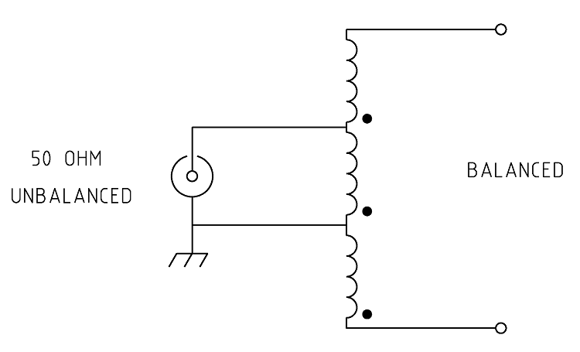
Single Core 1:9 Hybrid Balun Circuit
Trifilar Circuit
Input high side connects to top tap connection
Input ground connects to bottom tap
One output connects to start side of top winding #1
Second output connects to finish side of bottom winding #3
Balanced currents for symmetrical loads
Balanced voltage for non symmetrical loads
Has some common mode rejection
Same evaluation as Ruthroff 1:4 design, except Z max = 450 ohms instead of 200 ohms

Slide 48
1:1 RF Choke Balun (Poor Man’s Current Balun)
Version 1 Air Wound Choke Balun
Consists of winding several turns of the RF feedline on to an insulated tube
Effective for suppressing common mode currents provided that it is located on a low
impedance node on the transmission line.
Air wound Coil Inductance Equation:
L (uh) ≈ r² x N² / ( 9 x r + 10 x l )
where
r = coil radius in inches l = coil length in inches N = number of turns
A 15 micro henry inductor has 330 ohms of inductive reactance at 3.5 MHz, providing >16 dB of common mode isolation up through 10 meters.
An effective choke can be made by winding a single layer transmission line coil on a
4 inch PVC pipe, spanning 10 inches in length across the PVC.
Solving for N, number of turns:
__________________
N = √L x (9 x r + 10 x l) / r²
N = 21 turns

Slide 49
Why not use more than 21 turns?
Every inductor eventually undergoes self resonance, due to parasitic capacitances between turns.
Based on measurements using a VNA, this 21 turn inductor went through self resonance at 13 MHz, showing a parasitic capacitance of 10 pf .
Therefore, above 13 MHz the coil is no longer inductive, but capacitive.
At 30 MHz, this 10 pf capacitor has 531 ohms of reactance, which still provides enough common mode rejection (> 20 dB), to be useful as an isolation device.

Slide 50
Choke Balun Version 2 1:1 Ferrite Bead Balun
Simple Design:
Insert several ferrite toroids in tandem on the outer shield of the transmission line.
Each bead acts as an accumulating impedance, forming a high resistance choke for rf currents on the outside shield of the line.
FT114 mix 43 fits comfortably on RG - 8/U cable and has high absorptive loss properties, where the total parallel impedance is resistance dominant.
Each bead resembles a resistor loss of about 38 ohms; piling up 14 beads accounts for an equivalent resistance of greater than 500 ohms.
In addition, ferrite loss properties are broadband, bead resistance remains fairly constant beyond 30 MHz, thus forming an effective lossy RF choke.

Slide 51
Version 2 Ferrite Bead Choke cont …
However, excessive heating on the beads in the string could be a problem for unsymmetrical loads, or loads that have a high VSWR.
With 14 mix 43 beads, it would be very easy for the beads encounter 5 watts + of power dissipation per bead at PeP levels above 700 watts.
For higher power, use 25 or more Mix 61 beads; this would easily support a 1.5 Kw power level.
Even though a Mix 61 bead is only ½ of the Z value as Mix 43, using 25+ would still provide adequate isolation while allowing operation up to the legal power limit.

Slide 52
Verifying Ferrite Mixes or Determining Unknown Cores
Sometimes Ferrite Cores are color coded, but not always.
Can be identified by measurement of Inductance using known number of turns, compare to specs for core
Requires an RCL meter, MFJ Antenna Analyzer, or VNA set to read impedance.
Procedure:
Wind 4 turns of insulated thin gauge wire around and through the core to be tested
RCL meter: Set to read L on Low or Auto Scale , measure inductance (uh)
MFJ Analyzer: Set for 14 MHz, L measurement, Read L (uh) VNA: Set VNA stimulus for CW, 14 MHz
Set S11 screen parameters to read and measure Impedance (Z)
Calculate Inductance in uh from VNA Impedance Measurement:
L (uh) = Z / (2 x pi x 14 )

Slide 53
Inductance Comparison Chart for Select Toroid Cores (4 turns)
Toroid P/N Mix Size (OD) AL / Luh (4 turns)
FT50-43 43 0.5 440 / 7.04
FT50-61 61 0.5 69 / 1.10
FT82-43 43 0.825 470 / 7.52
FT82-61 61 0.825 79 / 1.26
FT114-43 43 1.14 510 / 8.16
FT114-61 61 1.14 75 / 1.20
FT140-43 43 1.40 850 / 13.6
FT140-61 61 1.40 150 / 2.40
FT240-43 43 2.40 1075 / 17.2
FT240-52 52 2.40 330 / 5.28
FT240-61 61 2.40 170 / 2.72

Slide 54
Guanella Current Balun
Achieves Equal and Opposite Output Currents regardless of Load
High Efficiency and Low Insertion Loss
Impedance Step up or Step down configurations
High isolation for common mode input current
High power capability with relatively small cores
Best Choice for use in balanced antenna systems

Slide 55
Guanella 1: 1 Balun Building Block
Almost equal and opposite voltages exist in both transmission line wires
Very Little Differential Magnetic Field exists in the core
Very Low core loss, and hysteresis loss
Top coil winding is in series between input and ½ of the output, this determines the Magnetization Inductance which affects the Low Frequency Operation
Calculated in the same manner as the Ruthroff design (Based on Total # of turns)
Leakage Inductance less than 1% of Magnetization Inductance, since almost unity coupling in transmission line line.

Slide 56
Guanella 1:1 Balun cont ……
Leakage Inductance can sometimes be used in conjunction
with external peaking capacitors to form a Low Pass Filter whose BW is
outside of the intended frequency response (discussed later)
This technique extends the operating bandwidth, and improves in band VSWR
Insertion Losses of milli-dBs across most of the Band easily possible.
Very compact rugged design …
Conservative approach …. The core size need be no larger than 1/3 the core volume needed in the Ruthroff approach for the same power
Only applies to the Guanella 1:1 connection
Examples (1:1 Guanella configuration):
FT140 mix 31 or mix 43 can easily support 500 watts SSB PeP
FT240 mix 31 or mix 43 can easily handle 1 Kw SSB PeP
Double stack FT240 cores can handle full legal key down power
Back-off to 70% if Load VSWR > 3:1

Slide 57
Guanella Balun can be configured to furnish
Impedance Transformation as well as Current balancing
1:4 and 1:9 Configurations are made my taking the 1:1 prototype
and combining the low impedance nodes in parallel, and high impedance nodes in series
Unlike the Ruthroff configuration:
None of the Guanella windings see the entire input or output voltages,
because of the series connections of some transmission lines
For example:
Worst case winding voltage in the 1:4 Balun is only ½ of the voltage on the high Z side,
Worst case for the 1:9 balun is only 2/3 of the highest voltages.
Whereas wires in the Ruthroff configuration see the entire voltage.
Allows for less flux and smaller cores than the Ruthroff approach

Slide 58
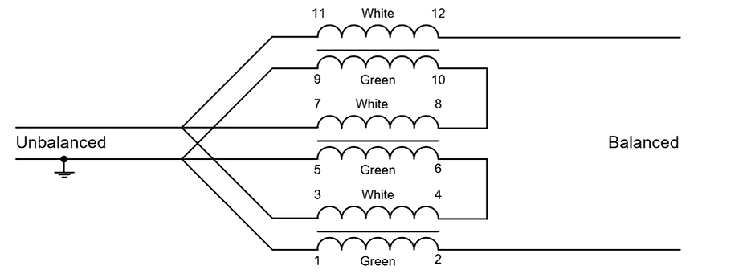
Guanella 1: 4 Current Balun
Guanella 1:9 Current Balun

Slide 59
Implications of the Guanella approach on Core Sizing
1:1 Balun Differential winding voltage ≈ 0, theoretically no flux in the core; using a core sized at 15% of PeP more than adequate
1:4 Balun 1 / 2 voltage equates to 6 dB power back-off = 25% actual power
1:9 Balun 2 / 3 voltage equates to 3.5 dB power back-off = 45% actual power
Summarizing:
Core size for a Guanella 1:1 balun can be chosen for 15% of operating PeP
Core size for a Guanella 1:4 balun can be chosen for 25% of operating PeP
Core size for a Guanella 1:9 balun can be chosen for 45% of operating PeP
Use these PeP values as inputs into the spreadsheet, rather than actual power level

Slide 60
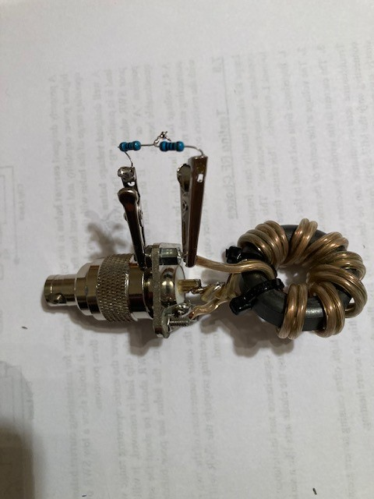
Preliminary Testing Prior to Installing Xfmr in Enclosure:
Low Level VSWR Measurement:
Temporarily solder UUT to a test connector, terminate the device in the required load as per the figure, below:
Measure VSWR across the desired frequency range either using
a VNA or Antenna Analyzer.
If VSWR is within design limits, perform coarse Insertion Loss
measurement ( will be discussed after VSWR peaking section).
Otherwise , VSWR may be improved either by adding a shunt peaking capacitor(s), or a series inductor, or combination

Slide 61
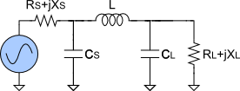
Adding External Reactances May Improve VSWR / Insertion Loss
How?
Consider a 3 section π Filter:
These elements are already embedded in the transformer
But may not be the optimal values for loss or VSWR
Add shunt capacitors to the Low Impedance side
Add series Inductors UNUN either side (Balun, unbalanced side, only)
as needed by test
Usually only needed to improve performance on high end

Slide 62
Goal is to achieve a Pi Filter with a Cut-off
Frequency Greater than F max, with specified
Insertion Loss and VSWR across band of interest
Determined empirically by measurement
Add shunt Capacitance if C is too small, or,
Add series air wound inductors if Leakage Inductance is too small
No need to achieve a “perfect” low pass response for the filter
Just improve performance to meet design specifications within band
Shunt Capacitor Guidelines:
Add to Low Impedance side only
UNUNS add from node to ground, BALUNS add across balanced terminals
Range of added values for HF: typically 5 pf to 68 pf, “dog bone” mica
Choose caps with proper voltage ratings (1500 w is 387 v peak on 50 ohms)
Inductor Guidelines:
Add in series only to unbalanced side, either high or low impedance
Air wound or Toroid coils (Toroids up to 200w PeP)
Typical Inductor range: 0.1uh to 2uh, air wounds use at least #14 gauge

Slide 63
“ Coarse” Low Power Insertion Loss Test
Use Antenna Analyzer or VNA
Antenna Analyzer
Disconnect Load fro Transformer
Set Analyzer to read Coax Loss
Measure Loss at several frequencies in Band
Verify less than 0.60 dB
VNA
Must be Accurately Calibrated
Set VNA for stimulus sweep range covering band of interest
Measurement mode S11 LOG mag dB
Disconnect Load from transformer, measure round trip S11 in dB
Divide S11 dB readings by 2 (one way )
Verify less than 0.60 dB
Concludes preliminary Transformer Measurements, but,
Why 0.60 dB?

Slide 64
Very “rough evaluation” of Preliminary 0.60 dB Insertion Loss
For now, we accepted a Total Loss = 0.60 dB
How much loss associate with:
VSWR?
Leakage Inductance
Copper Wire?
Core Loss?
0.60 dB total loss represents 12.9 % of total PeP
VSWR Approx % Power Loss
1.2 1%
1.5 4%
1.7 6.7%
2.0 11%
So far, VSWR accounts for this much percentage of 12.9% loss
Much of this can be recovered with Antenna Tuner

Slide 65
Leakage Inductance Loss:
Best case estimate of Leakage Inductance is 1% Magnetization Inductance
Approximately corresponds with 0.99 magnetic coupling coefficient, or
0.99² = 0.980 Power transfer efficiency
Leakage Loss percentage = (1 -.980) x 100 = 2%
Therefore ≈ 2% of the loss measurement can be accounted for by Leakage Inductance
Wire Loss
Was accounted for in a Previous Slide where Wire Gauge was selected
Criteria was Wire Resistance less than 2% of minimum operating impedance.
Corresponds to 4.0% power loss in copper wire

Slide 66
Sum these losses based on a 1.5 : 1 VSWR:
VSWR Loss 4%
Leakge Inductance Loss 2%
Copper Loss 4.0%
Total 10%
The remainder is Core Loss:
Relating to the preliminary Loss Measurement of 0.6 dB:
Core Loss = 12.9% - 10% = 2.9%
Therefore a “very rough” estimate of the core loss of a transmission line
transformer is 2.9% of operating PeP
In practice, some / most are even better than this using careful
design and construction techniques and proper
choice of materials

Slide 67
A Few Comments about Construction:
1 Short Leads where there are Low Impedances
1 inch of heavy wire ≈ 3 ohms of inductive Reactance at 30 MHz
2 Use solder lugs rather than mechanically securing wires under mounting hardware
3 Avoid mounting the transformer core directly above ground plane, or stand-off core at least ½ inch above and away from metal surfaces
4 Recommend a large surface for ground return (copper tape)
5 Use more than 1 screw connection for RF connector ground return
6 Mechanically secure Large Cores
7 Weatherproof as needed for outdoor use
(weep holes to eliminate moisture)

Slide 68
Final Tests
Repeat VSWR and Coarse Insertion Loss using VNA or Antenna Analyzer
Isolation Tests for Guanella Balun
1 Prepare a test load by soldering two unequal value resistors
in series for a total resistance ≈ to the required balun load
Try to use a 2 to 1 ratio, e.g. 130 ohms, and 68 ohms
in series for a 198 load ≈ 200 ohms for a 1:4 balun, 150 ohms and 300 ohms for 1:9 balun, etc.
2 Connect one end of an alligator clip lead to the ground of the coaxial input connector
3 Measure and record the VSWR of the balun at several in band
frequencies while leaving the other end of the clip lead un-connected
4 Alternately, connect the open end of the clip lead to Balun (+), Balun ( -), and the resistor junction
5 The VSWR for each position of the clip lead should be less than 2:1,
showing high isolation at all frequencies
6 Remove the balun load, repeat Insertion Loss measurements at the same frequencies as above. IL should remain below 0.6 dB when clip lead is connected to Balun(+), and Balun (-).

Slide 69
Do the VSWR, Isolation and Insertion Loss Tests
represent true transformer performance?
Y / N ?
I don’t know ? Maybe …
Providing that parameters stay constant up to the operating power level
Insertion Loss may be higher if the transformer operates near the compression level
Core heating may change the material AL value affecting VSWR especially at the low frequency end
If Possible, Transformer tests should be performed at near rated power levels to get a true picture of performance.
Actual VSWR, Isolation, and IL are difficult measurements to perform without special equipment.

Slide 70
High Power Soak
Simple test to perform, but ….
A pair of BALUNS / UNUNS are needed for ratios other than 1:1
Test method:
Uncover the UUT to expose the transformer and core
UUT (or a pair) of devices are connected to the transmitter or amplifier output
Recommend the use of an inline VSWR / Power meter if one is available.
Terminate the last device in a high power 50 ohm dummy load
Set transmitter to the desired frequency, slowly increase out level until rated power level is achieved, while monitoring VSWR and output level. Stop test if any erratic behavior is noted.
Continue to apply rated power for 60 seconds to 5 minutes depending on the size of the transformer.
Remove the RF power and quickly (carefully) touch the transformer core to evaluate the temperature rise. Unit may be warm or hot, but not overly uncomfortable to the touch. Look for signs of burning or discoloration.

